Slide 1
Yankey, Harter, Hottinger,
Kutz, Haefner
Pendleton, Hardy, Rockingham & Shenandoah, VA & Berks, PA
© James L. Powers, 2015
For more Information:
jlpowers@earthlink.net
707-738-3903
Reproduction may be made for non-commercial purposes only.
Information herein are solely my opinions and should not be treated as fact.

Slide 2
Yankee Tree
Shenandoah Valley Virginia
0. Andreas Johan Jencke (John Yankee) b. 1726 – d. 1783? b. Upper Silesia as per PLB
+ Unknown
OR
0. John Yankee b. 1750-d. 1783 b. Rockingham, VA
+ Catherine Zerkel b. 1743 – d. ? No evidence that John was married to Zerkel
1. Michael Yankee b. 1773 – d. 1835 b. &d. Pendleton WV
+ Magdeline Hottinger b. 1777 – d. 1853 b. & d. Rockingham, VA
2. Asenith Yankie b. 1822-d.1902 b. Rockingham, VA,
+ John Harter b. 1823-d. 1905 b. VA moved to OH 1858
3. William Harter b. 1841- d. ? b. VA
3. Jemima Elizabeth Harter b. 1844- d. 1901 b. Hardy County WV; + Robert Ballentine b. 1803? – d. 1884 b.. Cumberland, PA m. 1863 Clark,OH
3. Delila C Harter b. 1845- d. ? b. VA
3. Sarah Ann Harter b. 1848- d. 1901 b. VA
+ Isaac Overholser b. 1846- d.1896 b. OH
3. Americas Simeon Harter b. 1850-1934
+ Mary Jarnagin b. 1850-d.1918
3. James H. Harter b. 1853- d. ? b. VA
3. Noah C. Harter b. 1857- d. ? b. VA
3. Mary A. Harter b. 1851
3. Elsworth E. Harter b. 1864- d. ? b. OH
1. Andrew b. 1775 b. Rockingham, VA,
1. Jacob b. 1775 b. Rockingham, VA,
1. Elizabeth b. 1776? b. Rockingham, VA,
+ Frederick Hottinger
Notes:
Catherine Zirkle
Birth 6 Apr 1733 in Telford, Philadelphia, Pennsylvania, United StatesDeath 4 Jan 1817 in Forestville, Shenandoah, Virginia, United States
Zerkel marries grandson
From Ballentine Family Tree
Michael Yankey
Birth 1775 in Pendleton, Virginia, United StatesDeath 1835 in Shenandoah Mtn, Pendleton, Virginia, United States
+ Magdaline Hottinger
Birth 1777 in Rockingham, Rockingham, Virginia, United StatesDeath 1853 in Rockingham, Rockingham, Virginia, United States
She is daughter of
Johnann Conrad Honinger
Birth 1750Death 19 Jun 1804 in Rockingham, Virginia, United States
+ Marie Catherine Kutz
Birth 1719 in Maxatawny, Berks, Pennsylvania, United StatesDeath 27 Feb 1827 in Maxatawney, Berks, Pennsylvania, United States
Michael Yankee son of John Yankee & Catherine Zerkel
Catherine Zerkel
Birth 1743 in Slabrock, Page, VirginiaDeath in Rockingham, Virginia
John Yankee
Birth 1750 in Marsburg, , , GermanyDeath 25 Dec 1783 in Shenandoah Mountain, Pendleton, West Virginia
Honninger:
Johnann Conrad Honinger
Birth 1750Death 19 Jun 1804 in Rockingham, Virginia
From AlYankee1
Conrad Heninger
Birth 14 MAY 1722 in Hatten, Bas Rhin, GermanyDeath 15 AUG 1786 in Maxatawney, Berks, Pennsylvania,
Marie Catherine Kutz
Birth 1719 in Maxatawny, Berks, Pennsylvania, USADeath 27 FEB 1827 in Maxatawney, Berks, Pennsylvania, USA
Johann Conrad Henninger
Birth 20 Feb 1650 in Hunawihr, Haut Rhin, GermanyDeath 21 Jun 1712 in Hatten, Bas-Rhin, Alsace, France
My Family Tree by Robin Blackmon Inman
Asenith marries Naselrod

Slide 3
Andreas Jencke
1726-1775
Andreas Jencke
Andreas Jencke (Andrew John Yankey) is the known immigrant of the Yankey family. On September 22, 1726 he was born in Silesia and traveled with his family to Herrnhut, Germany in 1734. On June 22, 1750 Andreas Yencke arrived on the Moravian ship, IRENE, in New York, New York. After arriving with the Henry Jorde Colony he settled as a single brethern with the Moravian settlement in Bethlehem, Pennsylvania. In March of 1761 upon leaving the Moravians it was recorded that “he was educated and decided to leave the congregation.” Andreas settled in Virginia and appears in Dunmore (Shenandoah) County records of 1772 but no record of him owning land in this area has been found. In August 1774 there is a record of a civil law suit involving Andrew Yankey and a lease with Andrew Hudlow. This lawsuit was later dismissed. Three sons are known, Michael, Andrew, and Jacob plus probably one daughter, Elizabeth. In 1775 the sons were bound out to neighbors and in 1792 Elizabeth was bound out to Jacob Rife. On February 2, 1796 Elizabeth Hannah Yankey married Frederick Hottinger (Hartinger) in Madison County, Virginia which was the adjacent county to Shenandoah County at that time. It is from these siblings that the current Yankey family line descends. The combined biographies of Andreas Johan Jencke (Andrew John Yankey), Michael Yankey, and Jacob Yankey follows.
http://moversandsettlers.com/Yankey.html
By Phillip L. Baker, MD Topeka KS

Slide 4
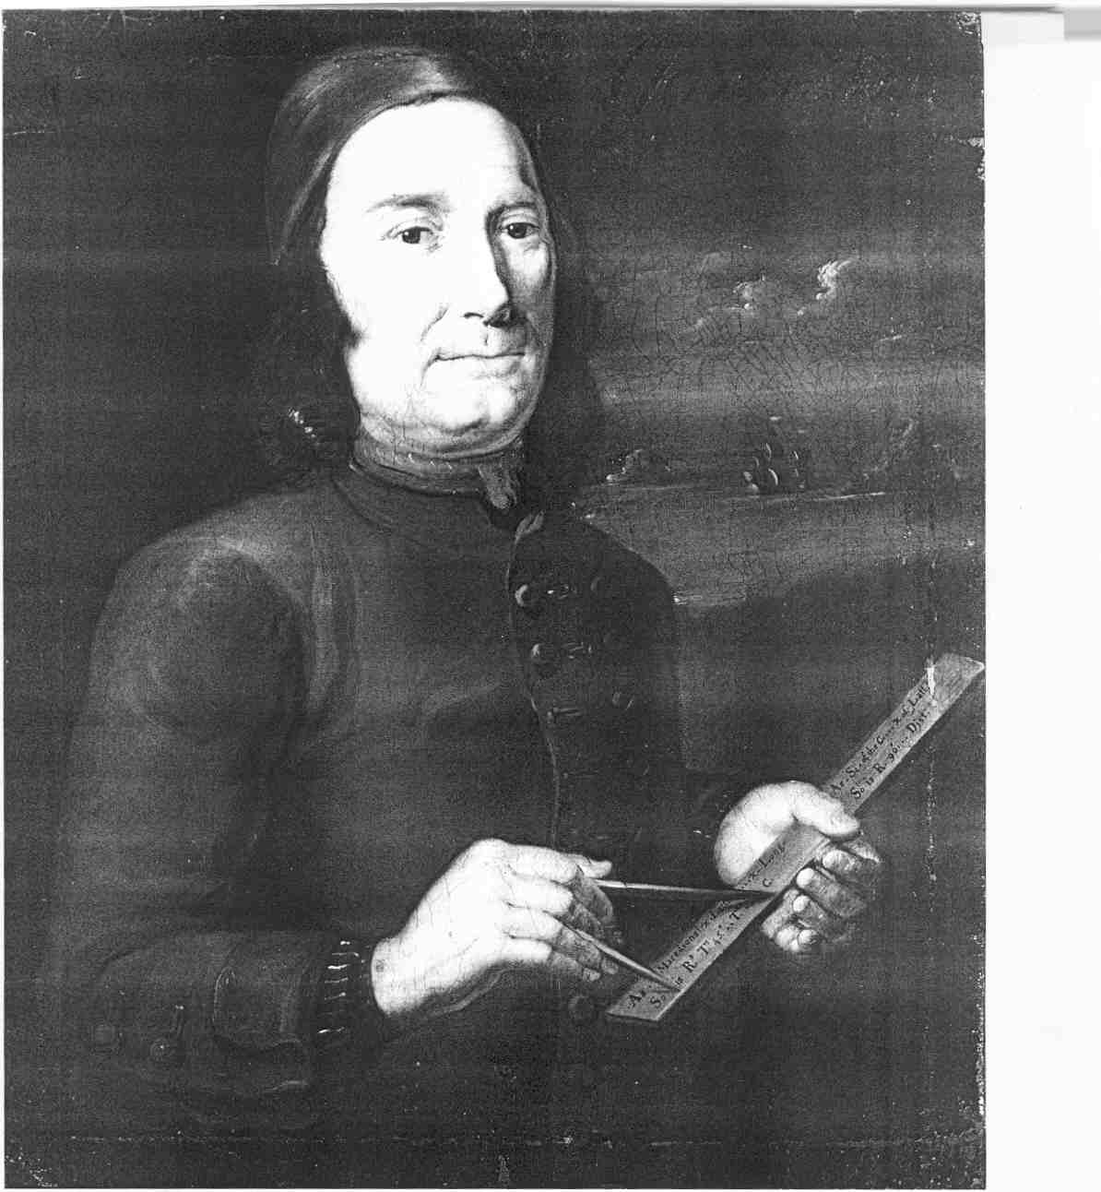
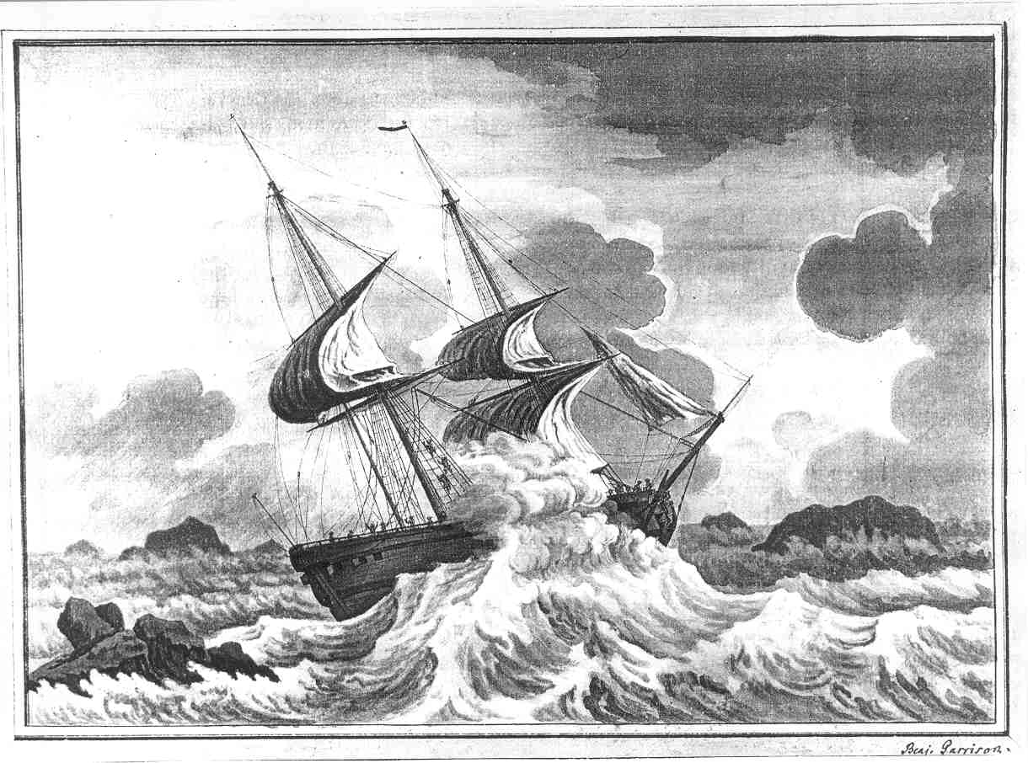
Irene & Captain Garrison

Slide 5
Moravian Ship
– Snow Irene
Christopher Merkly,
Jacob Meyer,
John Stephen Meyer,
Philip Meyer,
John Muensch,
Melchior Muenster,
John Jacob Nagle,
------- Neilhock,
John Michael Odenwald,
John Matthew Otto,
John Ortlieb,
Peter J. Pell,
Hans Peterson,
Frederick Jacob Pfeil,
John Michael Pitzman,
Jacob Priessing,
John Henry Richling,
John Richter,
Godfrey Roesler,
Daniel Ruenger,
Michael Sauter,
Paul Jansen Sherbeck,
Henry Schoen,
George Schweiger,
Christian Schwartz,
Gottfried Schwartz,
Abraham Strauss,
John Daniel Sydrich,
------- Theodorus,
John Andrew Wagenseil,
Andrew Weber.
FROM ZEYST.
Christopher Feldhausen,
John Christian Haensel,
Paul Hennig,
Henry Gerstberger,
Andrew Gross,
John Henry Merck,
Martin Presser,
Paul Christian Stauber,
John Thomas,
London (a negro from London),
Frederick Emmanuel Herrman,
Susan Maria Herrman,
Francis Steup,
Sophia Steup.
In July, thirty of these single brethern were sent up to Christian's Springs, in charge of John Gottlob Hoffman.
THIRD VOYAGE
On October 15, 1749, The Irene sailed from New York, among her passengers being Bishop Spangenberg, David Nitschmann and von Watteville, and arrived at London November 21, making the quick passage, as her log states, of only thirty days from land to land." She sailed from Dover May 11th, 1750, and arrived at New York on June 22, making a remarkable westward passage with the "Henry Jorde Colony" on board. The following are the names of the colonists:
John Andrew Albrecht,
Marcus Balffs,
George Baumgarten,
Henry Bergmann,
John Andrew Borhek,
Zacharias Eckhard,
Walter Ernst,
Just Erd,
Claus Euler,
Henry Feldhausen,
J. Christopher Feldhausen,
Godfrey Fockel, [= Gottlieb Fockel?]
John Godfrey Fockel,
Samuel Fockel,
Henry Friz,
Andrew Freyhube,
Lucas Fuss,
Christian Giersch,
John George Groen,
Abraham Hasselberg,
Balthaser Hege,
Jacob Heydecker,
John Henry Herbst,
Samuel Herr,
Jacob Herrman,
John Gottlob Hoffman,
Thomas Hoffman,
Christian Henry Hoepfner,
Eric Ingebretsen,
Andrew Jaencke,
John Theobold Kornmann,
John Gottlieb Lange,
John Samuel Lauck,
Henry Lindenmeyer,
Christian Henry Loether,
Carl Ludwig,
Jacob Lung,
John George Masner,
Christopher Matthiesen,
Nichols Matthiesen,
Notes:
http://www.fmoran.com/irene.html

Slide 6
Michael Yankey b. 1775 – www.wikitree.com/wiki/Yankey-8
Biography
(From a letter to Fran Ganard from Gerald Wayne Yankie) October 2004. Some time ago we talked about the Andrew Jaencke that arrived in NY on the Moravian ship Irene, June 22, 1750. Many in our family suspect that this Andrew Jaencke is the beginning of the Yankey family in America but this has not been proven. There is no proven connection of Andrew Jaencke to the Michael Yankey (1st) from Rockingham Co. Virginia, more research in required. What we do know, Michael Yankey (1st), son of John Yankey, was born in Virginia c. 1775. Michael Yankey (1st) had two brothers, Jacob Yankey, about two years older, born c. 1773, and Andrew Yankey, the same age as Michael (twins??). It seems that John Yankey either died or for some other reason was unable to care for his young boys Michael, Andrew and Jacob. The records show that Michael and Andrew were both 8 years old, Jacob was 10 years old and on December 25, 1783, all three boys were "bound out" (assigned to foster families) per instructions of the Shenandoah County Circuit Court at the County Seat in Woodstock, Virginia, "until the age of 14". In 1791, Michael Yankey was "conformed" into the Pine Church (Lutheran Church) in Shenandoah County, Virginia. Michael Yankey married Magdalene Hottinger (Daughter of Conrad Hottinger and Mary Catherine Kutz Hottinger) on July 20, 1793 in Rockingham Co. Virginia. Children of Michael and Magdalene Hottinger Yankey (four sons and six daughters) Jacob Yankey------------Lived and raised family in Rockingham Co. VA Lydia Yankey-------------Lived and raised family in Rockingham Co. VA Michael Yankey, Jr.-----Started family in VA, moved to Franklin Township, Adams Co. Ohio William A. Yankey ------Moved to Yazoo Co., Mississippi, raised family. Catherine Yankey-------Lived in VA. Jonathan Yankey--------Moved to Adams Co. Ohio, Married Sarah Armstrong (1), Married Elizabeth Lawrence (2) Mary (Polly) Yankey----Lived in VA. Phoebe Yankey----------Lived in VA. Malinda Yankey----------Lived in VA. Asenith Yankey----------Moved to Adams Co. Ohio married John Harter, both buried in Franklin Twnship, Adams Co. Ohio.
There are many Yankey/Yankie descendants from these ten children. Michael Yankey, Jr. lived a few miles from Jonathan Yankey in Adams Co. Ohio. However, I will focus on my specific line from Jonathan Yankey and Sarah Armstrong Yankey and will quote from the family bible records.
Jonathan Yankey (son of Michael and Malinda Yankey) was born April 24, 1806 in Rockingham Co. VA and died April 12, 1896 in Darlington MO, buried in Rouse Cemetery. Malinda may have been a familiar name for Magdalene Hottinger Yankey, not to be confused with Jonathan's younger sister, Malinda Yankey. Jonathan Yankey and Sarah Armstrong were married Thursday Feb. 23 1832 in Franklin Township, Adams Co. Ohio. Sarah Armstrong was born November 19, 1810 in Franklin Township, Adams Co. Ohio and died February 14, 1856 and is buried in the Armstrong Family Cemetery in what is now Bratton Township, Adams Co. Ohio. between Louden and Locust Grove, Ohio, off Horner Chapel Road, very near Serpents Mound. Michael Yankey ... ^{[1]}
Can you add any information on Michael Yankey? Please help grow his WikiTree profile. Everything you see here is a collaborative work-in-progress.
Sources
No sources. The events of Michael's life were either witnessed by Mike McClure or Mike plans to addsources here later.
Footnotes
↑ Entered by Mike McClure, Friday, November 22, 2013.
www.wikitree.com/wiki/Yankey-8
yankie.net/front.html
Notes:
http://www.wikitree.com/wiki/Yankey-8
http://yankie.net/front.html
To be read:
The Hottinger and Yankey families : including allied families of Nesselrodt/Nazelrod, Ratcliff, Halterman, Delawder, Dove, Wratchford, Hauck, Feezle, and others
Author:Lewis H Yankey; Patricia T RitchiePublisher:Criders, Virginia : [Lewis H. Yankey], 1991.Edition/Format: Print book : EnglishView all editions and formatsDatabase:WorldCatSummary:Michael Honinger was the emigrant ancestor. He arrived in Pennsylvania in 1729. He was the father of Conrad Honinger (d.1804) who married Catherine Kutz. Conrad anglicized the name by changing it to Hottinger. Early in their marriage Conrad and Catherine moved to Rockingham County where they were the parents of nine children. One of their sons married Elizabeth Yankey while a daughter, Magdaline, married Michael Read more...
Rating:(not yet rated) 0 with reviews - Be the first.
SubjectsHottinger.
Yankey.
Nazelrod.
View all subjects
More like thisSimilar Items

Slide 7
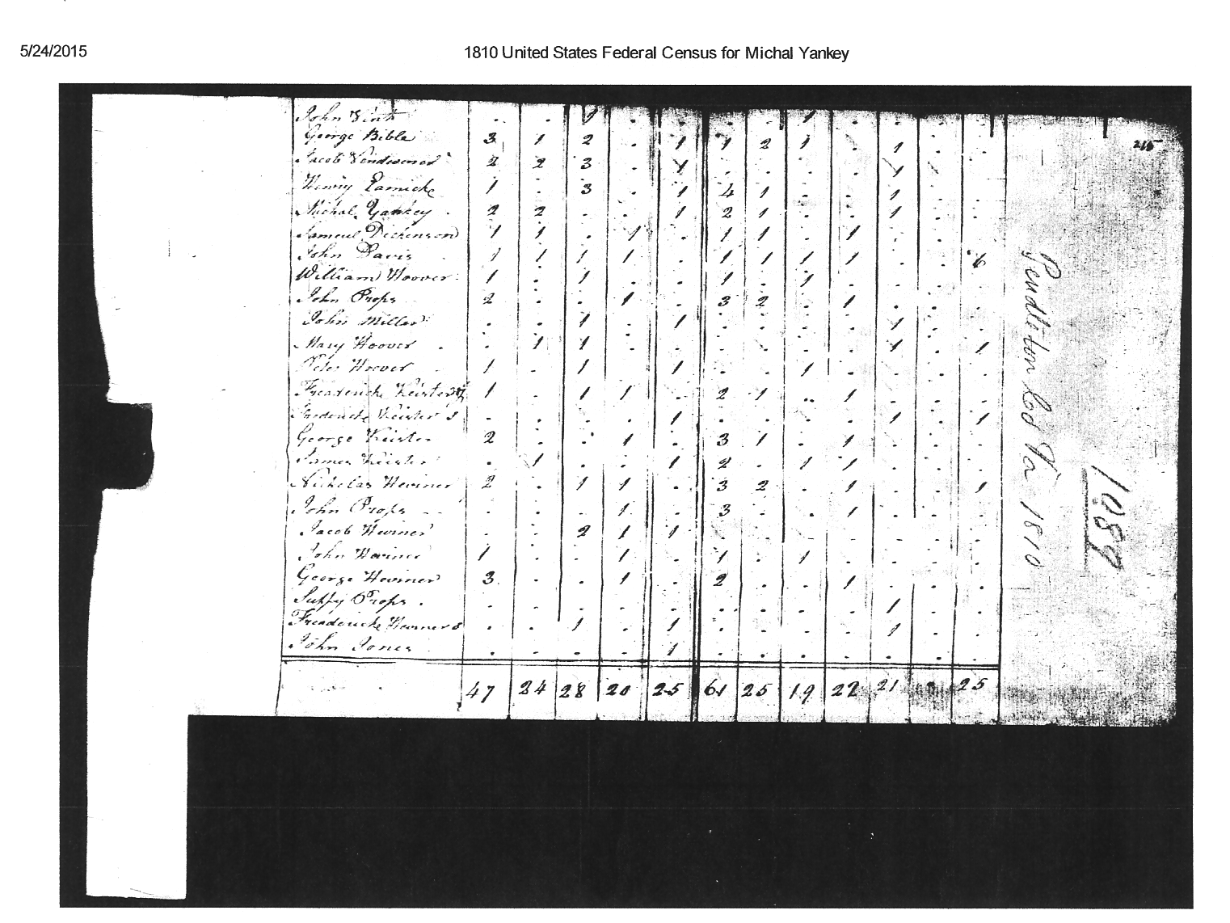
1810 US Census- Michael Yankey
Pendleton County, VA

Slide 8
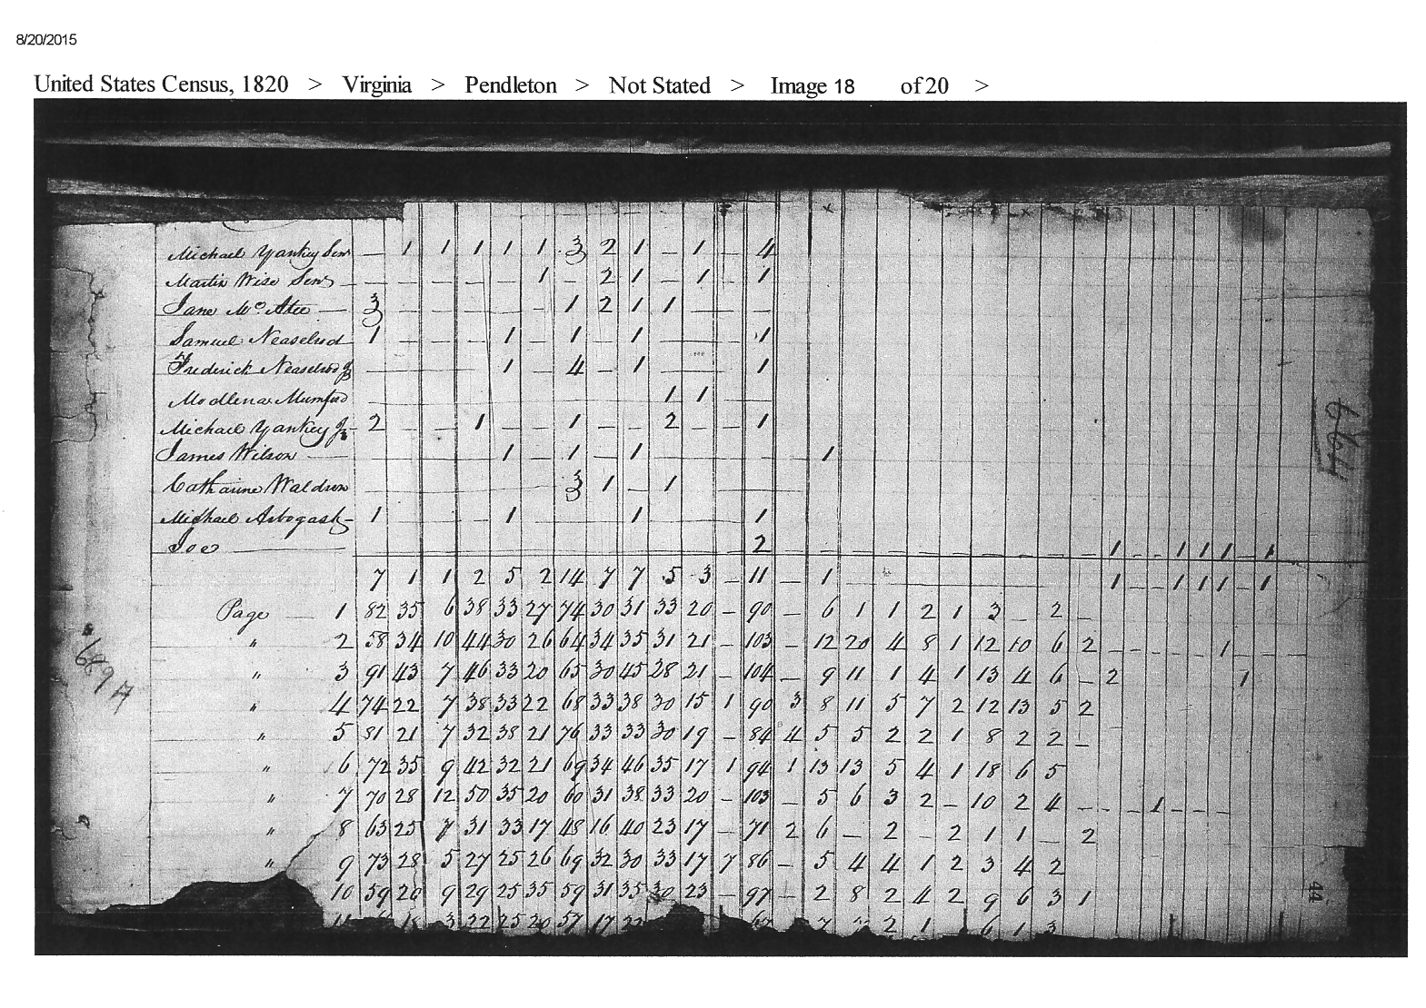
US Census 1820 – Michael Yankey
Pendleton, County, VA

Slide 9
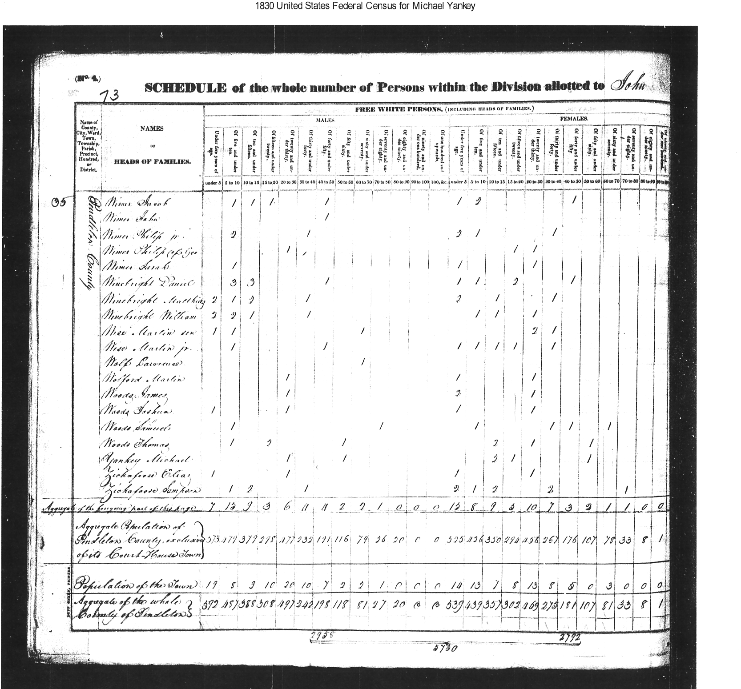
1830 US Census – Michael Yankey
Pendleton County, VA

Slide 10
Hottinger/Yankey Tree
Shenandoah Valley, Virginia
0. Hans Michael Honinger b. 1726 – d. 1775 b. Switzerland & d. Maxatawney, Berks, PA
+ Anna Maria Pary b. 1705 – d. 1763 b. Baden-Wuertemburg. d. Maxatawney, Berks, PA
1. Johann Conrad Hottinger b. 1722- d. 1804 b. 1729 arrived in Philadelphia, 1757- Maxatawney, Berks, PA
+ Marie Catherine Kutz b. 17?? – d. 18?? d. Rockingham, VA? see Cootes Store, VA
2. Magdeline Hottinger b. 1777 – d. 1853 b. &d. Pendleton WV
+ Michael Yankey b. 1773 – d. 1835 b. & d. Rockingham, VA
3. Asenith Yankie b. 1822-d.1902 b. Rockingham, VA,
+ John Harter b. 1823-d. 1905 b. VA
3. William Harter b. 1841- d. ? b. VA
3. Jemima Elizabeth Harter b. 1844- d. 1901 b. Hardy County WV; m. + Robert Ballentine b. 1803? – d. 1884 b.. Cumberland, PA m. 1863 Clark,OH
3. Delila C Harter b. 1845- d. ? b. VA
3. Sarah Ann Harter b. 1847- d. 1926 b. VA
+ Isaac Overholser b. 1845- d.1896 b. OH, d. Strait Creek Cem.
3. Americas Simeon Harter b. 1851-1935
+ Mary Jarnagin b. 1849-d.1918
3. James Harrison Harter b. 1853- d. ? b. VA
3. Noah C. Harter b. 1857- d. ? b. VA
3. Mary A b. 1859
3. Elsworth Elmer Harter b. 1864- d. ? b. OH
2. Andrew b. 1775 b. Rockingham, VA,
2. Jacob b. 1775 b. Rockingham, VA,
2. Elizabeth b. 1776? b. Rockingham, VA,
+ Frederick Hottinger
Notes:
Parents of Marie Catherine Kutz
Nicholas Kutz
Birth 1690 in SwitzerlandDeath 1749 in Maxatawney, Berks, Pennsylvania,
Anna Catharina Grimm
Birth 1695 in Berks, Pennsylvania, USADeath 07 APR 1768 in Maxatawney, Berks, Pennsylvania,
From Ballentine Family Tree
Michael Yankey
Birth 1775 in Pendleton, Virginia, United StatesDeath 1835 in Shenandoah Mtn, Pendleton, Virginia, United States
+ Magdaline Hottinger
Birth 1777 in Rockingham, Rockingham, Virginia, United StatesDeath 1853 in Rockingham, Rockingham, Virginia, United States
She is daughter of
Johnann Conrad Honinger
Birth 1750Death 19 Jun 1804 in Rockingham, Virginia, United States
+ Marie Catherine Kutz
Birth 1719 in Maxatawny, Berks, Pennsylvania, United StatesDeath 27 Feb 1827 in Maxatawney, Berks, Pennsylvania, United States
Honninger:
Johnann Conrad Honinger
Birth 1750Death 19 Jun 1804 in Rockingham, Virginia
From AlYankee1
Conrad Heninger
Birth 14 MAY 1722 in Hatten, Bas Rhin, GermanyDeath 15 AUG 1786 in Maxatawney, Berks, Pennsylvania,
Marie Catherine Kutz
Birth 1719 in Maxatawny, Berks, Pennsylvania, USADeath 27 FEB 1827 in Maxatawney, Berks, Pennsylvania, USA
Johann Conrad Henninger
Birth 20 Feb 1650 in Hunawihr, Haut Rhin, GermanyDeath 21 Jun 1712 in Hatten, Bas-Rhin, Alsace, France
My Family Tree by Robin Blackmon Inman
Asenith marries Naselrod

Slide 11
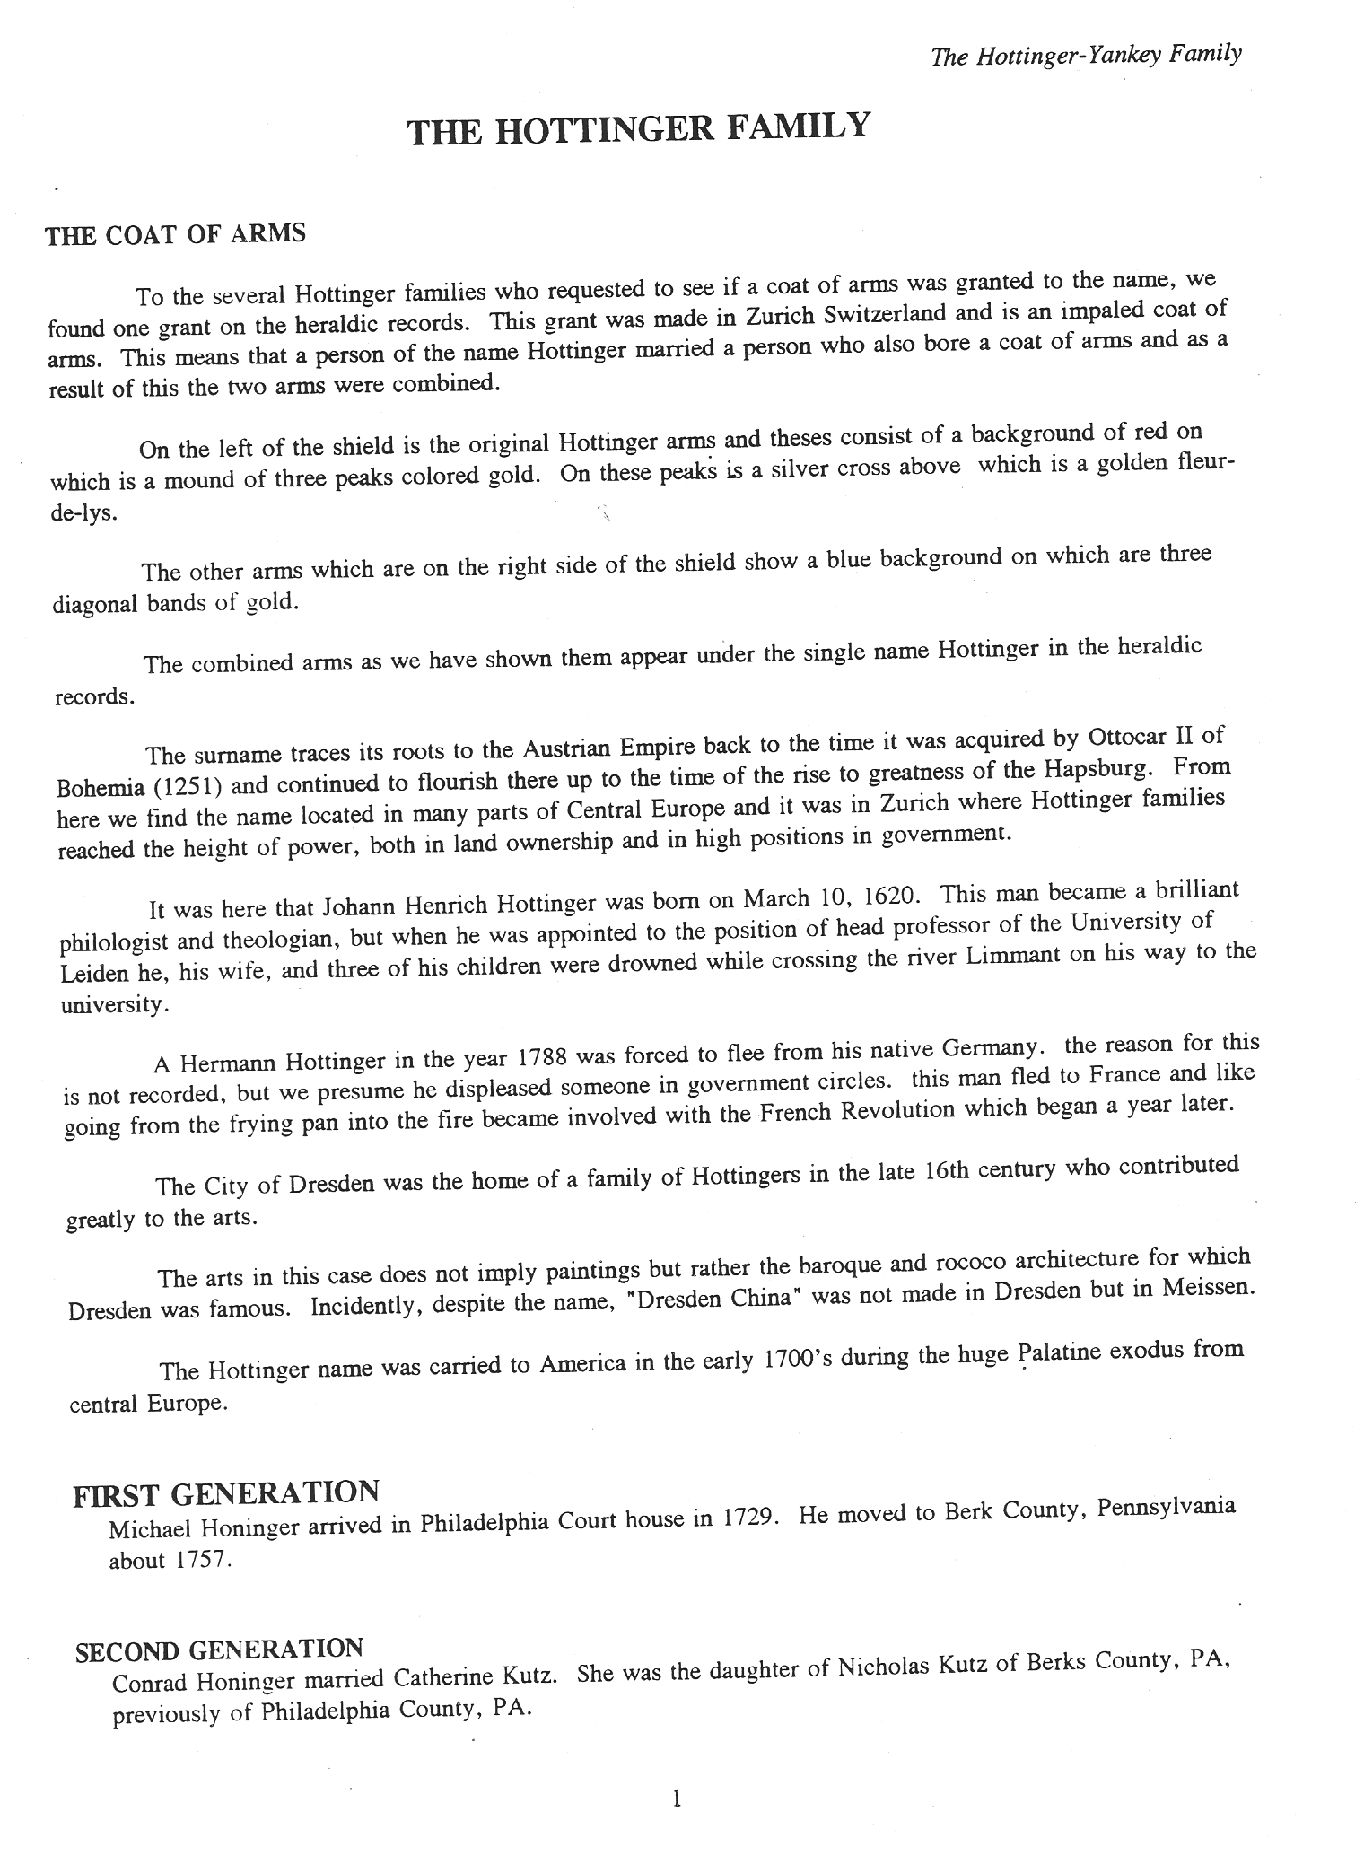
The Hottinger & Yankey Families
Compiled by Lewis H. Yankey - Typed & Edited by Patricia T. Ritchie 1991
p 1.

Slide 12
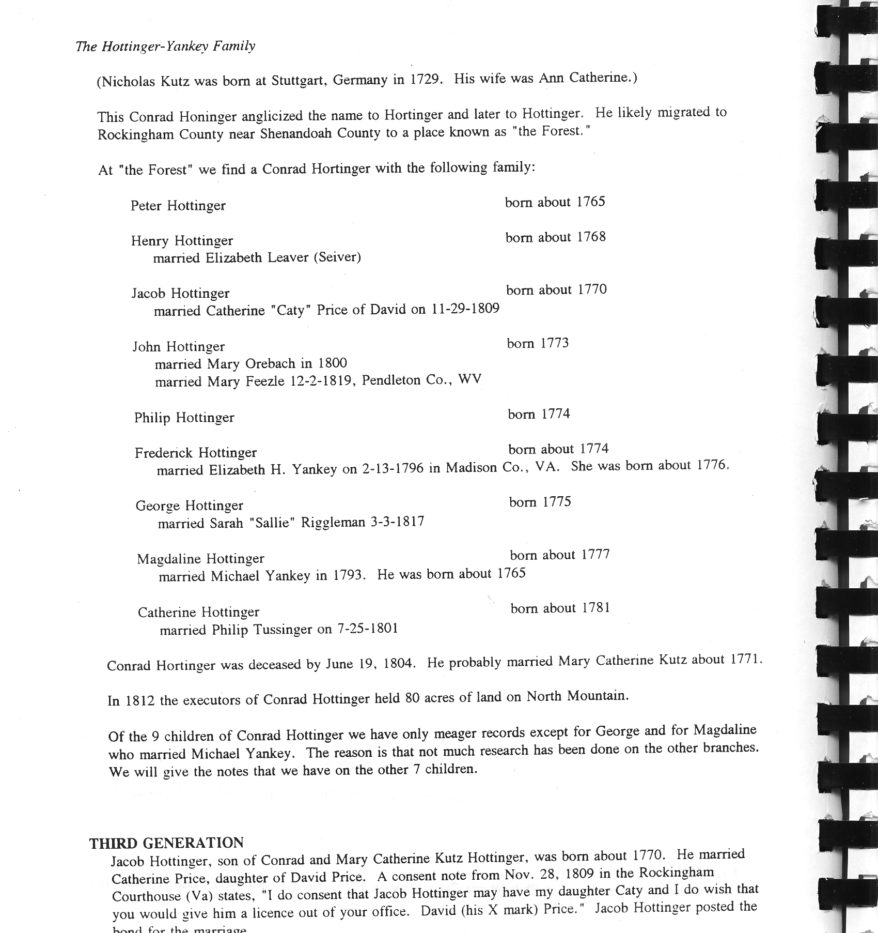
The Hottinger-Yankey Family p. 2

Slide 13
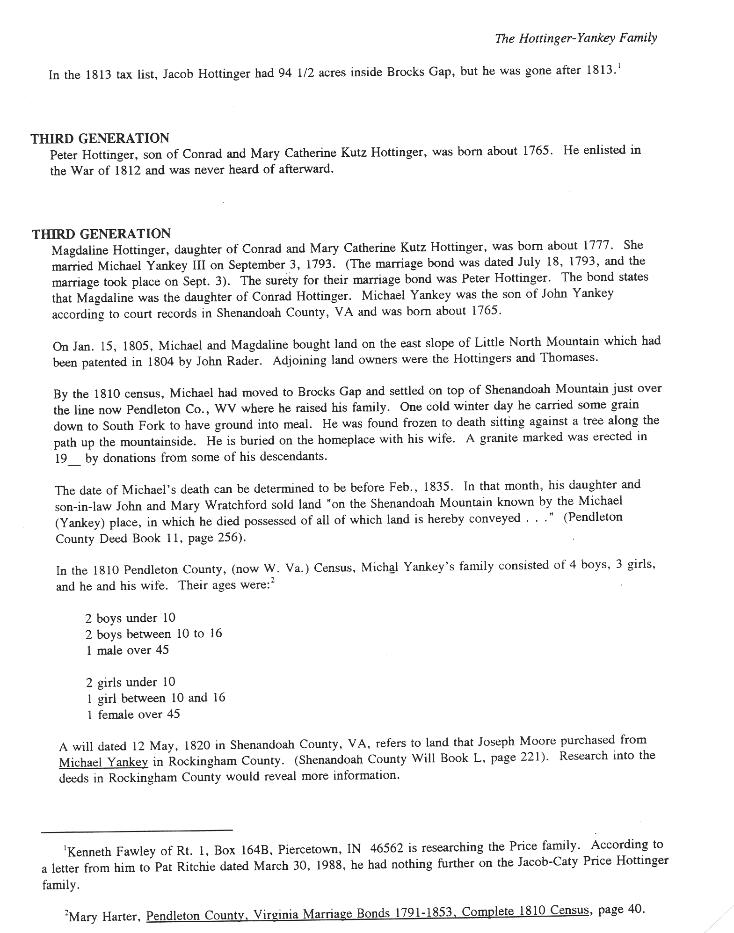
The Hottinger & Yankey Families
Compiled by Lewis H. Yankey - Typed & Edited by Patricia T. Ritchie 1991
p 3.
Notes:
Harter, Mary Marriages of Pendleton County Virginia 1788-1853 Key West, FL 1978

Slide 14
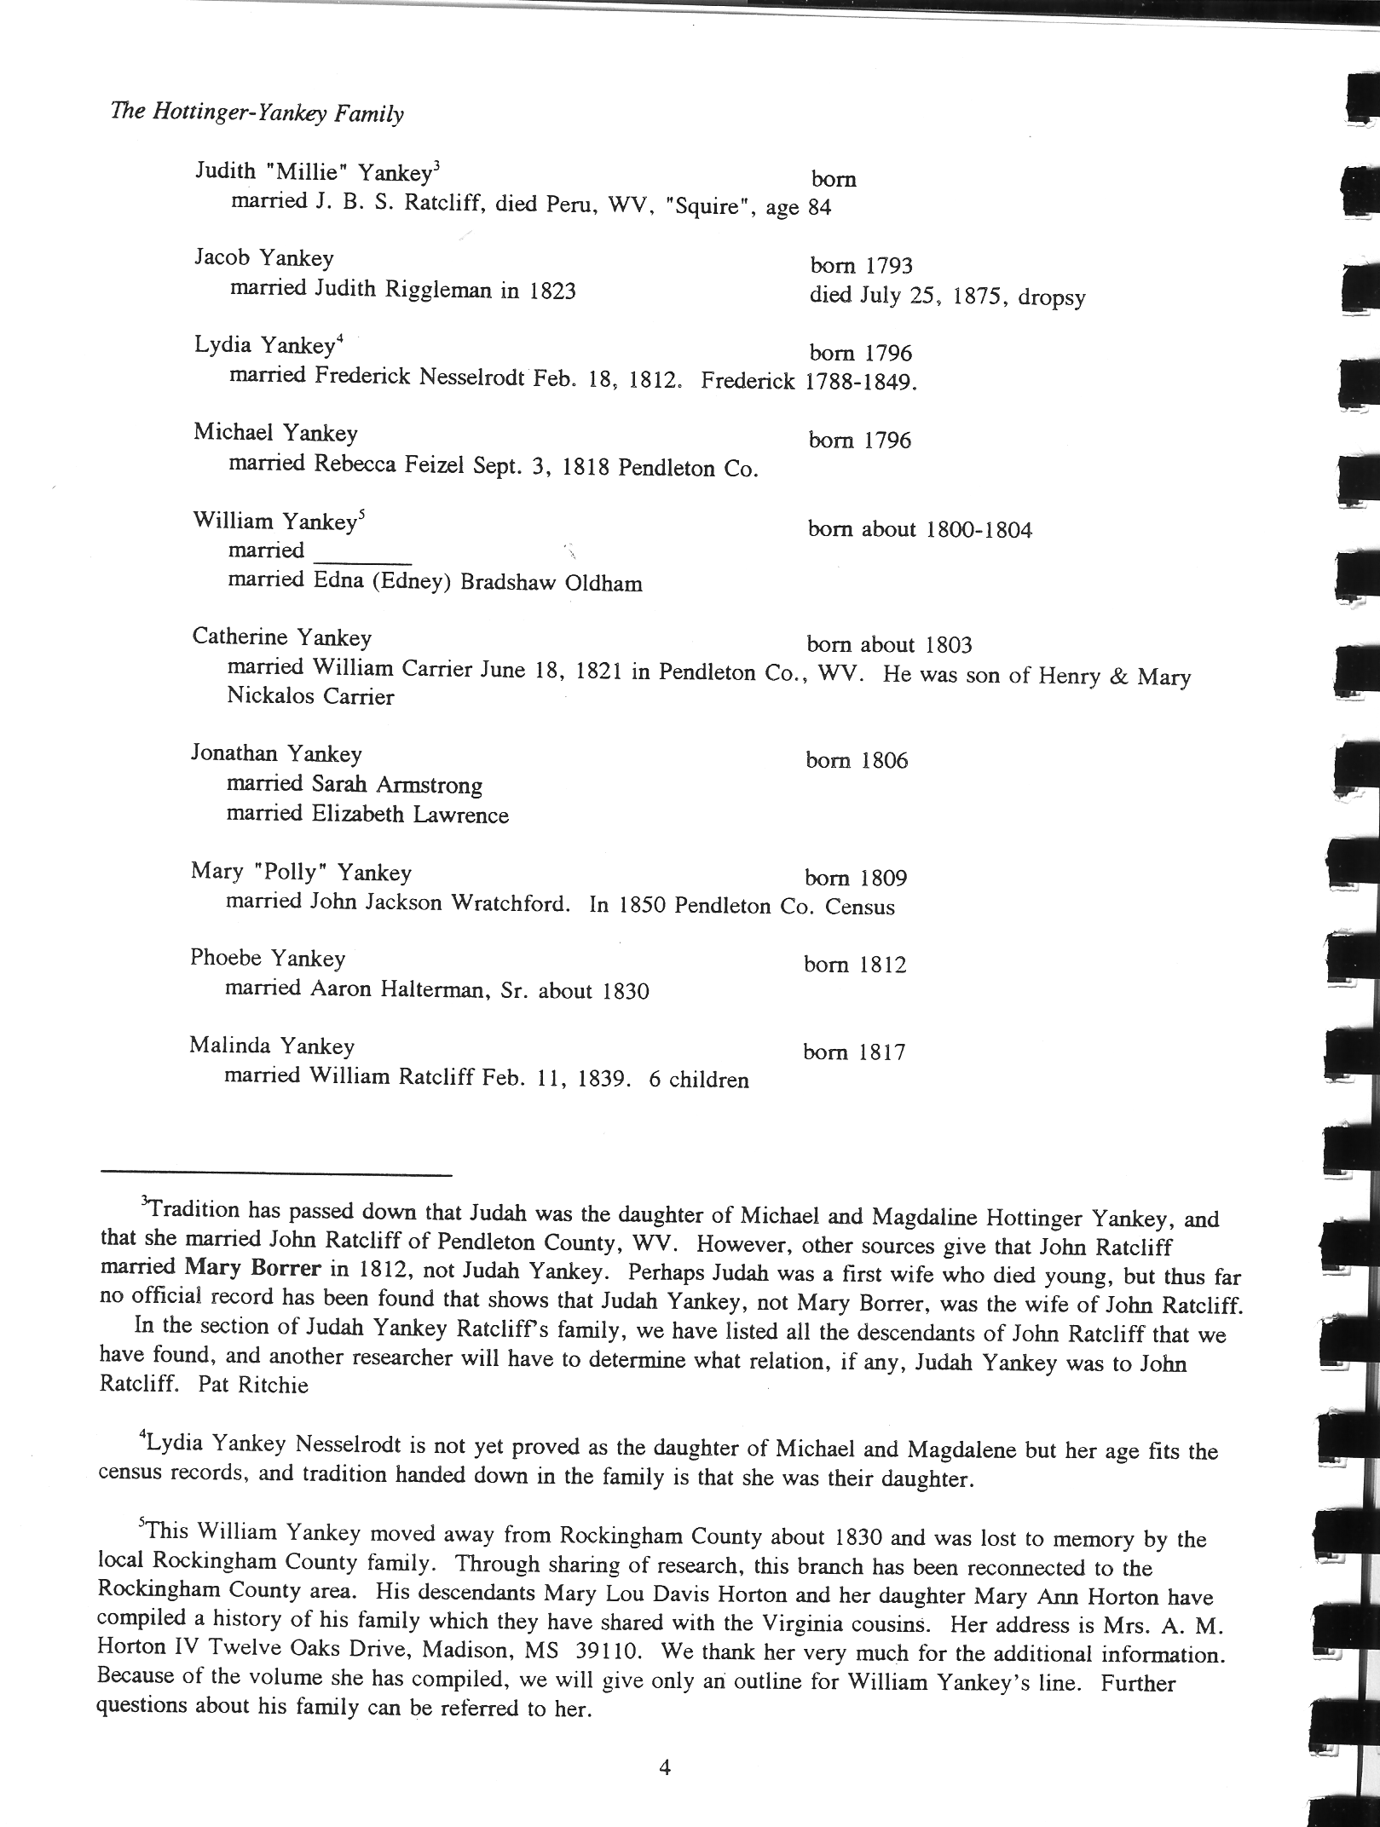
The Hottinger-Yankey Family p. 4

Slide 15
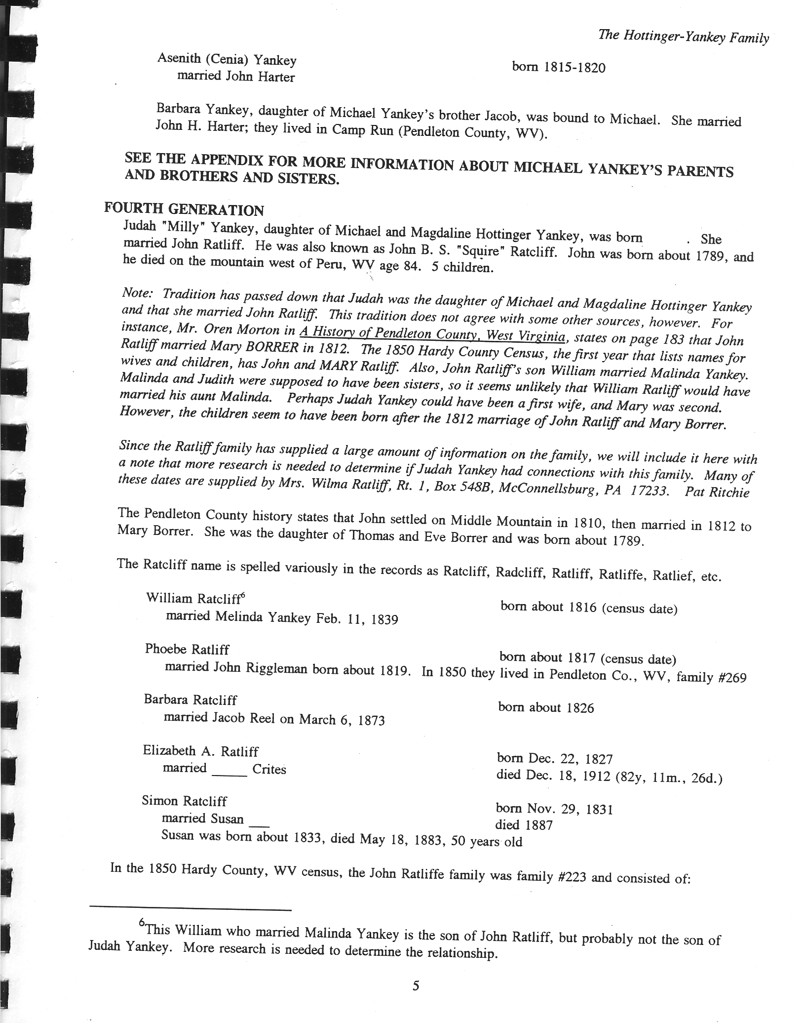
The Hottinger-Yankey Family p. 5

Slide 16
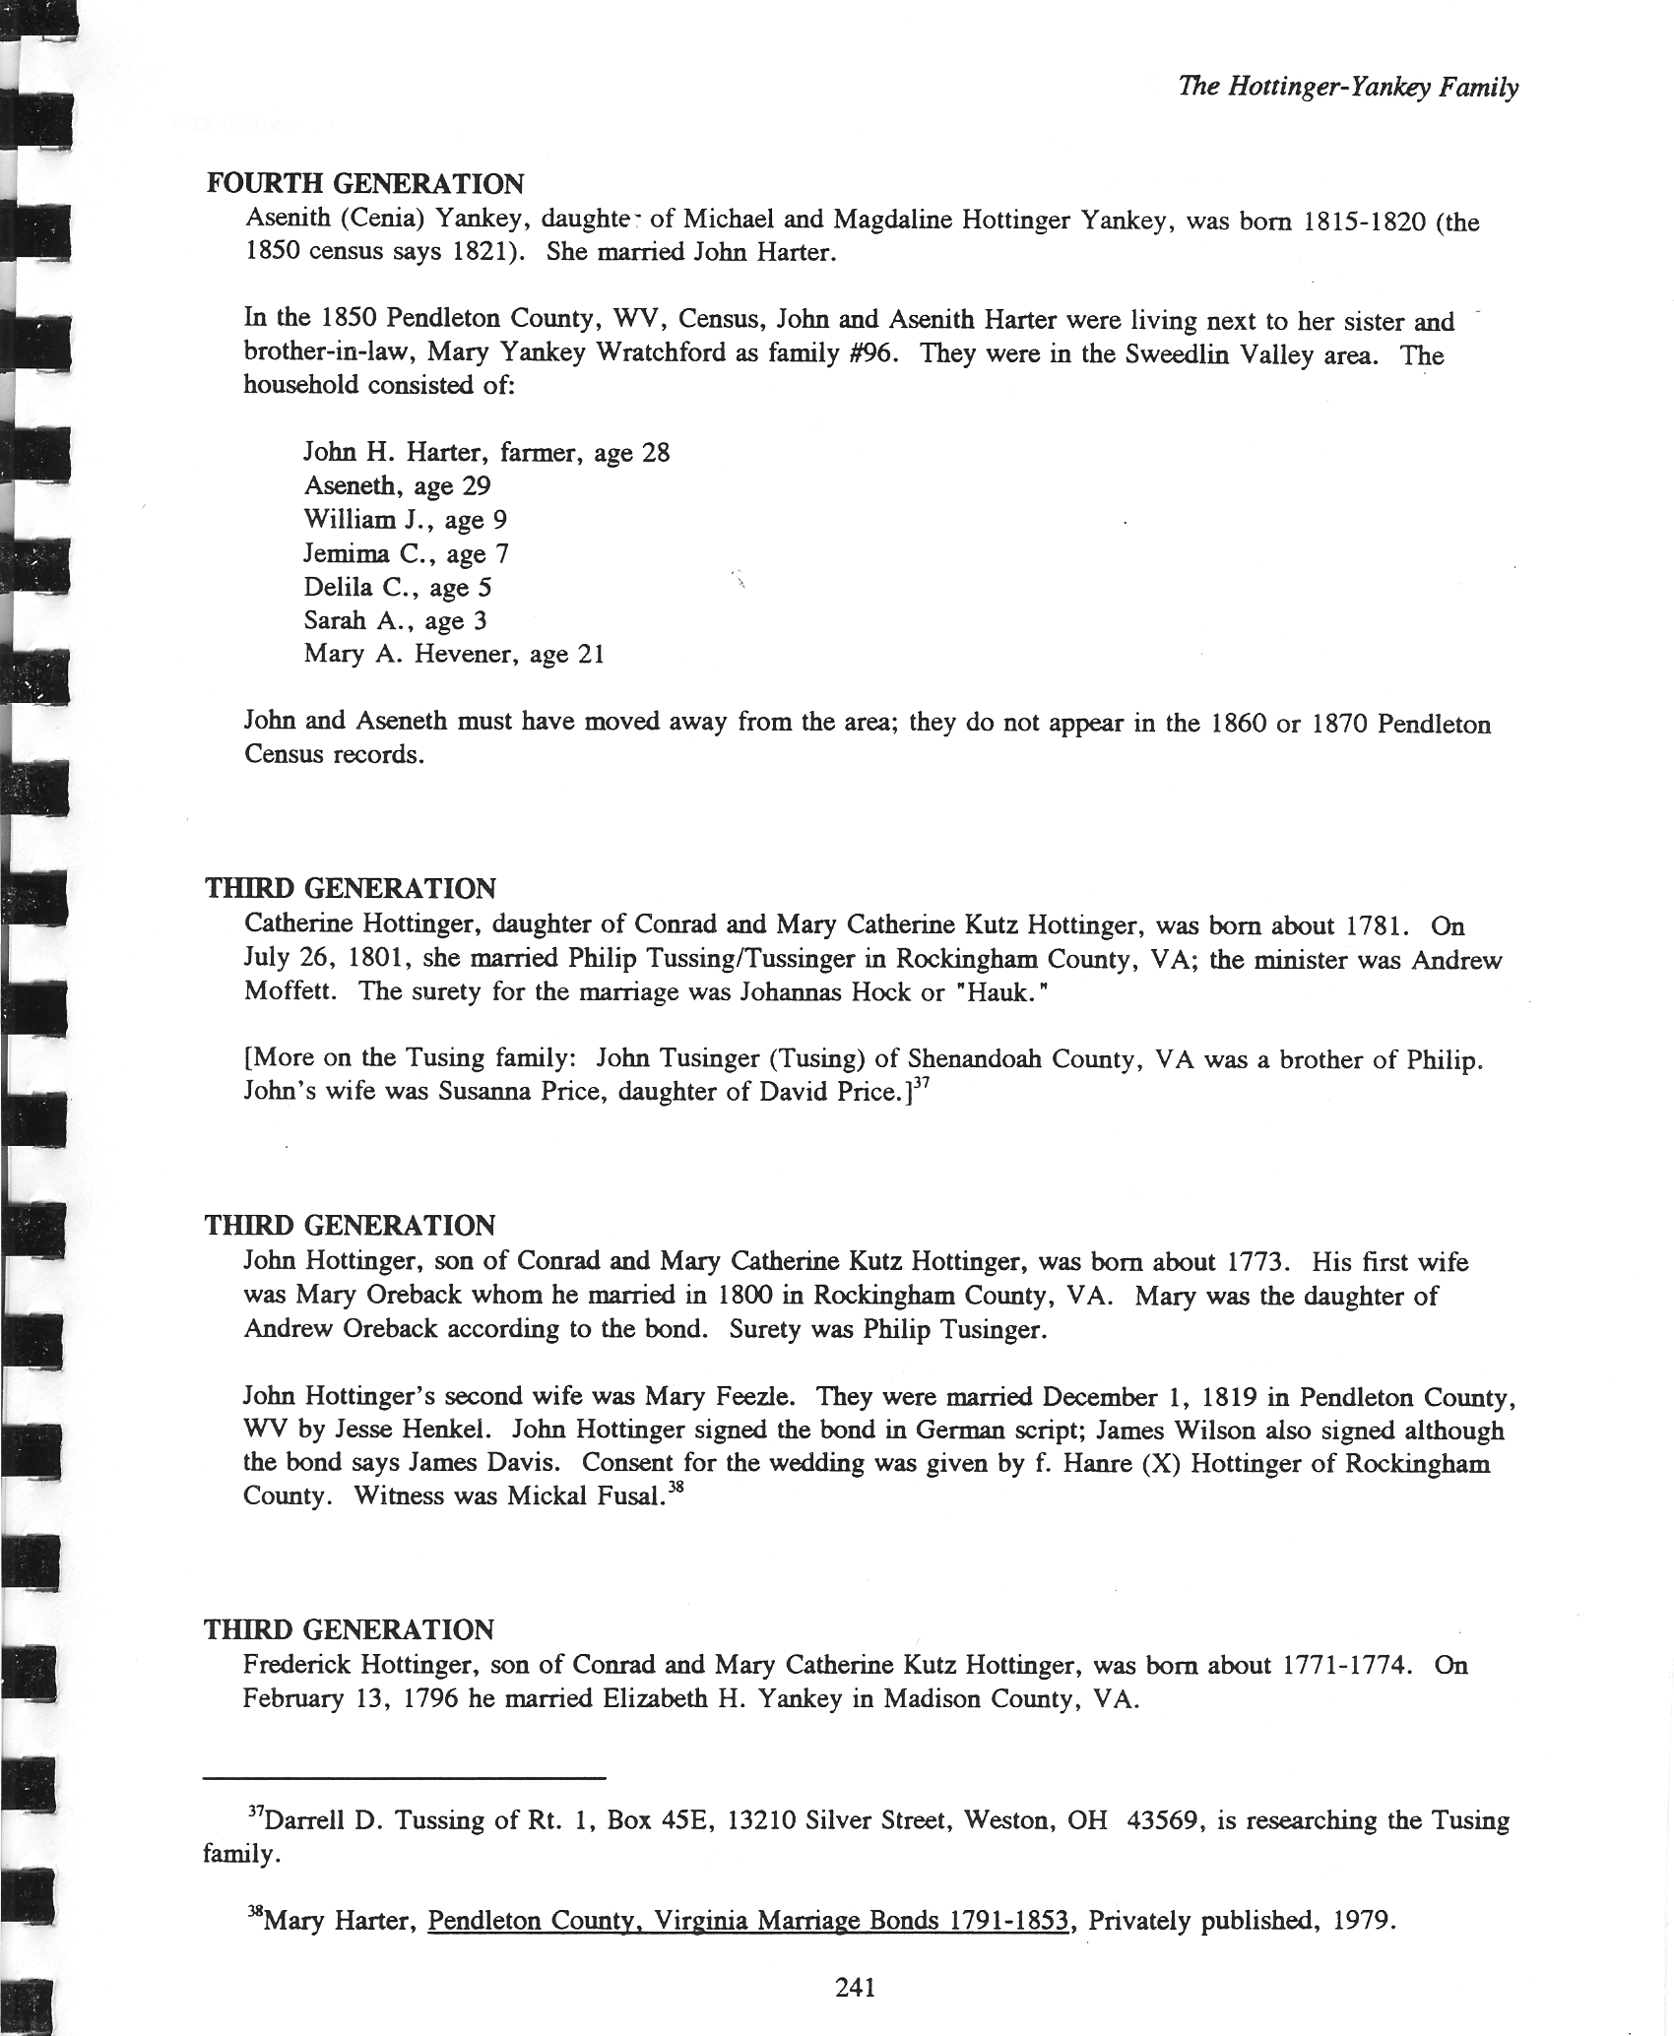
The Hottinger-Yankey Family p. 241

Slide 17
Hottinger/Yankey
Notes
Sources: p. 318-319.
Includes index.
Michael Honinger was the emigrant ancestor. He arrived in Pennsylvania in 1729. He was the father of Conrad Honinger (d.1804) who married Catherine Kutz. Conrad anglicized the name by changing it to Hottinger. Early in their marriage Conrad and Catherine moved to Rockingham County where they were the parents of nine children. One of their sons married Elizabeth Yankey while a daughter, Magdaline, married Michael Yankey. The Yankey family descends from a Michael Jenghe I (1690-?) who traveled from Berlin, Germany and settled in Virginia. His only known son, Michael Yankie II settled in Shenandoah County where he was the father of five children,* one of whom was Michael Yankey (1775-1835) who married Magdaline Hottinger. Michael and Magdaline moved to Brocks Gap about 1800. Descendants live in Virginia and West Virginia.
Conrad Honinger married Catherine Kutz. She was the daughter of Nicholas Kutz of Berks County, PA. Previously of Philadelphia, County, PA. (Nicholas Kutz was born in Stuttgart, in 1729,)**
The Hottinger and Yankey families : including allied families of Nesselrodt/Nazelrod, Ratcliff, Halterman, Delawder, Dove, Wratchford, Hauck, Feezle, and others
Lewis H Yankey; Patricia T Ritchie Publisher:Criders, Virginia : [Lewis H. Yankey], 1991
* This has been shown to be false. See Yankie Fortune Letters.
** Nicholas Kutz was born in 1691, not in 1729. He was probably from Switzerland. See FindaGrave.
Notes:
The Hottinger and Yankey families : including allied families of Nesselrodt/Nazelrod, Ratcliff, Halterman, Delawder, Dove, Wratchford, Hauck, Feezle, and others
Author:Lewis H Yankey; Patricia T Ritchie Publisher:Criders, Virginia : [Lewis H. Yankey], 1991.Edition/Format: Print book : EnglishView all editions and formatsDatabase:WorldCatSummary:Michael Honinger was the emigrant ancestor. He arrived in Pennsylvania in 1729. He was the father of Conrad Honinger (d.1804) who married Catherine Kutz. Conrad anglicized the name by changing it to Hottinger. Early in their marriage Conrad and Catherine moved to Rockingham County where they were the parents of nine children. One of their sons married Elizabeth Yankey while a daughter, Magdaline, married Michael Yankey. The Yankey family descends from a Michael Jenghe I (1690-?) who traveled from Berlin, Germany and settled in Virginia. His only known son, Michael Yankie II settled in Shenandoah County where he was the father of five children, one of whom was Michael Yankey (1775-1830) who married Magdaline Hottinger. Michael and Magdaline moved to Brocks Gap about 1800. Descendants live in Virginia and West Virginia. Read less
Rating:(not yet rated) 0 with reviews - Be the first.
SubjectsHottinger.
Yankey.
Nazelrod.
View all subjects
More like thisSimilar Items

Slide 18
Yankie/Yankey Fortune Letters
In the early part of the 1900’s it was reported in newspapers that the Yankie/Yankey family of America was heir to a fortune of millions in Germany. The family was required to establish the lineage to Germany to claim this money. This era was one of hyperinflation in Germany with paper notes of 100,000 marks and one milliard marks (equivalent to one billion marks). William Henry Yankee reportedly saw initial the advertisement.
This potential for wealth prompted an exchange of letters among numerous family members in an attempt to establish a lineage. These family letters became known as theYankie Fortune Letters. Some family members changed the spelling of their name to correspond with the spelling in the newspaper advertisements. The letters available began in 1911 and extended to 1924. The first to seek the Yankie/Yankey Fortune was William Henry Yankie but other writers were James Minor Yankie, Joseph Samuel Yankey, and William Riley Yankey.
The Yankie Fortune Letters mention Michael Yankey I and II and that the family reportedly originated in Berlin, Germany in the 1600’s.The letters also include “Slabtown” as the early location of the Yankie family in Virginia. This information in the Yankie Fortune Letters became accepted as factual. These letters appear to be the source of the misinformation that has lead to considerable inaccuracies in the Yankie family’s lineage on genealogical sites, in family histories, and on the Internet. Early researchers apparently utilized these letters as a primary source of information.
The Yankie Fortune Letters reported that three brothers “got off a ship” but now it is assumed that the three brothers were probably Andrew John Yankie’s sons, Michael, Andrew, and Jacob Yankie, born in Virginia. It is now known that on June 22, 1750, the immigrant Andreas Johan Jencke arrived on the ship, Irene.
A positive result from the Yankie Fortune Letters was that they are a source of considerable Yankie/Yankey family information including names of children. At the time of the letters the family was scattered throughout the United States and this exchange of letters allowed additional family history to be compiled. A discussion of the Yankie Fortune Letters can be found on the Yankie Cousins Web site, www.yankie.net, by Jerry Yankie. The defining work of Barbara Mahoney and Ruth Gregory is well documented on the Yankie Cousins Web site and in personal communication to the author from Barbara Mahoney. We are indebted to the Yankie family members for their diligence in establishing many family members; however, the Yankie Fortune was a scam or fraud.
It is now known that the lineage of Michael Yankie I and II is incorrect. The initial immigrant was Andreas Johan Jencke born in Upper Silesia in1726. In 1734, he arrived with his family at the Moravian Society in Herrnhut, Germany. In 1750 he sailed to New York and traveled to the Moravian Community in Bethlehem, Pennsylvania. In March of 1761 Andrew John Yankie moved to Dunmore County, Virginia that was later renamed Shenandoah County, Virginia. This book traces a portion of the Yankie/Yankey family.

Slide 19
Yankey Family Cemetery , Criders, Rockingham County, VA
Birth: 1773
Shenandoah County
Virginia, USA Death: unknown
Pendleton County
West Virginia, USA
Michael Yankey is buried on Shenandoah Mountain at Criders, Virginia, originally the Yankey Family Cemetery which is now called Caplinger Cemetery.
Michael Yankey was born about 1773 in Shenandoah County, Virginia, the son of Andrew John (Andreas Johan) Yankey, a German immigrant who arrived into US in 1750. Michael's father seems to have gone by the name John A. Yankey. (Michael's birth year is assessed according to the 1783 Shenandoah County Circuit Court Records regarding Guardianship after father John Yankie died; since Michael's father had died he was bonded out to a Guardian, Michael Nease.).
When Michael was around 20 years old he obtained a marriage bond to marry Maria Magdaline Hottinger with Peter Hottinger signing as bondsman, and her father Conrad Hottinger giving consent for Maria Magdaline's hand in marriage. They were married on 22 July 1793 in Rockingham County.
Michael died between 1830 and 1840 between the ages of 55-65 according to "Papa" Lewis Harvey Yankey. Papa Yankey told me the story at one of the Yankey Family Reunions in Friendship Park (which was his land, cleared for a family park) at the bottom of the mountain as we sat in front of the fireplace. I asked many questions while I had the opportunity and stuck to him like glue. Papa Yankie was in his 90's at the time. He told me that Michael had gone to the grist mill in very cold winter weather to have some grain ground to meal. He was found leaning against a tree on the side of the mountain and sadly, frozen to death. He is buried on the home place where he lived with his wife Magdaline which lies in the north part of Rockingham County close to the Shenandoah County line. It is called North Mountain or Little North Mountain. The Yankey Family Cemetery lies on top of this mountain. Papa Yankey along with some other descendants erected headstones for Michael and Maria Hottinger Yankey.
In awe of walking almost on what felt to us sacred ground, my brother and I moved among the graves of our beloved ancestors and took in the remains of the original cabin, the spring, the apple cellar, old barbed wire fences built so long ago by their hands, and the paths and roads they travelled as we walked where they had walked. It was a beautiful and extremely rewarding experience and something that my brother, Wayne Anderson Yankie and I gratefully and lovingly shared together. We are extremely close, but we sealed a very special bond as we made this unique journey together back into the time and place of our brave ancestors. (Nancy Yankie Sidarous, proud Yankey/Yankey/Yankee Descendant, and daughter of Beloved Father Hugh Alvin "Boots" Yankie, and Granddaughter of Michael Yankey.)
Family links:
Spouse:
Maria Magdaline Hottinger Yankey
Burial: Yankey Family Cemetery Criders Rockingham County, Virginia, USA
Created by: Nancy Yankie Sidarous
Record added: Feb 03, 2015
Find A Grave Memorial# 142178249
Notes:
From FindaGrave

Slide 20
Maria Magdaline Hottinger Yankey
Birth: unknown
Pendleton County
West Virginia, USA Death: unknown
Pendleton County
West Virginia, USA
Maria Magdaline Hottinger and Michael Yankey were married 22 July 1793 in Rockingham County by Rev. Paul Henkel. She is the daughter of Conrad Hottinger. (Yankie Descendant Nancy Yankie)
Family links:
Spouse:
Michael Andrew Yankey (1773 - ____)*
*Calculated relationship
Burial:
Yankey Family Cemetery
Criders
Rockingham County
Virginia, USA
Created by: Nancy Yankie Sidarous
Record added: Feb 03, 2015
Find A Grave Memorial# 142179428
http://www.findagrave.com/cgi-bin/fg.cgi?page=cr&GScid=2568095&CRid=2568095&pt=Yankey%20Family%20Cemetery&

Slide 21
On April 27, 1792 Rockingham County, Virginia Court records ordered that “Elizabeth Yankey, base born [93] child of Mary Yankey, be bound out by the Overseers of the Poor to Jacob Rife according to law.” [94] [95] Elizabeth Yankey’s birth year was listed as 1776 on the 1850 Virginia Census. [96]Elizabeth Yankey could have been born out of wedlock after Andrew Yankey’s death. It would have been very unusual that a child was conceived out of wedlock within one year after the birth of sibling brothers in a society that was very religious and moral.
Notes:
Marriage Bond, Rockingham County Records, Book 1, page 556, reported from the records of Barbara Mahoney, from the Shenandoah County Circuit Court Record, Woodstock, Virginia, The Minute Book 1781-1785, page 156, reported in The American family history of William A. Yankey, 1803-1865, Volume II, Mary Ann Horton and Mary Lou Davis Horton, 1991.

Slide 22
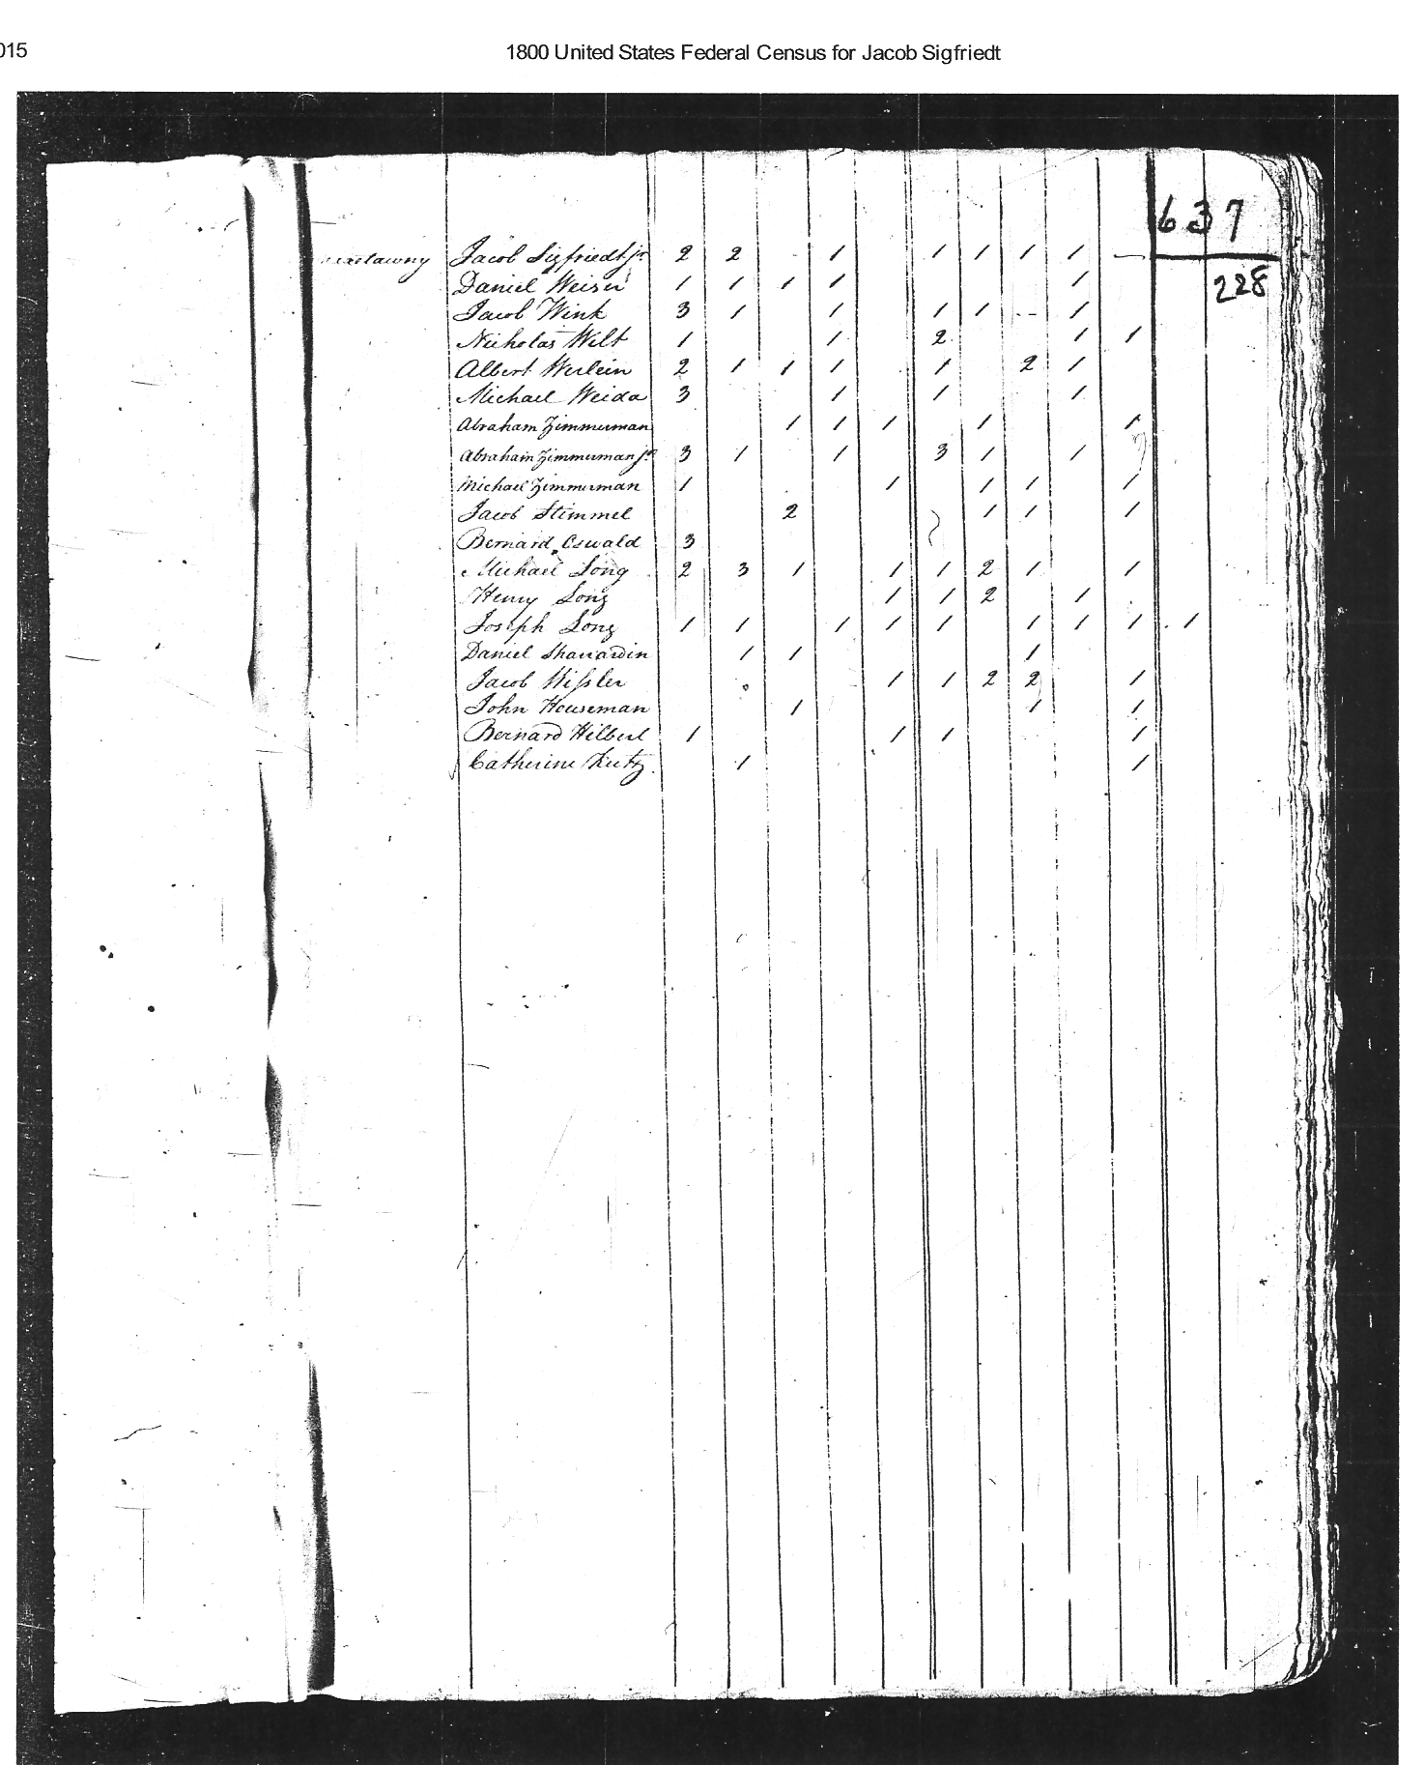
Is this Catherine Kutz Honinger?

Slide 23
Harter/Hevener Tree
Shenandoah Valley, Virginia
0. Simeon Harter b. 1798 - Hardy WV
+ Elizabeth Hevner b. 1795- Maryland, m. 19Sep1820, father- Cutlip Hefner,
1. Catherine b. 1821-1890 b. Va d. Ft Seybert WV
+ Phillip Nazzlerod b. 1796-d. 1877 b. Va, d. Ft Seybert WV
1. John Harter b. 1823-d. 1905 b. VA d. Franklin Twp, Adams OH
+ Asenith Yankie b. 1822-d.1902 b. Rockingham, VA, d. Franklin Twp, Adams OH
2. William Harter b. 1841- d. ? b. VA
2. Jemima Elizabeth Harter b. 1844- d. 1901 b. Hardy County WV; m. 1863 Clark,OH
2. Delila C Harter b. 1845- d. ? b. VA
2. Sarah Ann Harter b. 1848- d. 1901 b. VA
+ Isaac Overholser b. 1846- d.1896 b. OH
2. Americas Simeon Harter b. 1850-1934 b. VA
+ Mary Jarnagin b. 1850-d.1918 b. Highland, OH
2. James H. Harter b. 1853- d. b. VA
2. Noah C. Harter b. 1857- d. ? b. VA
2. Elsworth E. Harter b. 1864- d. ? b. OH
1. Peter Harter b. 1827-d. 1863? b. Living near John, died at Gettysburg 1863.
1. Hiram b. 1829 b. Va
Heffner Tree, Middletown, Maryland
0. Johannes Haefner b. 17?? - d ? lived in Middletown, Frederick, MD
+ Catherina b. 17?? -
1. Gotlip Heffner b. 1767 - 1833? lived in Middletown, Frederick, MD
+ Catherine Shafer b. 1765?
2. Mary J Hevener b. 1793 – d. 1866
+ Philip Kesner b. 1796-d. 1888
2. Elizabeth Hevner b. 1795- Maryland, m. 19Sep1820, father- Cutlip Hefner,
+ Simeon Harter b. 1798 - Hardy WV
2. Cutlip Hevner Jr. B. 1811 – d. aft 1860 1860 Census, Franklin Twp, Pendleton
Notes:
Catherine Harter
Birth 27 Jun 1822 in Pendleton, West Virginia, United StatesDeath 29 Nov 1890 in Ft Seybert, Pendleton, West Virginia, United States
m. Philip Nazzlerod
Birth 9 Jun 1796 in Pendleton, West Virginia, United StatesDeath 22 May 1877 in Ft seybert, Pendleton, West Virginia, United States
The Pendleton County Harter's seem to start in the 1830's and continue to the present ( in Hardy County WVa though)all the other Pend.Co. Harter's are no longer in that area.
The Harter's are;
Simeon Harter-Father
John Harter- son
Catherine Nesselrodt-daughter married Phillip Nesselrodt
Peter Harter-son 25th Va Inf 2nd Co K married Susanah Coffman
Hiram Harter-son 18th Va Cav.
(http://www.genealogy.com/forum/surnames/topics/harter/198/)

Slide 24
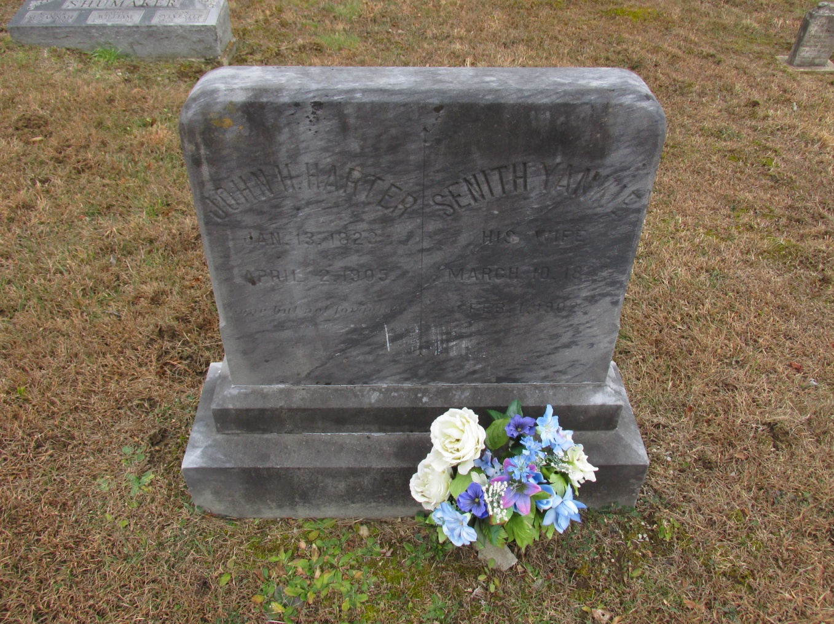
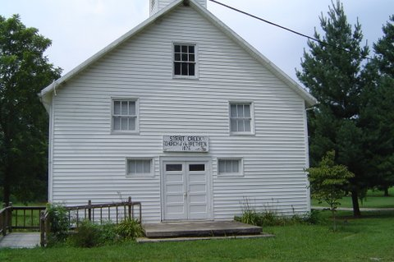
John H & Senith Yankie Harter
John Harter
Birth: Jan. 13, 1823 Death: Apr. 2, 1905
Senith Yankie Harter
Birth: Mar. 10, 1822 Death: Feb. 1, 1902
wife of John H. Harter
Burial:
Strait Creek Cemetery
Highland County Ohio, USA
Created by: Kim Graham
Record added: Jul 20, 2008
Find A Grave Memorial# 28406968
This is the Strait Creek Road Church of the Brethren (Dunkard) near Adams County Ohio. John Harter and Asenith Yankey/Yankie are buried in the church cemetery, just to the right of this church..
Thank you Gerald Yankie for supplying the picture. and comment.
Notes:
Asenith’s Daughter - Sarah Harter Overholser & Isaac Overholser buried here.
Daniel Yankee 1863-1939 buried here

Slide 25
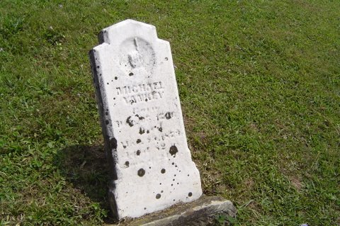
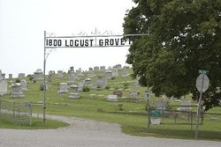
Michael Yankey (1796- 1879) brother of Elizabeth Yankie Harter
Ohio State Route 41 and Cemetery Road
Peebles
Adams County
Ohio USA
Postal Code: 45660
Many other Yankie’s are buried here
Thanks to Gerald Yankie for photos
Notes:
http://www.findagrave.com/cgi-bin/fg.cgi?page=gr&GSln=yankie&GSiman=1&GScid=41854&GRid=84832350&

Slide 26
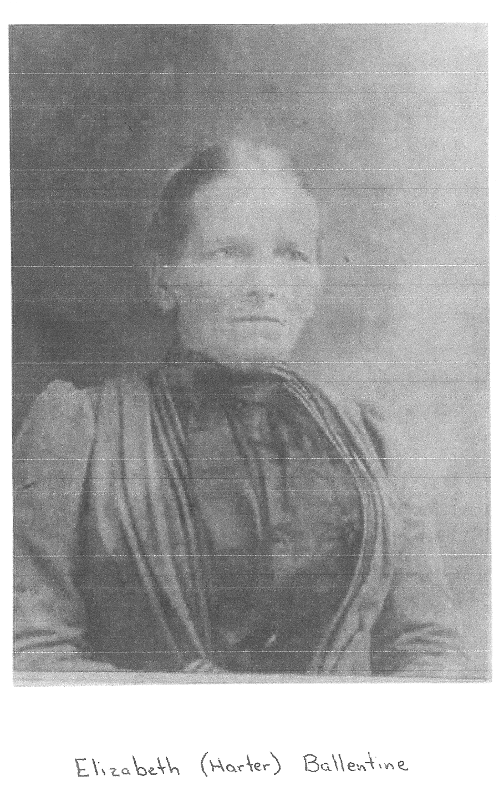
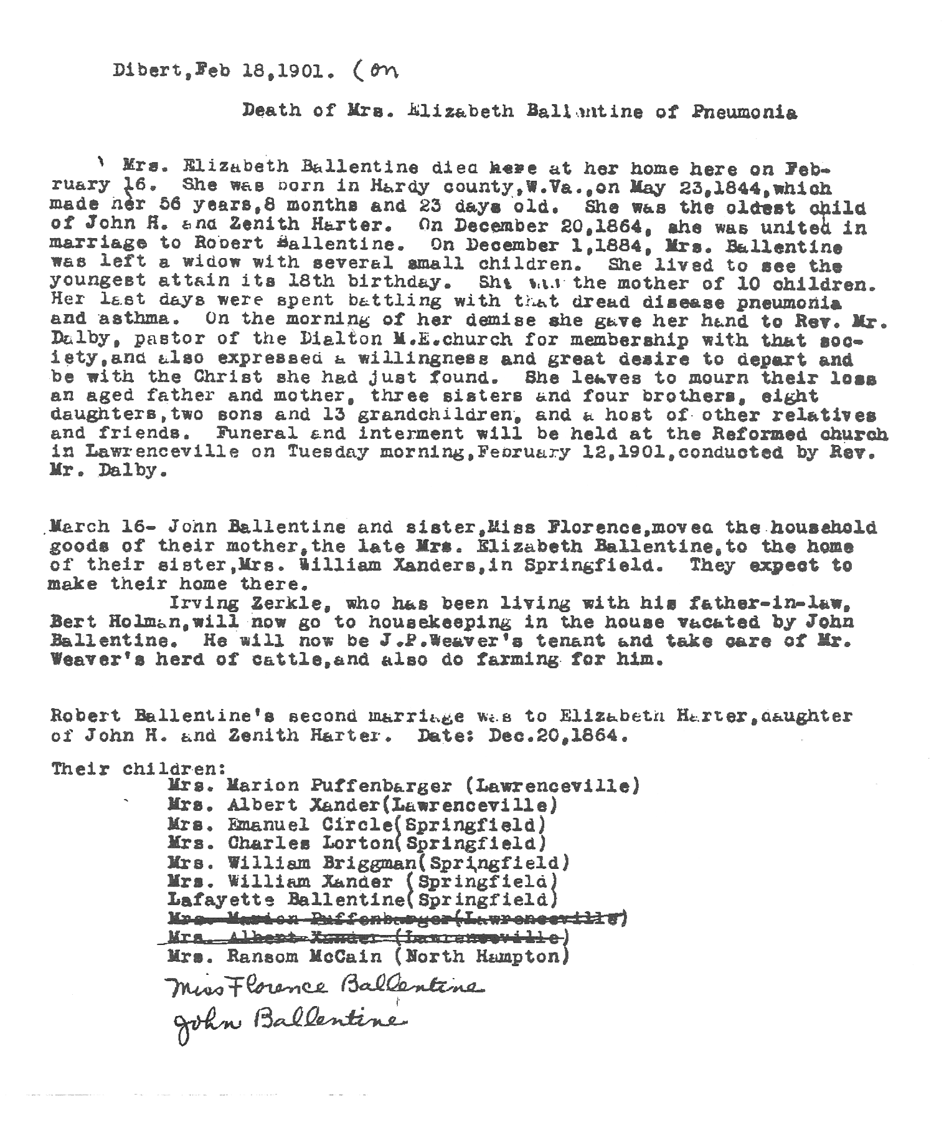
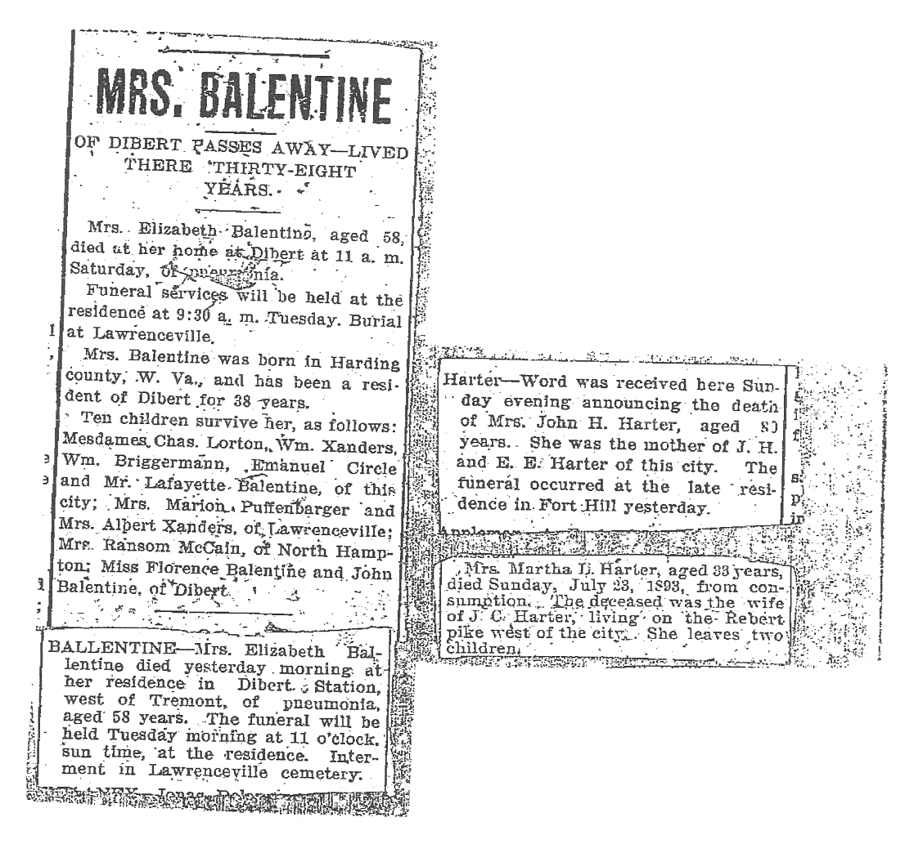
Elizabeth Harter Ballentine b.1844- d.1901

Slide 27
Hevener Tree
Middletown, MD
Heffner Tree, Middletown, Maryland
0. Johannes Haefner b. 17?? - d ? lived in Middletown, Frederick, MD
+ Catherina b. 17?? -
1. Gotlip Heffner b. 1767 - 1833? lived in Middletown, Frederick, MD
+ Catherine Shafer b. 1765?
2. JohnHeffner b. ? – d. ? M. 1807
Ruth Keister b. ?-d. ?
2. Susannah . B.
2. Jemima B. d.
2. Catharine B. d. m. 1810
+ George Mumbert b. d.
2. Jacob . B.
2. Peter . B.
2. Mary J Hevener b. 1793 – d. 1866
+ Philip Kesner b. 1796-d. 1888
2. Elizabeth Hevner b. 1795- Maryland, m. 19Sep1820, father- Cutlip Hefner,
+ Simeon Harter b. 1798 - Hardy WV
2. Cutlip Hevner Jr. B. 1811 – d. aft 1860 1860 Census, Franklin Twp, Pendleton
Notes:
(C). Cutlip Heffner (Catharine )—voter, 1799—d. 1833 — Sweedland — related to the Heveners—ch.—1. John (Ruth Keister)-m. 1807. 2. Cutlip. 3. Susannah. 4. Jemima. 5. Catharine (GeorgeMumbert)—m. 1810. 6. Jacob. 7. Peter. 8. Mary ( Kessner). 9. Elizabeth ( Harter).
cutlip heffner
Replies: 4
Re: cutlip heffner
cannonsmc59 (View posts)
Posted: 7 Jul 2016 9:13AM GMT
Classification: Query
The good news is that you can read "A History of Pendleton County, WV." On GoogleBooks, it's easy to use the search engine for the book to find specific people.
By the way, I did another Google search this morning and found a book that is not on the Internet--could be the one you're referring to. It's called Heavner-Hefner-Hevener of the Virginias and was written in 1998 by a descendant named Dennis N. Hevener. This family history book is in a number of genealogy libraries though. I was able to see a brief clip of the book and saw that this author believes that the Frederick County Haefners and Schaeffers I referenced in the earlier emails are the correct ones. The pages in this book that seem relevant are pages 398-400. There seems to be more on pg. 417 about Johan Heafner, the father of Gotlieb/Cutlif Sr. When I did a search of that book, I found one section called "Jacob," so I think this is the book, you are referring to that's in Harrisburg and other places.
I really don't know a lot about the Hevener line. A relative compiled a genealogy history of my mother's line and knew that Hannah Casner (wife of Jonathan Wesley Yankey) was the daughter of Philip Casner and Mary Hevener. I was seeing what I could find on the Internet about them when I came across your post and thought I'd share what I've been finding. In our family history book, there is a photo of Jonathan Yankey and Hannah Casner. They moved west living in Missouri and Illinois. Jonathan and Hannah Yankey are buried in Illinois and can be found on Find a Grave.
Therefore, you may have more stories than I do!
Sharon
2. cutlip heffner
Replies: 4
Re: cutlip heffner
mandsdietz (View posts)
Posted: 7 Jul 2016 8:22AM GMT
Classification: Query
Surnames: Hevner, Miller
oh thank you, Mary's descendant. I have not read Pendleton's history for ages, probably did not know he was a 3g gf, much less related. have u seen the book by the descendant that traces back to - I believe it''s Jacob? I know there's a copy in Moorefield, WV and also in Harrisonburg, VA, I think at the college/university. I would think there would be a copy somewhere in Pendleton Co.
My line is thru Chloe Diana/Flora/Hora Hevner, a daughter of the second Cutlip. I'd love to know any stories about the family and the fathers/Cutlip 1 and 2. Called Annie, a sister Elizabeth, married a brother to my gg gf :Morgan Wm Miller. She was called Lizzie. At times however, I am not certain she is in this family. But I know the relationships so it has to be since Annie is in this family, albeit with a butchered name every time until she was an adult.
s
3. cutlip heffner
Replies: 4
Re: cutlip heffner
cannonsmc59 (View posts)
Posted: 7 Jul 2016 9:13AM GMT
Classification: Query
The good news is that you can read "A History of Pendleton County, WV." On GoogleBooks, it's easy to use the search engine for the book to find specific people.
By the way, I did another Google search this morning and found a book that is not on the Internet--could be the one you're referring to. It's called Heavner-Hefner-Hevener of the Virginias and was written in 1998 by a descendant named Dennis N. Hevener. This family history book is in a number of genealogy libraries though. I was able to see a brief clip of the book and saw that this author believes that the Frederick County Haefners and Schaeffers I referenced in the earlier emails are the correct ones. The pages in this book that seem relevant are pages 398-400. There seems to be more on pg. 417 about Johan Heafner, the father of Gotlieb/Cutlif Sr. When I did a search of that book, I found one section called "Jacob," so I think this is the book, you are referring to that's in Harrisburg and other places.
I really don't know a lot about the Hevener line. A relative compiled a genealogy history of my mother's line and knew that Hannah Casner (wife of Jonathan Wesley Yankey) was the daughter of Philip Casner and Mary Hevener. I was seeing what I could find on the Internet about them when I came across your post and thought I'd share what I've been finding. In our family history book, there is a photo of Jonathan Yankey and Hannah Casner. They moved west living in Missouri and Illinois. Jonathan and Hannah Yankey are buried in Illinois and can be found on Find a Grave.
Therefore, you may have more stories than I do!
Sharon
Hevener. (A.) The first name we find is William, appointed road overseer in 1756. He appears to have lived on the original Hevener farm beginning a mile below Brandywine. He is then lost sight of, and may have been one of the killed at Fort Seybert. The next is Nicholas (Elizabeth ) who died in 1769, his will being attested by Matthew Patton, Robert Davis, and James Stephenson. He owned a 225 wagon and copper tubs. Peter, who settled in the Crabbottom, and represented 3 tithables in 1790, appears to have been a brother, and both were very likely sons of William.

Slide 28
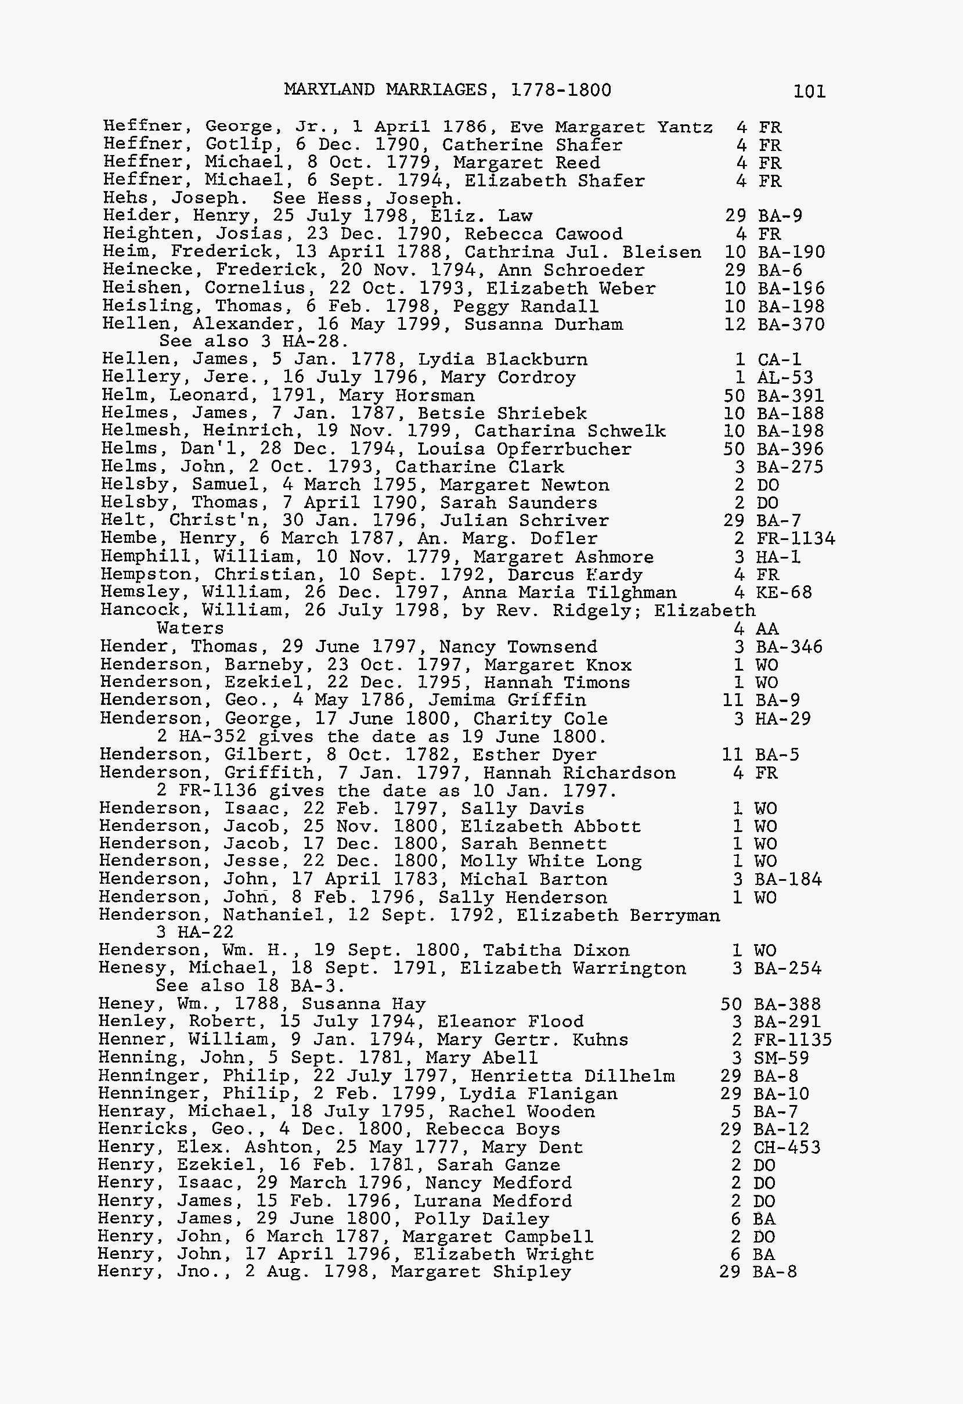
Maryland Marriages
1778-1800
Gotlip Heffner & Catherine Shafer
1790 Frederick County, MD
Gottlieb Haefner in the
Maryland, Births and Christenings Index, 1662-1911
Name:Gottlieb Haefner
Gender:Male
Christening Date:19 Apr 1767Christening Place:Evangelical Lutheran of Middletown, Frederick, Maryland
Father's name:Johannes Haefner
Mother's name: Catharina
FHL Film Number:13934
Source Information
Ancestry.com. Maryland, Births and Christenings Index, 1662-1911 [database on-line]. Provo, UT, USA: Ancestry.com Operations, Inc., 2011.
Notes:
Maryland Marriages 1778-1800, compiled by Robert Barnes Genealogical Publishing Co. copyright 1978
Gottlieb Haefner in the Maryland, Births and Christenings Index, 1662-1911
Name:Gottlieb HaefnerGender:MaleChristening Date:19 Apr 1767Christening Place:Evangelical Lutheran of Middletown, Frederick, MarylandFather's name:Johannes HaefnerMother's name:CatharinaFHL Film Number:13934
Source Information
Ancestry.com. Maryland, Births and Christenings Index, 1662-1911 [database on-line]. Provo, UT, USA: Ancestry.com Operations, Inc., 2011.
Original data:
"Maryland Births and Christenings, 1600–1995." Index. FamilySearch, Salt Lake City, Utah, 2009, 2010. Index entries derived from digital copies of original
and compiled records.
Description
This database is an index extracted from more than 200,000 birth, baptism, and christening records from Maryland. Learn more...
© 2015, Ancestry.com
Roy N. Dickenson Family Tree
1. Johannes Haefner
BIRTH 1730 • , , , Germany
DEATH 1830 • Clearing Springs, Maryland, United States
2. Catharina Elisabetha
BIRTH 1732 • Rotfelden, Calw, Baden-Wuerttemberg, Germany
DEATH 1832
3. Michael Haefner (Father of Johannes)
BIRTH 1680 • , , , Germany
DEATH 1742
4. Maria Magareth (wife of Michael)
BIRTH 1690
DEATH Unknown

Slide 29
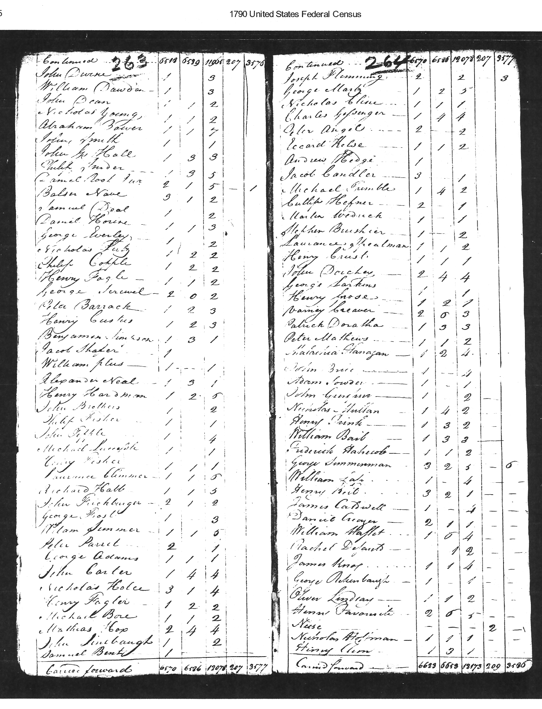
1790 Census – Cutlip Hefner
Frederick, MD
2 Males older than 16
3 in Family

Slide 30
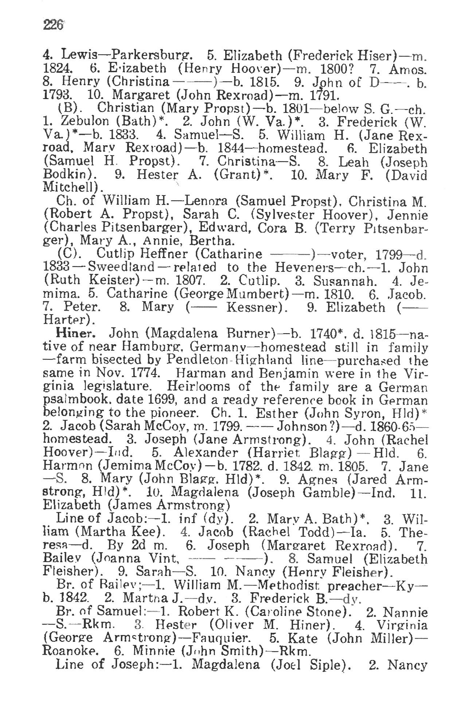
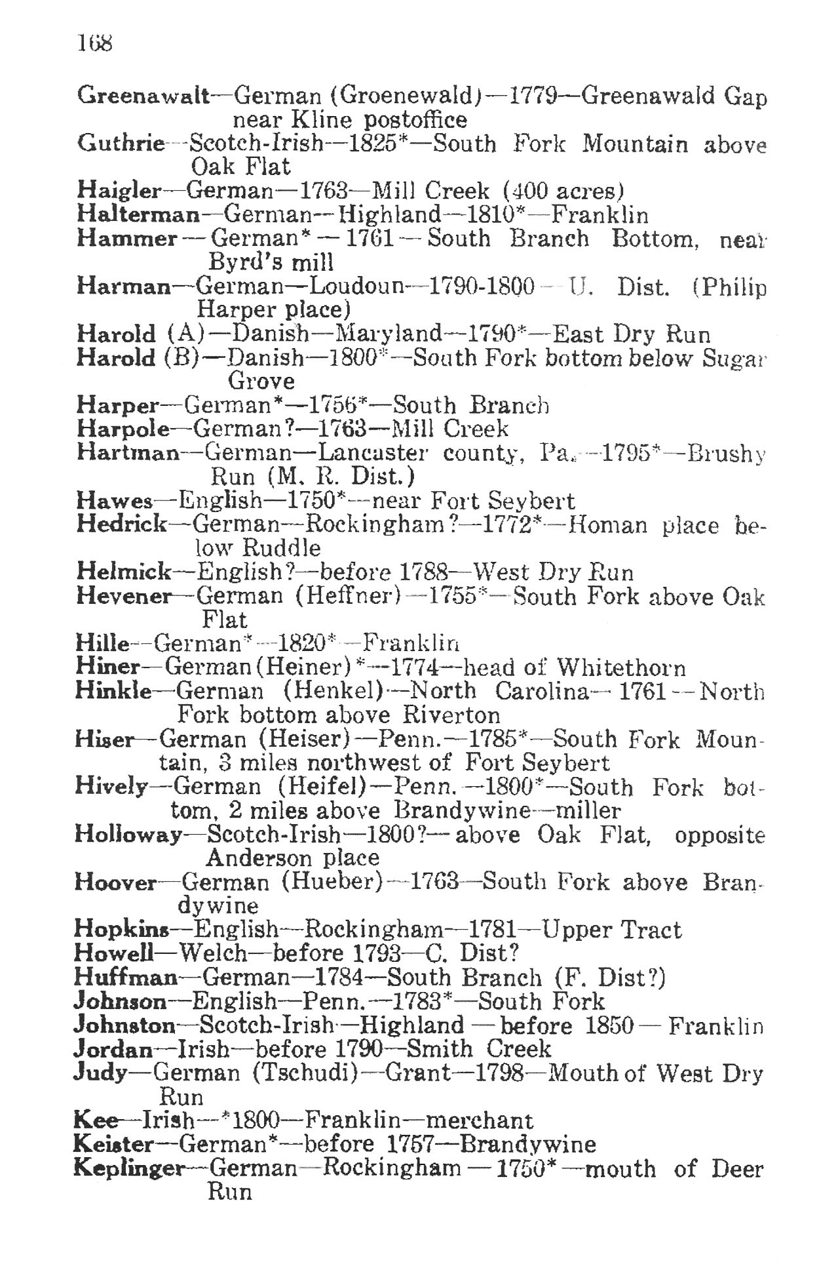
From “History of Pendleton County, WV” by OF Morton 1926

Slide 31
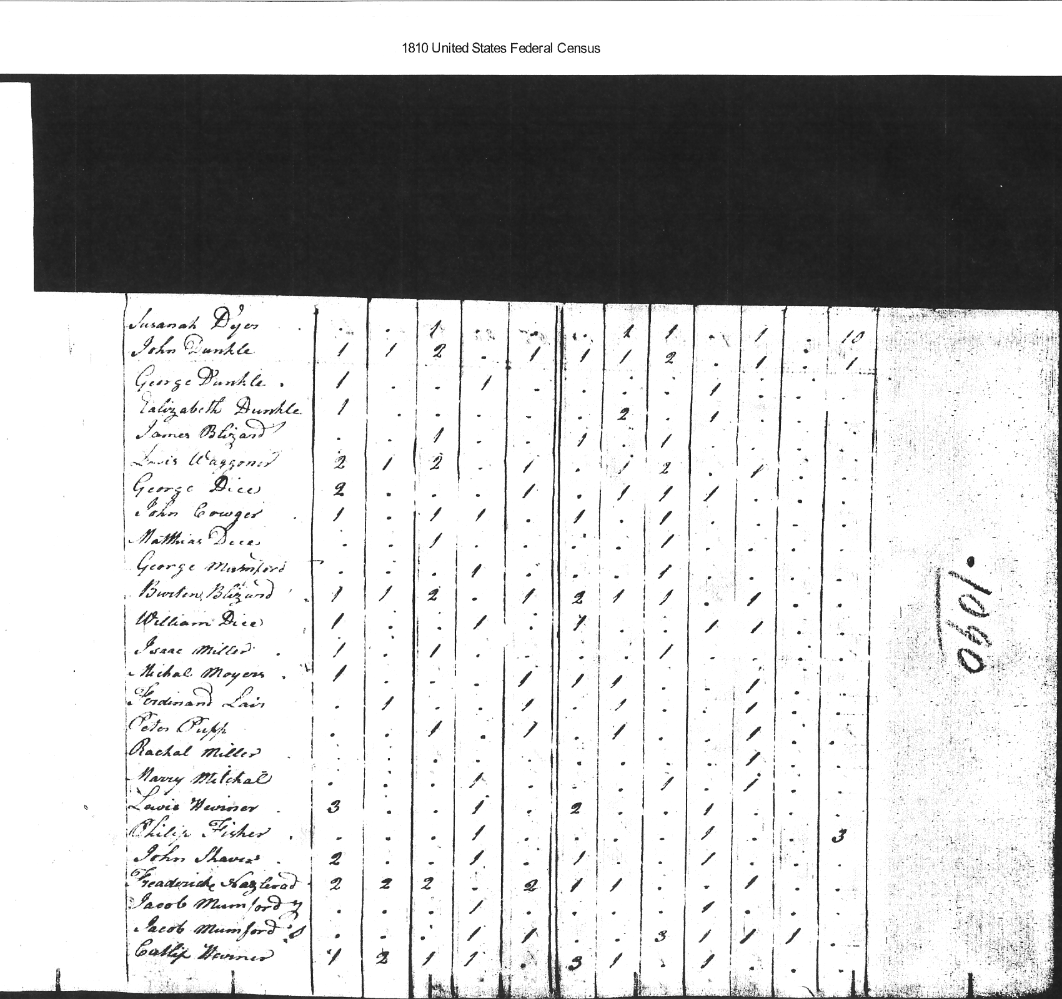
1810 US Census – Cutlip Hevener
Pendleton, Va

Slide 32

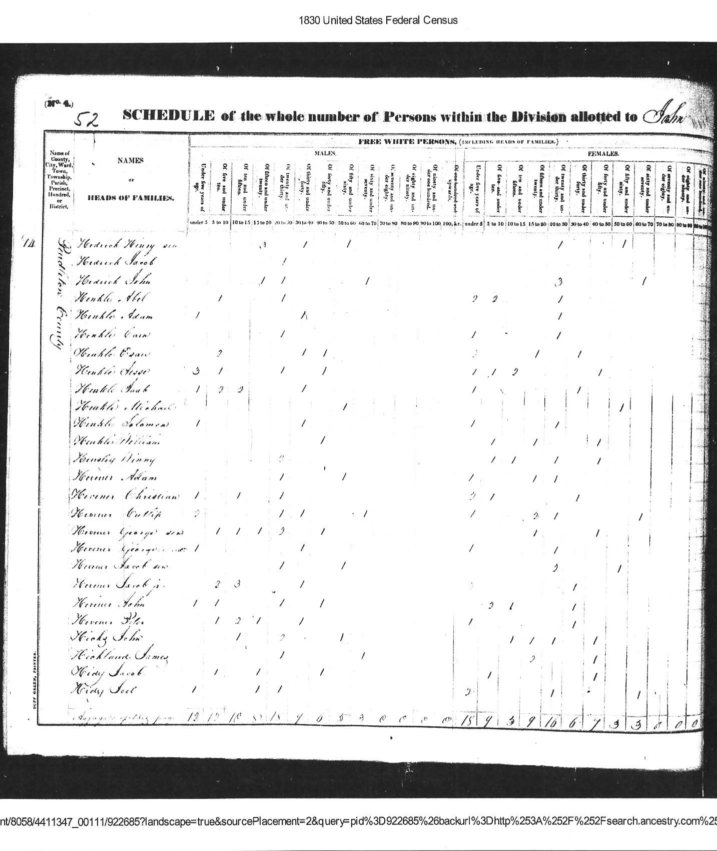
1830 Census - Cutlip Hevener
Pendleton, VA
Notes:
Elisabeth Hevner in the West Virginia, Marriages Index, 1785-1971
Name:Elisabeth HevnerGender:FemaleSpouse's Name:Simion HarterSpouse Gender:MaleMarriage Date:19 Sep 1820Marriage Place:Pendleton, West Virginia
Source Information
Ancestry.com. West Virginia, Marriages Index, 1785-1971 [database on-line]. Provo, UT, USA: Ancestry.com Operations, Inc., 2011.
Original data:
"West Virginia Marriages, 1853–1970." Index. FamilySearch, Salt Lake City, Utah, 2008, 2009. Digital images of originals housed in County Courthouses in various counties throughout West Virginia. Marriage records.
Description
This database contains an index extracted from West Virginia marriage records. Learn more...

Slide 33
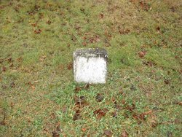
Hevener/ Harter Notes
Birth: | 1811 Fort Seybert Pendleton County West Virginia, USA
Death: | unknown
Born to Gotlieb "Cutlip" Hevener and Catherine Shafer in Sweedlin Valley, Pendleton, West Virgnia, Cutlip married Mary Dasher in 1833 in Pendleton County, West Virginia. Of this union the following children were born; Catherine, John D, Charles Whitfield, and AG Hevener. The last name has several spellings; Havener,Hefner, Heavener, and Heffner. Cutlip was born in the area known as Camp Run these days near Ft. Seybert. The road through Camp Run branches off near Ft. Seybert and runs to Criders where some of the family settled. Family links: Children: Charles Whitfield Hevener (1838 - ____)* *Calculated relationship
Burial: Caplinger Cemetery Criders Rockingham County Virginia, USA
Created by: Roy Dickenson Record added: Aug 13, 2012 Find A Grave Memorial# 95291539
Notes:
From: "Karen McKellar" <kadica@tds.net>
Subject: [HARTER] Rockingham/Licking County Harters (also Perry County)
Date: Wed, 12 Aug 2009 09:00:16 -0400
It has been several years since I have reviewed my Harter research. My research has centered around those Harters living in Rockingham County, Virginia in the 1770's and their descendants who migrated to Licking County, Ohio in the early 1800's.
I began my research many years ago and was lucky enough to have corresponded with the late Byron Harter who was the first that I know who was interested in researching this family.
Following is a synopsis of the information I have put together some of it provided by Byron in the early 1970's:
This Harter family first appears about 1785 in Rockingham county when son Phlip married. They appear in some tax records and a few deed transfers have survived that give us a little glimpse of the family history. George had at the least the following children:
Philip -- Not much known about him. In 1808 he was living in Highland Ohio when he was appointed attorney by his brothers Henry and John who were also living in Ohio. Philip married Maryliz Oldman in Rockingham county and was perhaps the first to leave Rockingham for Ohio.
Henry came to Ohio via Kentucky where he stopped and lived for several years. He married Catherine Dove before leaving Rockingham. They had at least two children, Jacob Dove Harter and Catherine who married Jacob Ullery. He moved from Kentucky to Miami County about 1817.
John Harter also lived in Miami County at some time. I have very little information on his family.
Adam Harter son of George, Sr. b. between 1760 and 1770 in Rockingham County, VA. married Elizabeth Dispennet. Appears in the 1788 tax list of Rockingham County. Moved from Rockingham to Licking County, Ohio before 1817. Died in 1831 in Licking County. Had following children: John b. 4 March 1818, m. Margaret Dispennet daughter of John Dispennet and Mary Harter. Aaron Harter married 6 March 1828 Sarah Dispennett sister to Margaret. Elizabeth Harter married John Harter (her cousin) 6 Sept 1872. Had at least one son, Henderson and one daughter, Lucinda.
Polly (perhaps Mary) married Jeremiah Clark
Henry Harter b. 1786 Rockingham Co., VA. married Mary. Had Jacob, Susan, Malinda, Hannah and David and perhaps others. May be the Henry whose family went to Allen county, Indiana.
George Harter b. ca 1790, Rockingham Co., VA, married Magdalena. Died before 1838.
Adam Harter b. 1790 died 1875, bur Fairmont Cemetery, Licking County
Jacob Harter b. 10 Jan 1792, Rockingham County, married Margaret Mossman. Children: Mary, vincent, Harvey, Nancy, Jacob, Margaret, John,. Died Licking County 1884.
Joseph Harter b. 1798, Rockingham Co., VA. Married Sarah Frazier, children Noah, Eliza, Daniel, and Hugh. Died 1840 Licking Co., Ohio
Sarah Harter b. ca 1800, married John Fulk.
These children are all identified by a deed transferring the land of Adam Harter, deceased dated in March 1831.
Mary Harter daughter of George Harter, Sr. b. ca 1770 Rockingham Co., VA married John Dispennet. Children: George, Barbara, Margaret, Joseph, Elizabeth, Jacob, William, Sarah, and Isaac. d. before 1840, Licking Co., Ohio
Magdalena Harter dau of George Harter Sr. Married Michael Lime, Rockingham Co., VA. No further information known
George Harter, Jr. son of George Harter sr. b. between 1770 and 1775 Rockingham County, VA, probably the youngest son. Brought his family to Licking County about 1817. Perhaps he had other children than those listed below. Died Burlington Township, Licking County 1835.
Wife's name: Elizabeth (some researchers give her name as Martha)
Children of George and Elizabeth:
Catherine b. 1800 married Richard Holtsberry son of Nicholas Holtsberry and Catharine (probably Corbus). Children: Martha Ann, John Nicholas, Gabriel, Harvey, and Mary Amanda. Most of these children went to Franklin county, Ohio and eventually to Paulding County, Ohio.
George b. 22 Sept 1801 Rockingham Co., VA., m. Anna Elizabeth Geiger. Children, John, Mary, Henry, Anthony Wayne, Elizabeth, and Sarah Ann. Died in Whitley Co., Indiana 9 March 1854.
John Harter son of George Jr. b. 25 May 1803, Rockingham County, Va., married Mary Bower. Children: Benjamin, William, Harvey, Margaret, Henry, Elizabeth,Sarah and Catharine. Died 11 Nov 1871, Smith Township, Whitley County, Indiana.
Susannah dau of George Jr. B. 1807 married John Geiger. Died 1829 Licking County Ohio
Frances Harter dau of George jr. b. 1807. Married James Holtsberry, (brother of Richard). Children: Catharine, John J., Martha Ann, Isaac, Solomon, William, Christenia and Mary Ann. Died in Licking County, Ohio Buried at Hebron Cemetery.
Isaac Harter son of George jr. Married Sally Holtsberry(sister of Richard and James). Would like to learn more about him. No further information. Where did they go? Did they die young?
Charlotte Harter dau of George jr. Married Pressley Trumbo. Probably died before 1840. She may have died young and husband remarried.
Gabriel Harter son of George, jr. Married Edy Boners. Need more information about him.
Christian Harter son of George Jr. married a Catherine. No further information.
In looking at current research being posted to Ancestry.COM, I find that a lot of researchers are showing that George, Jr. born in 1806 married Anna Elizabeth Geiger. In my opinion this seems unlikely, since his son, George III married a lady by the same name and I have found no evidence that his wife was a Geiger.. Can anyone give documentation of his wife's name thru baptizmal records etc.?
Can anyone give us verifiable evidence George Sr. of Rockingham was the son of Johannes George Harter and Eva Mikesell as is appearing on many family trees on Ancestry. Does anyone have land records or estate records that proves this connection. The evidence would probably be estate records or land records deeding propery from Johannes George (probably called George) to son in Rockingham.
After all these years, I would like to make the connection between Johannes George and George of Rockingham if it can be proven.
Karen
MORE NOTES:
Sources
http://genforum.genealogy.com/hevener/messages/85.html
[1] Re: Heafner Les Stewart (View posts) Posted: 1 Jun 2006 1:39AM GMT Classification: Query Surnames: Heafner, Hepner, Hefner, Harter, Mathias, Shoemaker, Stewart, Fogel This gets a little confusing. Gotlieb Heafner (Hepner) was called Cutlip in many books that I have seen. He had a son named Cutlip Hefner Jr. There is that name change again. Gotlieb married Catherine Shafer in Clearing Springs , Frederick County, Maryland ( now called Clear Springs I believe). He died in 1833 in Sweedlin Valley, Pendleton County, West Virginia, I have a picture of his and Catherine's graves if you are interested. From what I can find about Mary and PhillipCasner ( Kessner) She is one of Gotlieb's daughters. I have her birth date being March 20, 1793 and death August 30, 1860. The book Brocks Gap Families has Mary and Philip married on August 19,1820 Philip Casner and Cutlip Heffner ( name change) signed the bond. Cutlip signed in German
Does this info match up with what you have?
http://genforum.genealogy.com/fultz/messages/683.html Re: John FOULTZ (1797-1849) Lancaster Co.,PA Posted by: Dale Linton (ID *****3164) Date: February 21, 2007 at 19:28:50 In Reply to: Re: John FOULTZ (1797-1849) Lancaster Co.,PA by Clayton Hutchins of 790
Clayton, Thanks so much for the info and replying. John Adam Casner (Kesner) and Hannah Foultz are my four Great-Grandparents. Their son Phillip married Mary Heaviner/Hepner/Haefner/Hefner (dau of Gottlieb Hepner and Cather Shafer). Hannah Casner married Jonathan Wesley Yankey--their daughter, Elizabeth Ann Yankey was the 2nd or 3rd wife of Stephen Edward Welch. Elizabeth and Stephen's oldest child, Edward Wesley Welch married LouCindy Catherine Scitern--their daughter (my Mother was next.) Maybe this would be helpful to someone else. If you want further info, I would rather do it direct.
Thanks again, Dale

Slide 34
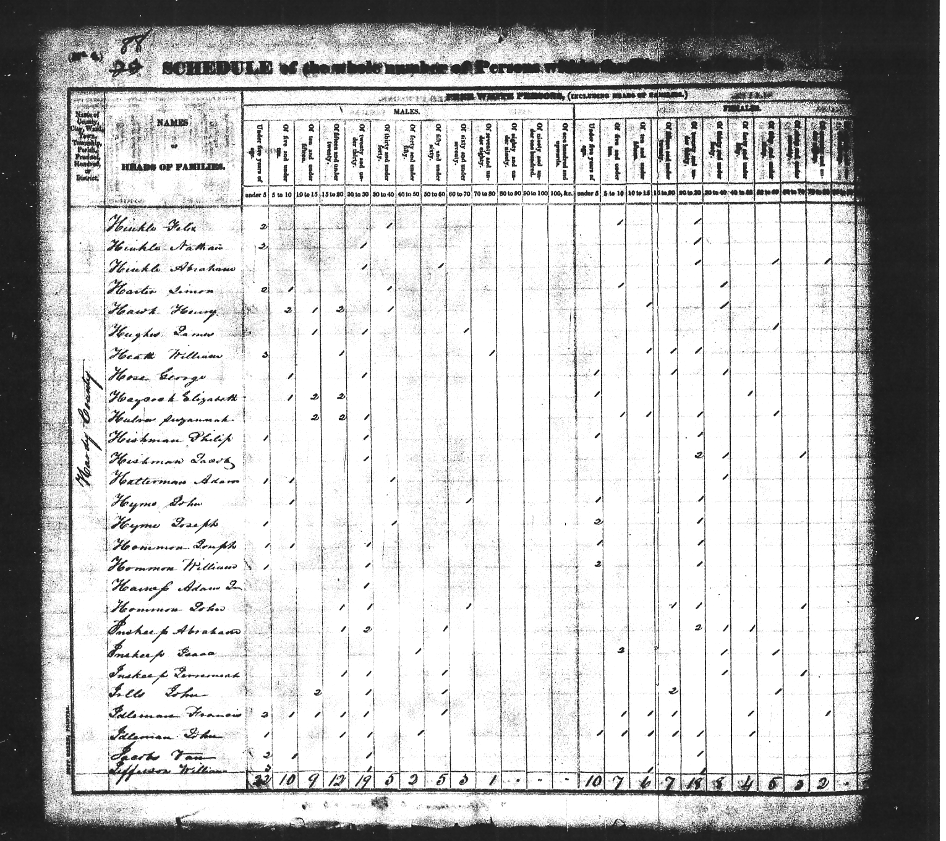
1830 Census – Simon Harter
Hardy, VA
Notes:
Elisabeth Hevner in the West Virginia, Marriages Index, 1785-1971
Name:Elisabeth HevnerGender:FemaleSpouse's Name:Simion HarterSpouse Gender:MaleMarriage Date:19 Sep 1820Marriage Place:Pendleton, West Virginia
Source Information
Ancestry.com. West Virginia, Marriages Index, 1785-1971 [database on-line]. Provo, UT, USA: Ancestry.com Operations, Inc., 2011.
Original data:
"West Virginia Marriages, 1853–1970." Index. FamilySearch, Salt Lake City, Utah, 2008, 2009. Digital images of originals housed in County Courthouses in various counties throughout West Virginia. Marriage records.
Description
This database contains an index extracted from West Virginia marriage records. Learn more...

Slide 35
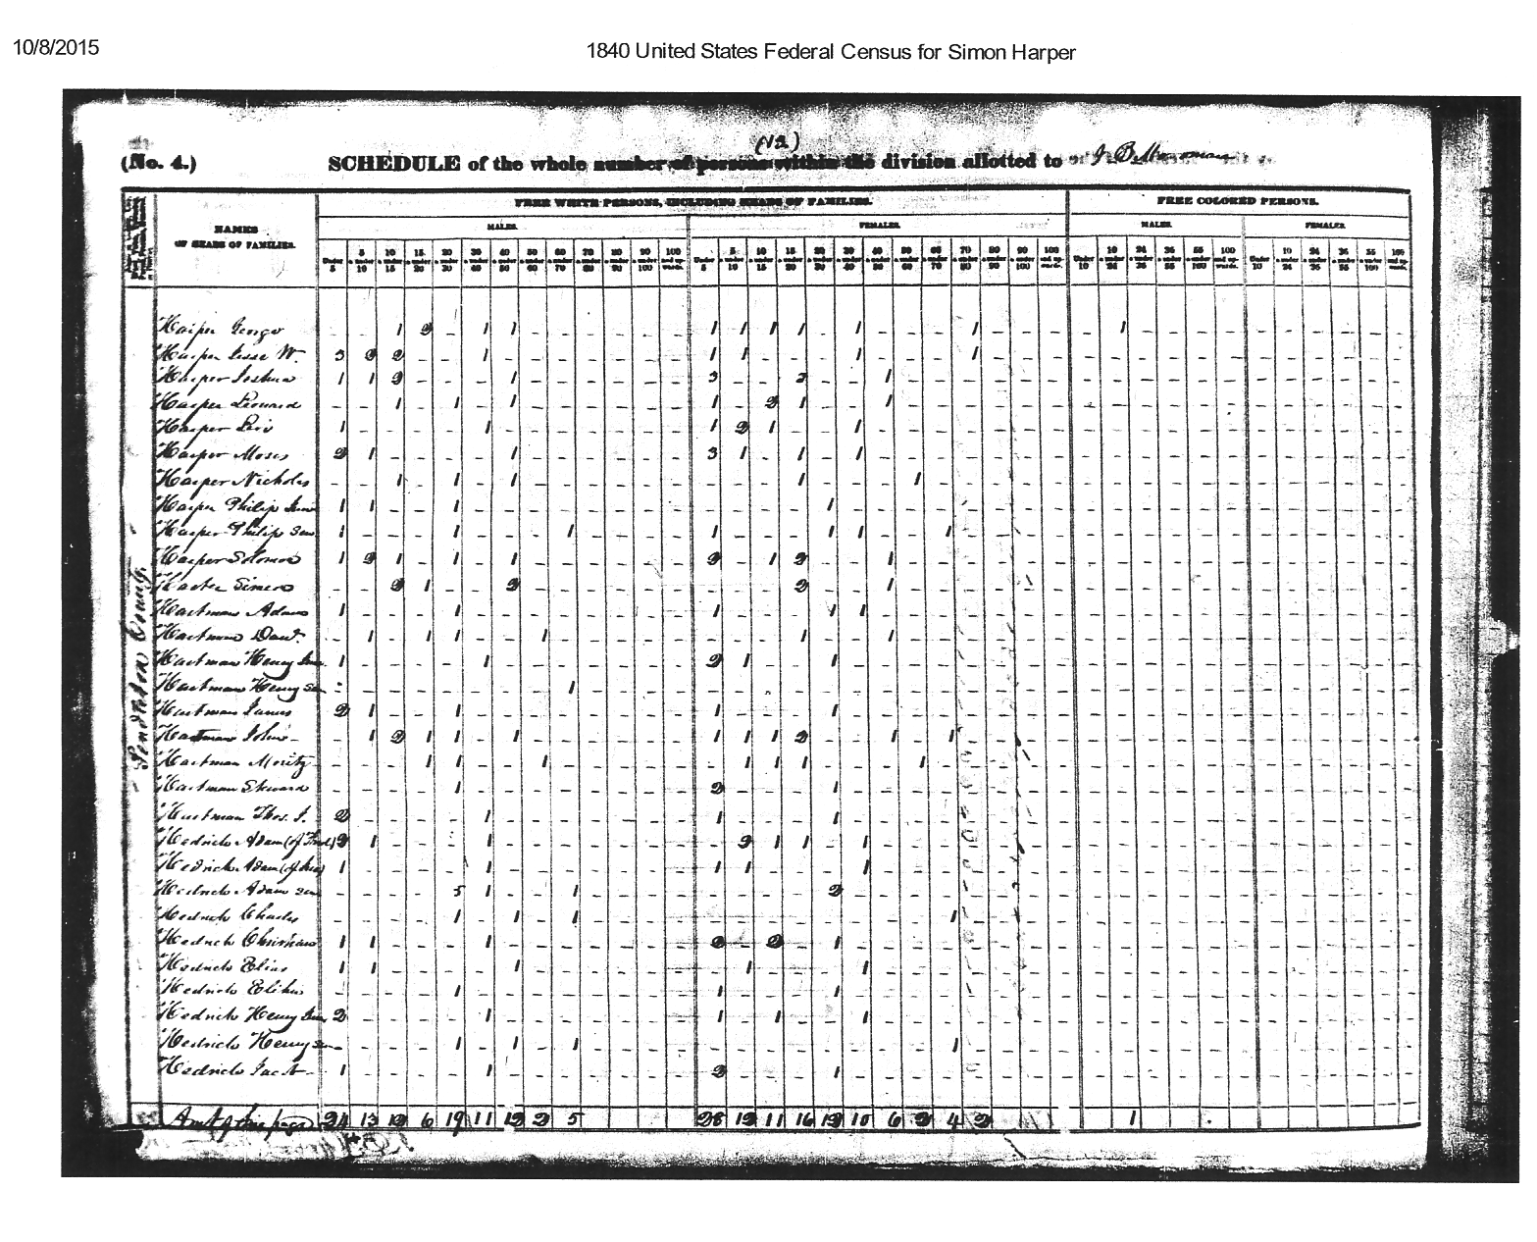
1840 Census
Pendleton VA

Slide 36

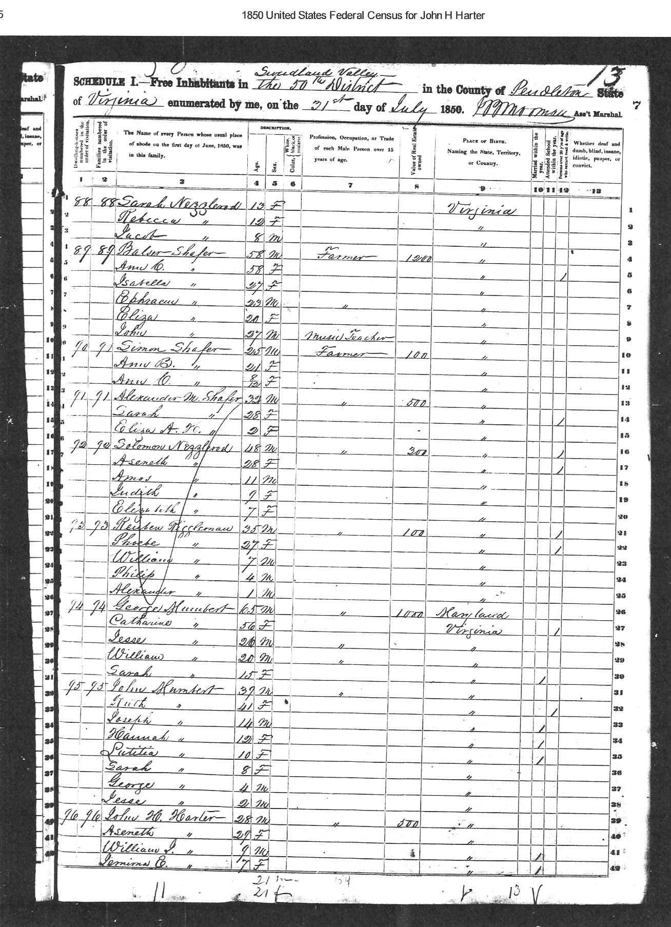
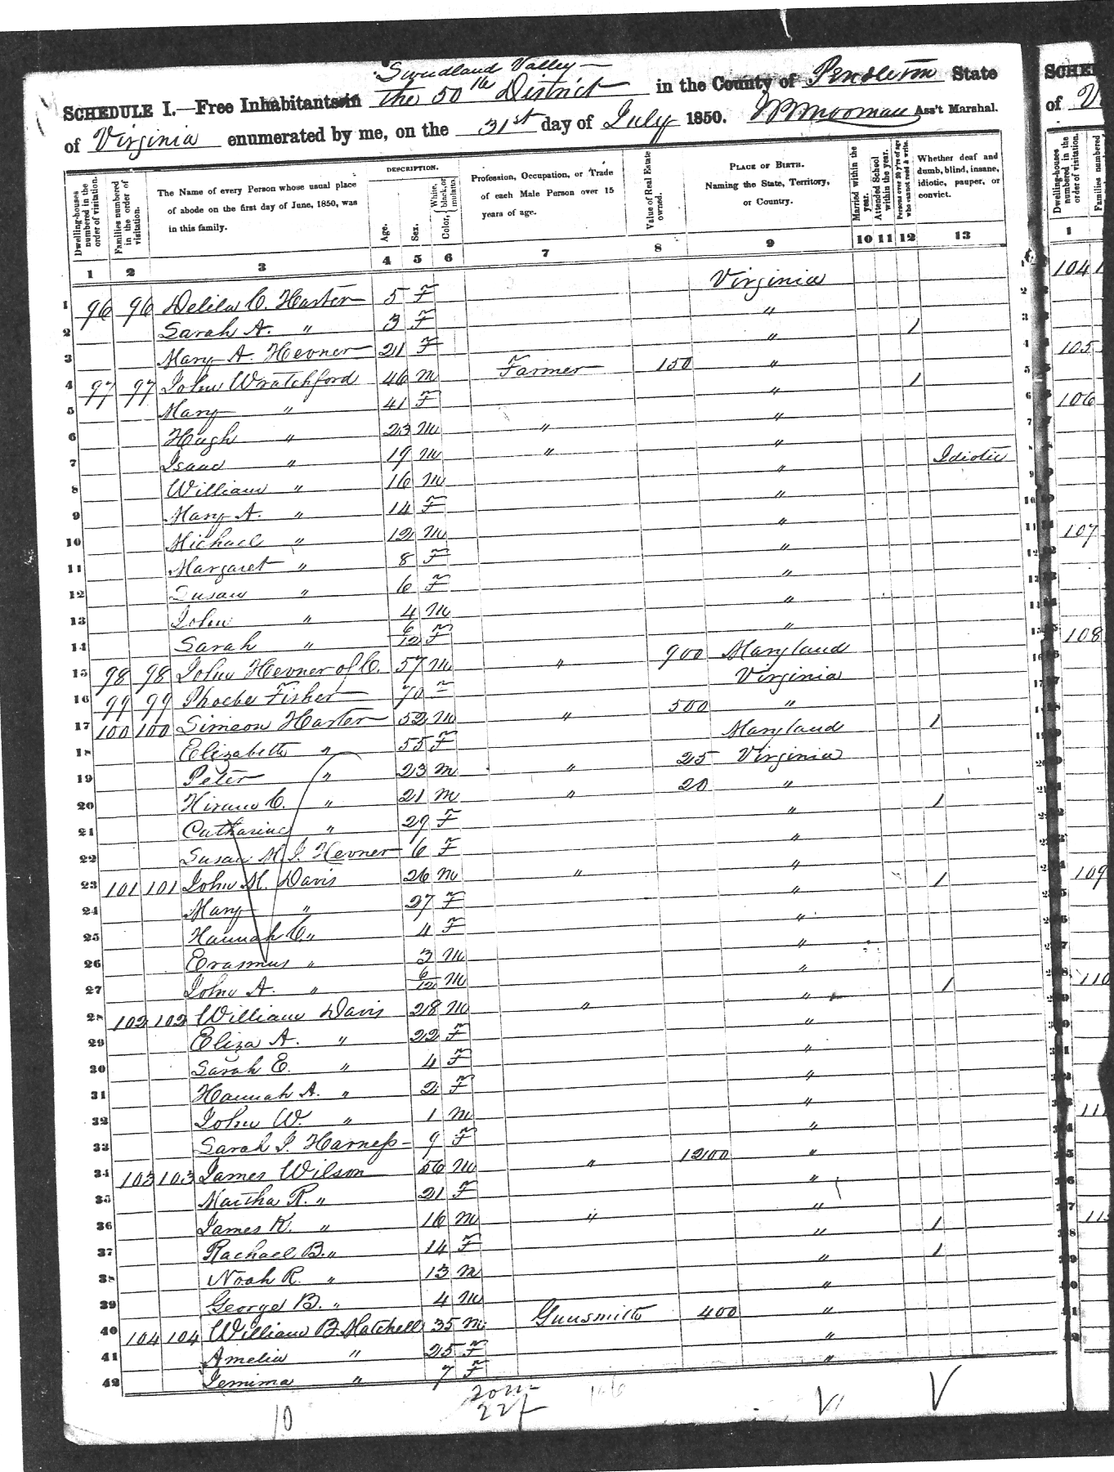
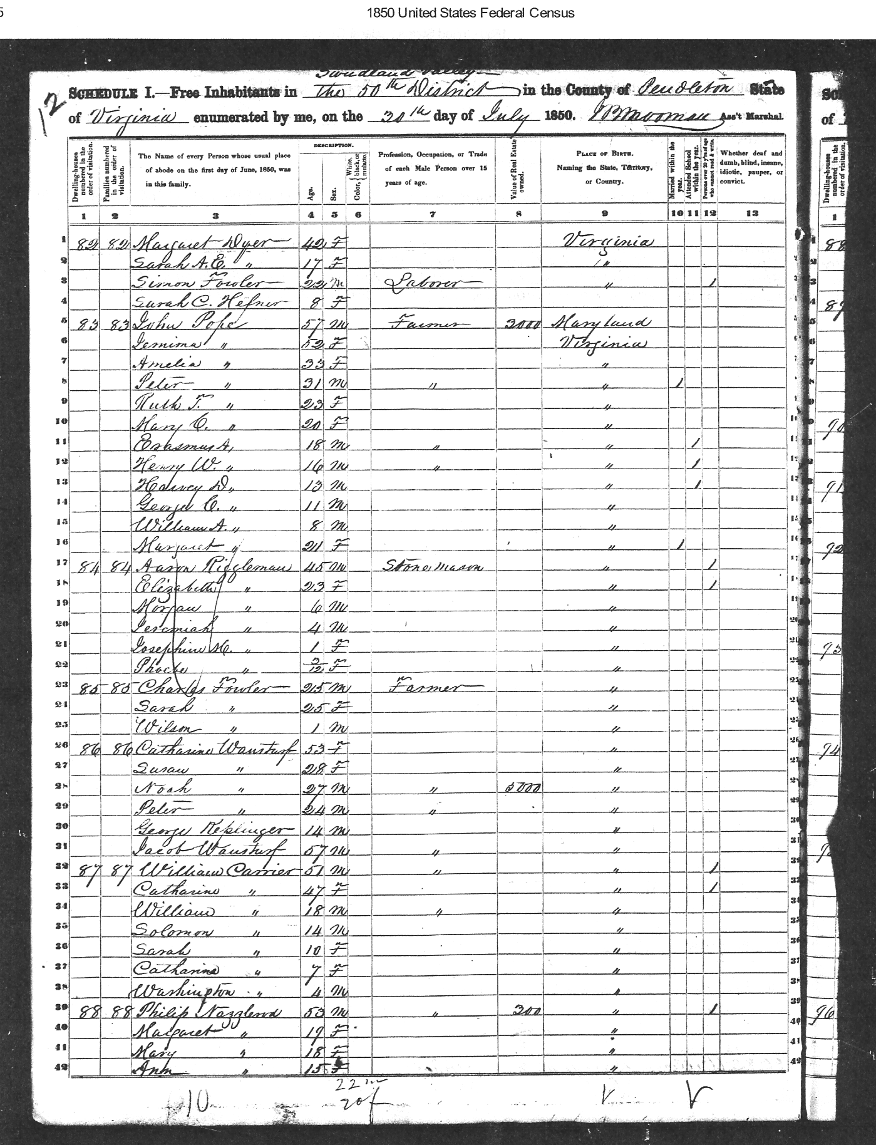
1850 Census
Sweedlin Valley, Pendleton VA
Simeon Harter lives nearby- probably father of John H Harter,
Hevener shows up in DNA matches
Notes:
There are two Aseneth’s on this page
Sweedlin is misspelled on the Census

Slide 37
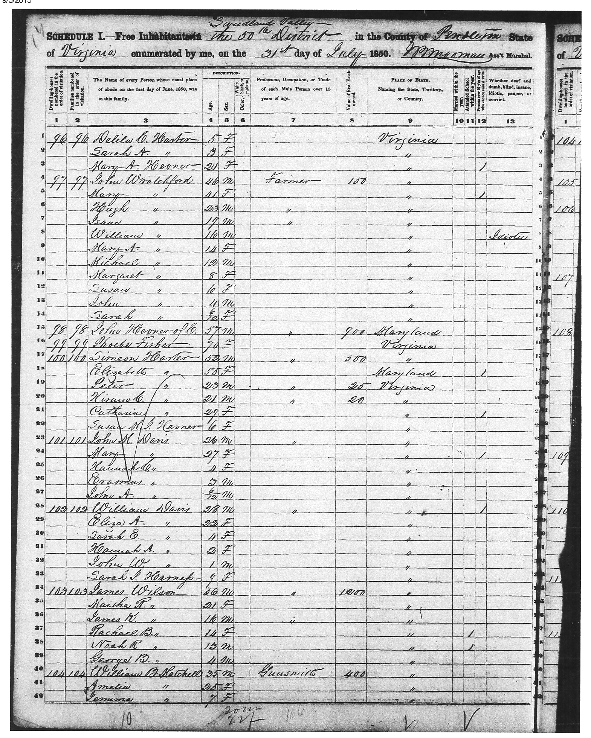
US Census 1850
Simeon &
Elizabeth Harter b. 1798 -& b. 1795
Notes:
Elisabeth Hevner in the West Virginia, Marriages Index, 1785-1971
Name:Elisabeth HevnerGender:FemaleSpouse's Name:Simion HarterSpouse Gender:MaleMarriage Date:19 Sep 1820Marriage Place:Pendleton, West Virginia
Source Information
Ancestry.com. West Virginia, Marriages Index, 1785-1971 [database on-line]. Provo, UT, USA: Ancestry.com Operations, Inc., 2011.
Original data:
"West Virginia Marriages, 1853–1970." Index. FamilySearch, Salt Lake City, Utah, 2008, 2009. Digital images of originals housed in County Courthouses in various counties throughout West Virginia. Marriage records.
Description
This database contains an index extracted from West Virginia marriage records. Learn more...

Slide 38
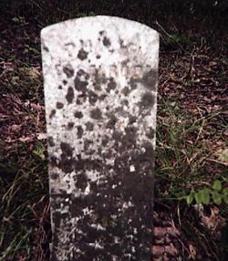
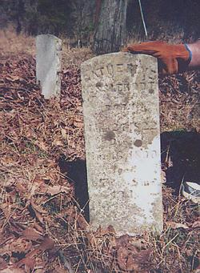
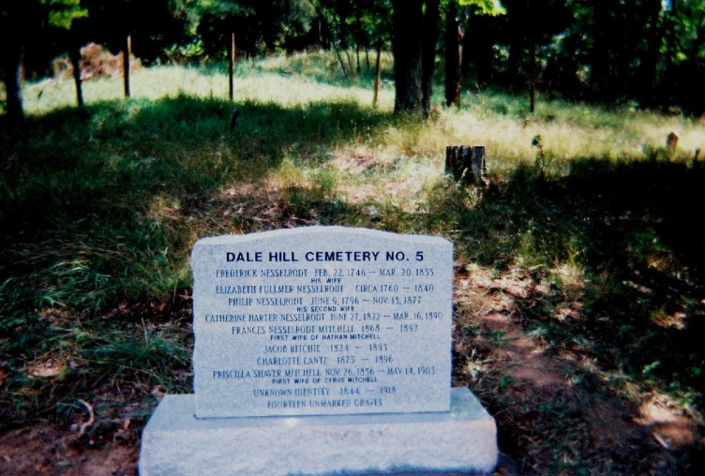
Philip & Catherine Harter Nesslerodt
Dale Hill Cemetery No. 5
Fort Seybert
Pendleton County
West Virginia, USA
http://www.findagrave.com/cgi-bin/fg.cgi?page=gr&GScid=2300469&GRid=35599093&
Notes:
Birth: Jun. 9, 1796
Pendleton County
West Virginia, USADeath: Nov. 13, 1877
Pendleton County
West Virginia, USA
In the name of God, Amen, I Philip Nesselrodt of the County of Pendleton, and the state of W Virginia, being weak in body but of perfect minbd and memory. and knowing that it is appointed for us all to die, do make and ordain this my last will and testament. In the first place, I give to my wife Catherine Nesselrodt all my property including land and all other property, with the exception of one gray colt which I give to my son Peter H Nesselrodt, to have and to hold the said and above named property forever. ------
This and no other to be my last will and testament.
May 22, 1877
Philip X Nesselrodt
( X his mark)
Witness:
Christian dasher
L M Pope
Daniel Smith
The will was probated
March 1878
Pendleton Co, W Virginia
Family links:
Spouse:
Anna Coffman Nesselrodt (1805 - 1845)
Children:
Phoebe Nesselrodt Riggleman (1820 - ____)*
*Calculated relationship
Burial:
Dale Hill Cemetery No. 5
Fort Seybert
Pendleton County
West Virginia, USA
Birth: Jun. 27, 1822Death: Mar. 16, 1890
Second Wife of Philip Nesselrodt
Description: Catherine Harter was born June 27, 1822 and died March 16, 1890 at Ft Seybert, Pendleton Co, W Va
Catherine married Philip Nesselrodt on June 06, 1854 in Franklin, Pendleton Co, W Va.
She is buried in Dale Hill Cemetery, Clip Road, Pendleton Co, W Va.
Burial:
Dale Hill Cemetery No. 5
Fort Seybert
Pendleton County
West Virginia, USA
Created by: Glenn Benson
Record added: Apr 06, 2009
Find A Grave Memorial# 35599228

Slide 39
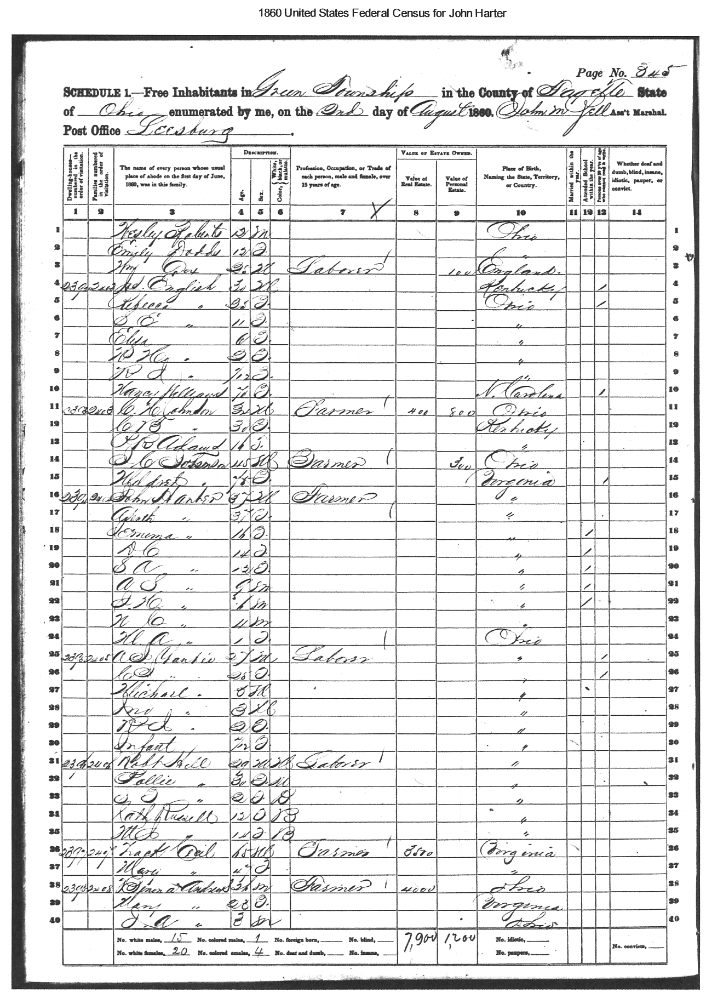
1860 Census John Harter
Green Twp, Lafayette, Ohio
Moved to Ohio ca. 1859
Notes:
Record Url: http://search.ancestry.com/cgi-bin/sse.dll?
indiv=1&db=1860usfedcenancestry&h=43282890
Source Citation: Year: 1860; Census Place: Green,
Fayette, Ohio; Roll: M653_959; Page: 485; Image: 352;
Family History Library Film: 803959
Source Information: Ancestry.com. 1860 United States
Federal Census [database on-line]. Provo, UT, USA:
Ancestry.com Operations, Inc., 2009. Images reproduced
by FamilySearch.
Original data: 1860 U.S. census, population schedule.
NARA microfilm publication M653, 1,438 rolls.
Washington, D.C.: National Archives and Records
Administration, n.d.

Slide 40
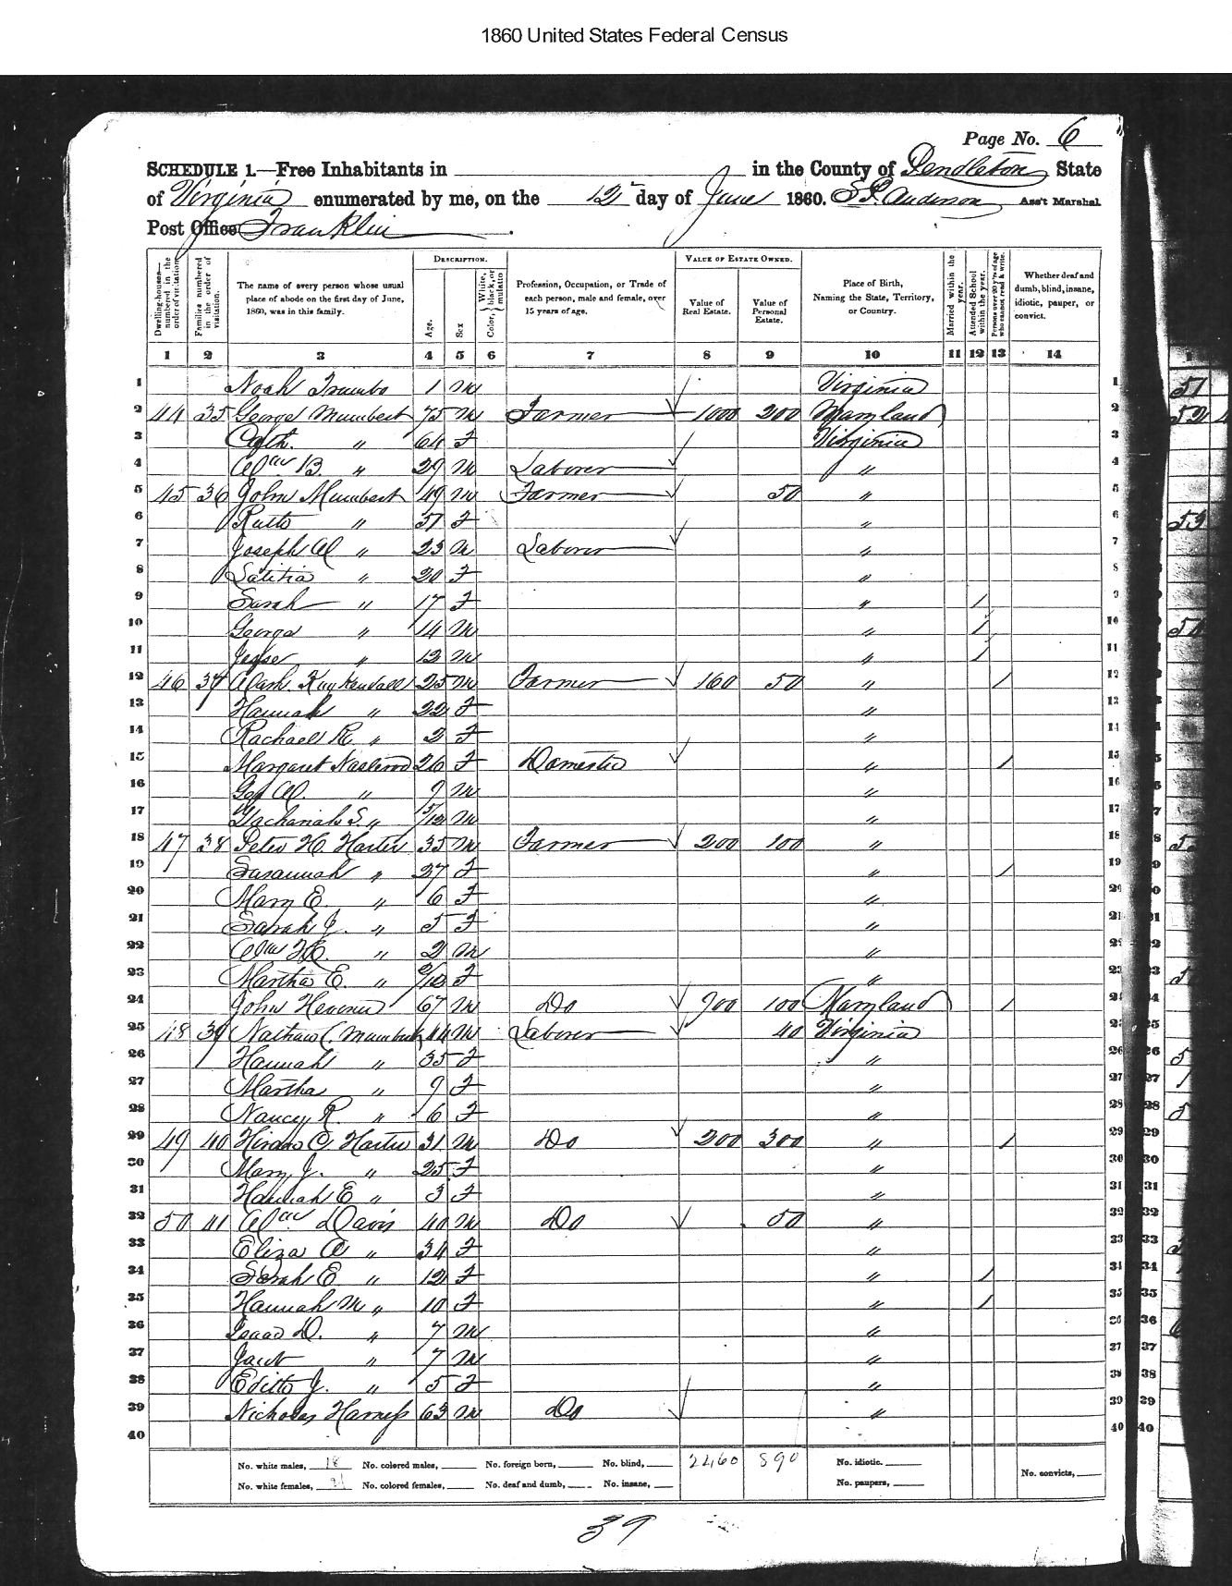
1860 Census Peter Harter
Green Twp, Lafayette, Ohio
Peter
Died at Gettysburg
July 3,1863
Susannah age 27
disappears after 1860
John Hevner, age 67
Brother of Elizabeth?
Hiram C Harter, age 31
Peter & John’s Brother
Wife - Mary age 25
Notes:
Original data: 1860 U.S. census, population schedule.
NARA microfilm publication M653, 1,438 rolls.
Washington, D.C.: National Archives and Records
Administration, n.d.

Slide 41
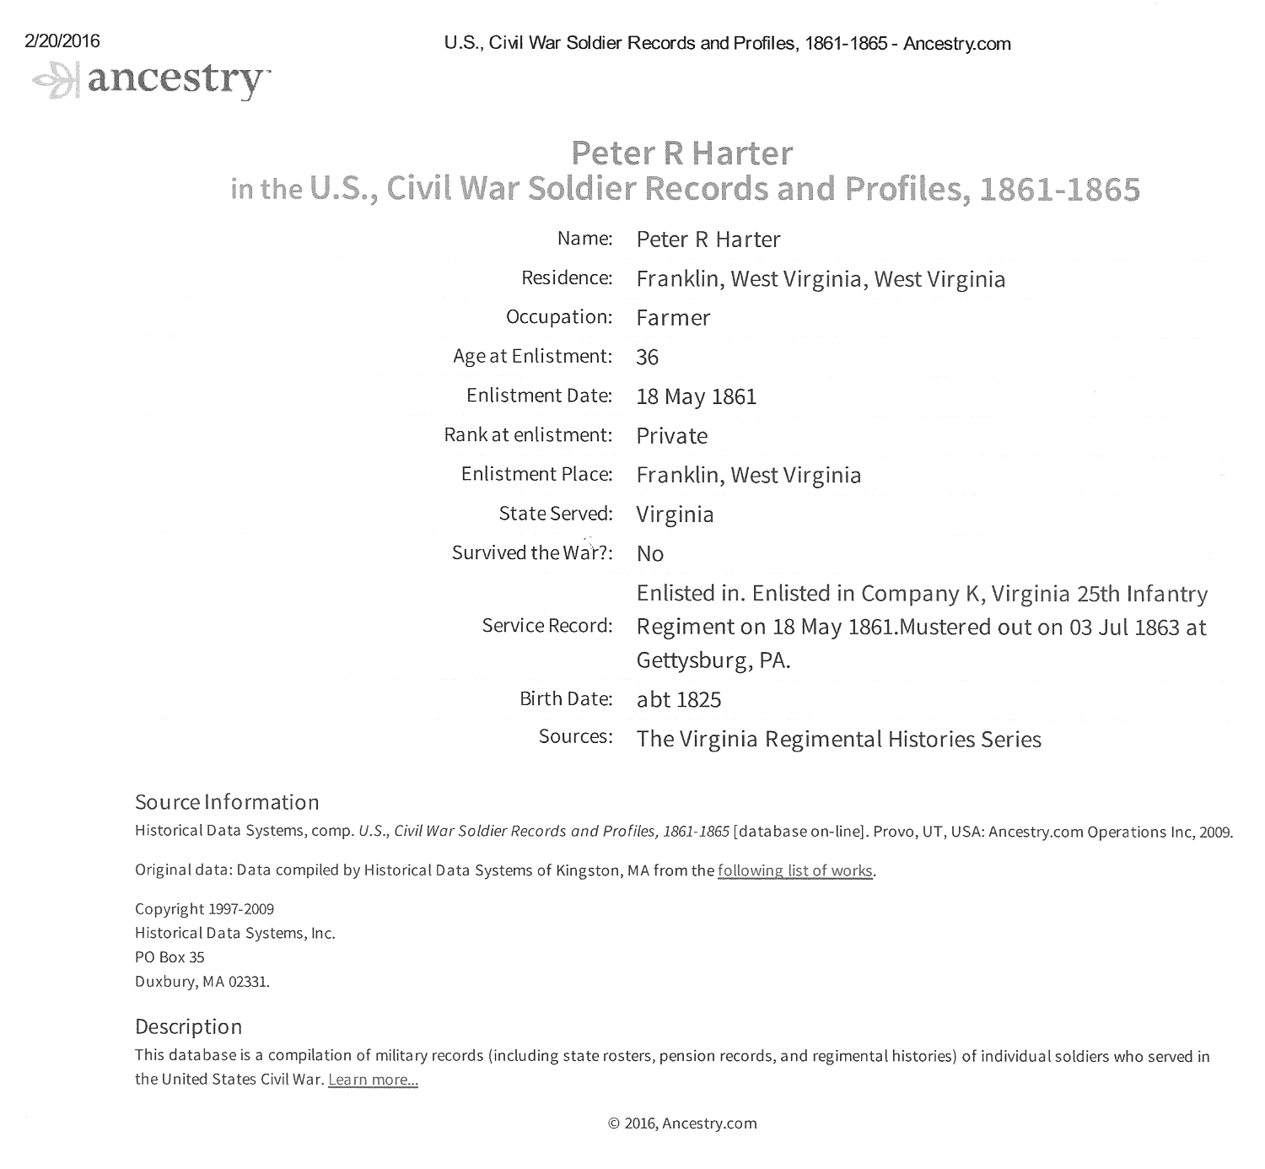
Peter Harter
Confederate Civil War Record
Notes:
Franklin, WV is the County Seat of Pendleton County

Slide 42
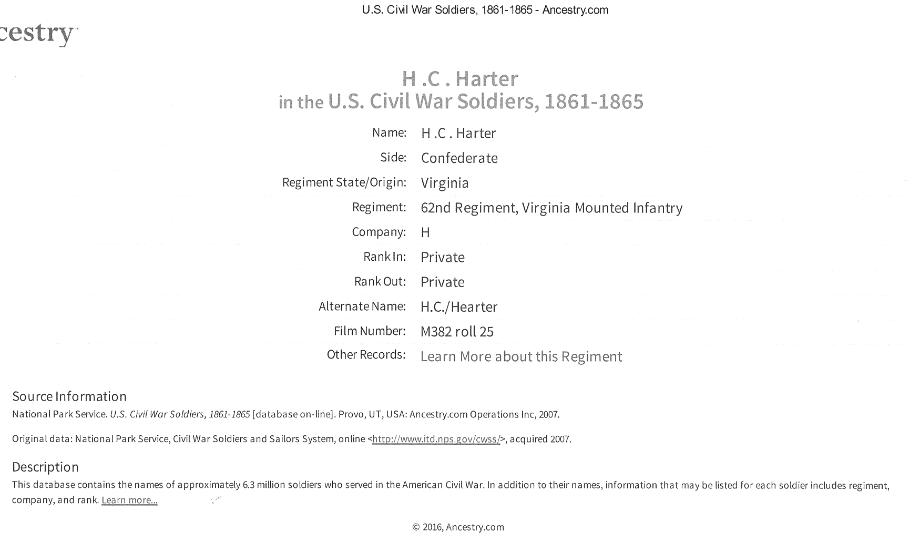
H.C. (Hiram) Harter
Confederate Civil War Record
Notes:
Franklin, WV is the County Seat of Pendleton County

Slide 43
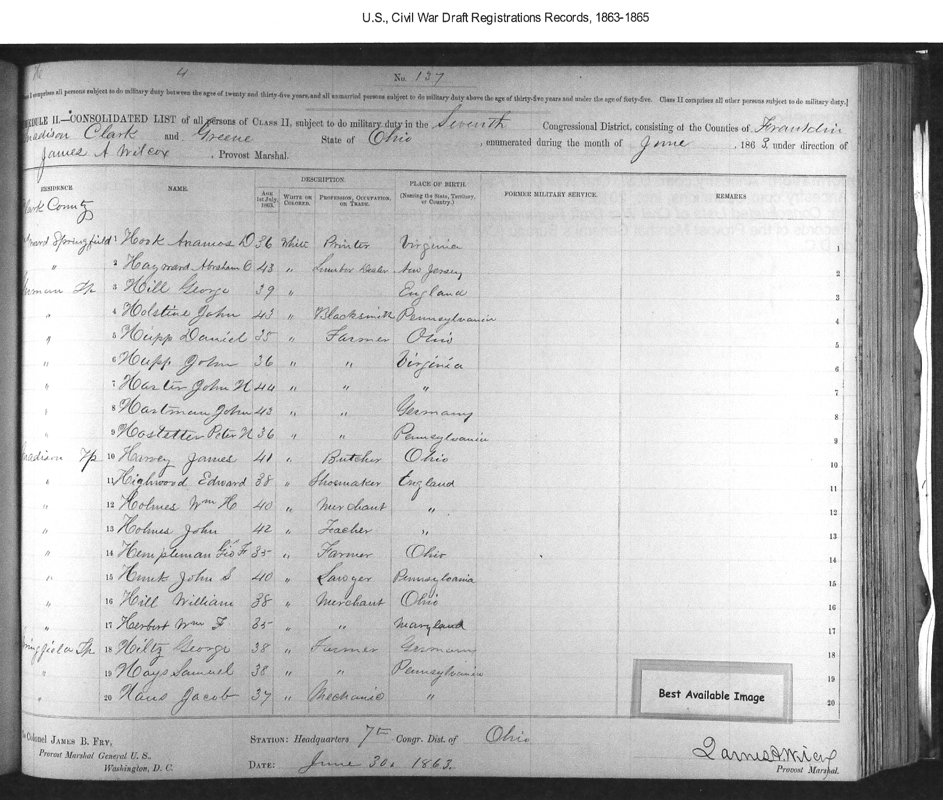
John H Harter
Draft Registration- June, 1863
John H Harter
Farmer
Born Virginia
Age 44
Notes:
I think he gave an incorrect age to minimize his risk of being drafted.

Slide 44
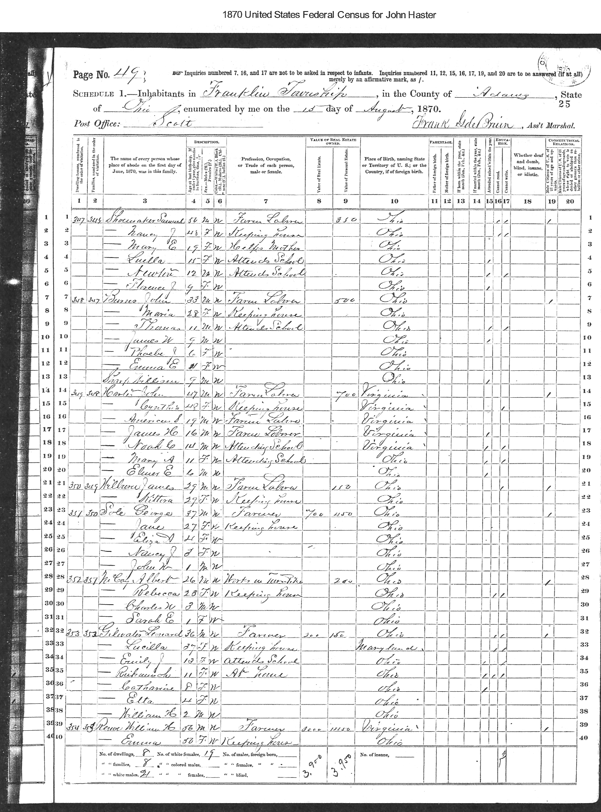
1870 Census John Harter
Franklin Twp, Adams, Ohio

Slide 45
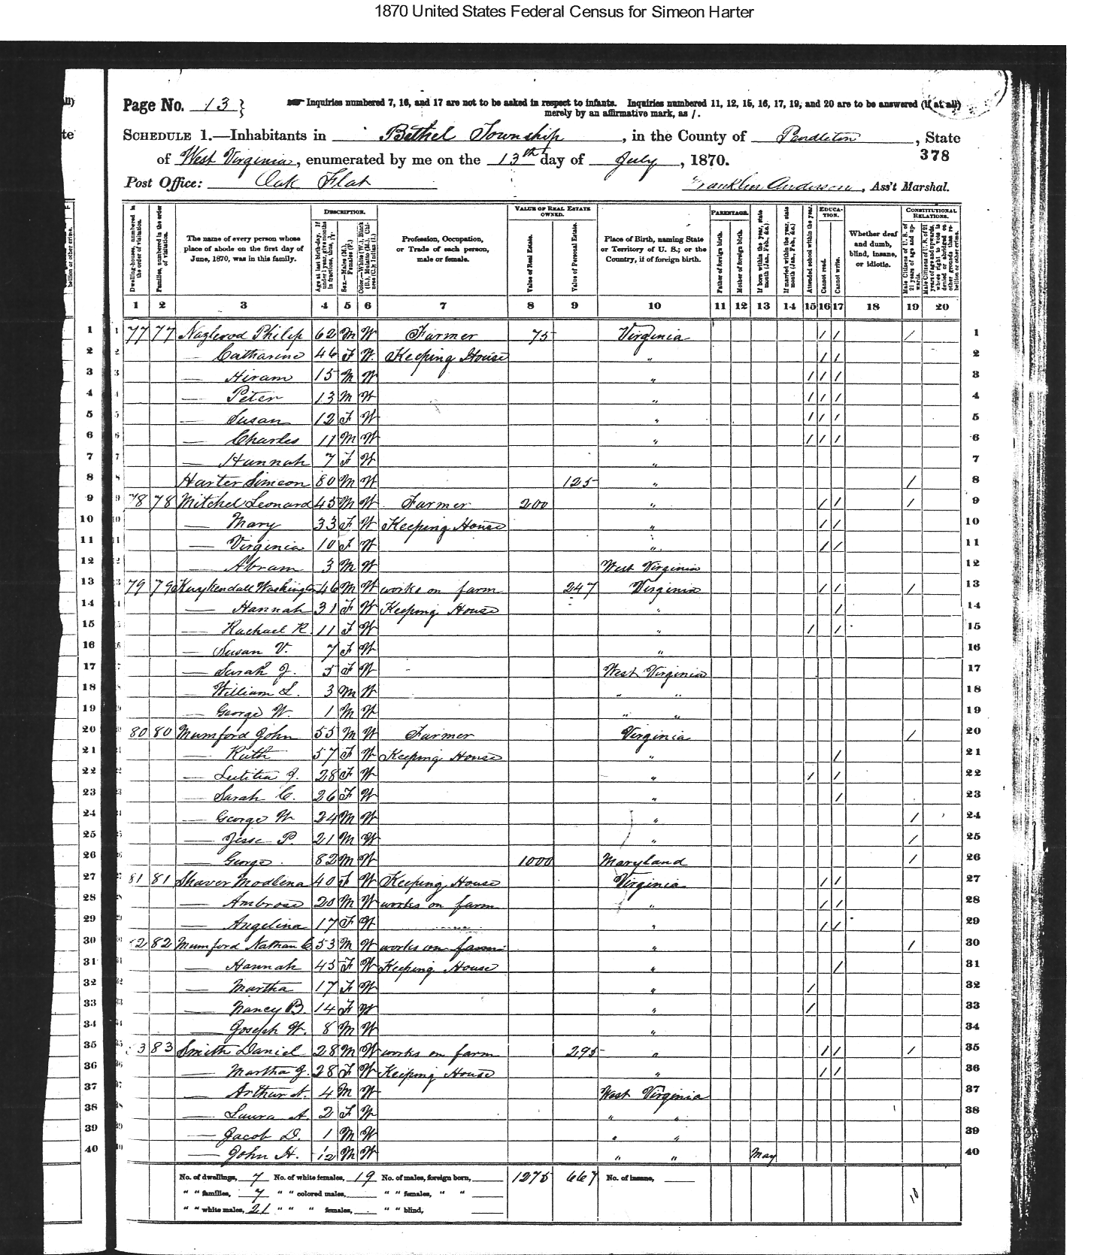
1870 US Census
Simeon Harter
Living with Philip & Catherine Nazlerod in West Virginia
Notes:
Living with Philip & Catherine Nazlerod, good evidence for Father
In the name of God, Amen, I Philip Nesselrodt of the County of Pendleton, and the state of W Virginia, being weak in body but of perfect minbd and memory. and knowing that it is appointed for us all to die, do make and ordain this my last will and testament. In the first place, I give to my wife Catherine Nesselrodt all my property including land and all other property, with the exception of one gray colt which I give to my son Peter H Nesselrodt, to have and to hold the said and above named property forever. ------

Slide 46
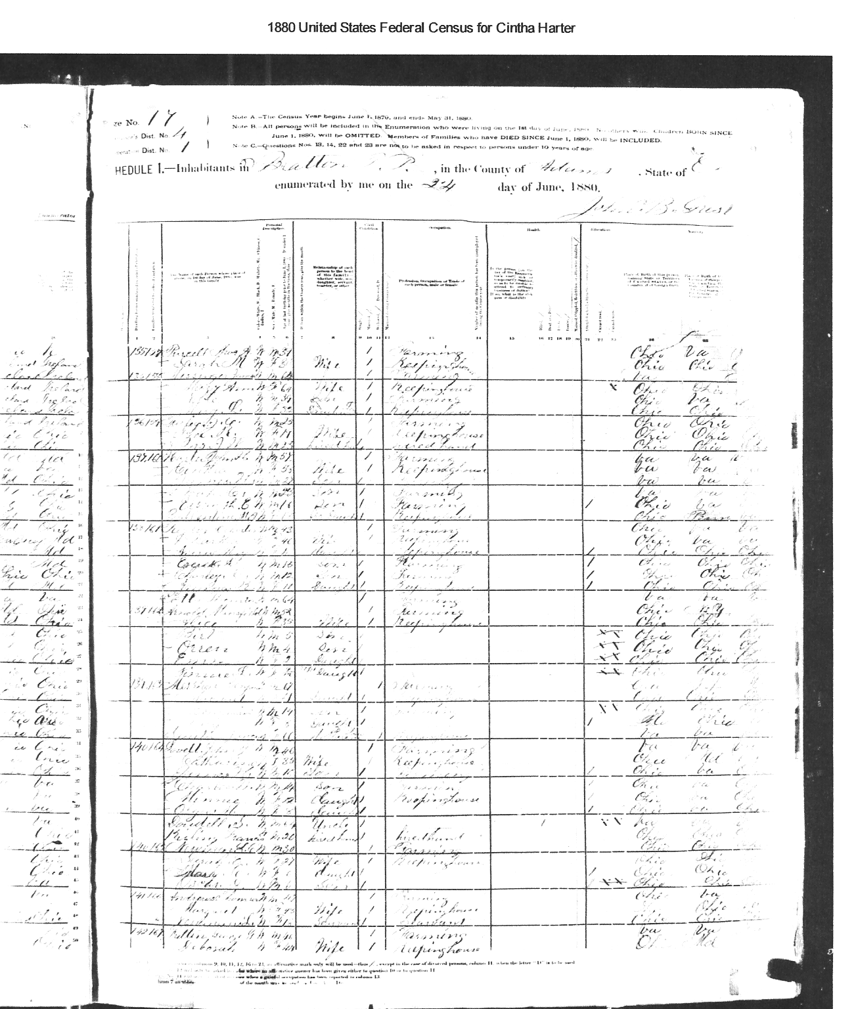
1880 Census John Harter
Bratton Twp, Adams, Ohio
Notes:
Record Url: http://search.ancestry.com/cgi-bin/sse.dll?
indiv=1&db=1880usfedcen&h=22842024
Source Citation: Year: 1880; Census Place: Bratton,
Adams, Ohio; Roll: 989; Family History Film: 1254989;
Page: 9A; Enumeration District: 001; Image: 0020
Source Information: Ancestry.com and The Church of
Jesus Christ of Latter-day Saints. 1880 United States
Federal Census [database on-line]. Provo, UT, USA:
Ancestry.com Operations Inc, 2010. 1880 U.S. Census
Index provided by The Church of Jesus Christ of Latter-day
Saints © Copyright 1999 Intellectual Reserve, Inc. All
rights reserved. All use is subject to the limited use license
and other terms and conditions applicable to this site.
Original data: Tenth Census of the United States, 1880.
(NARA microfilm publication T9, 1,454 rolls). Records of
the Bureau of the Census, Record Group 29. National
Archives, Washington, D.C.

Slide 47
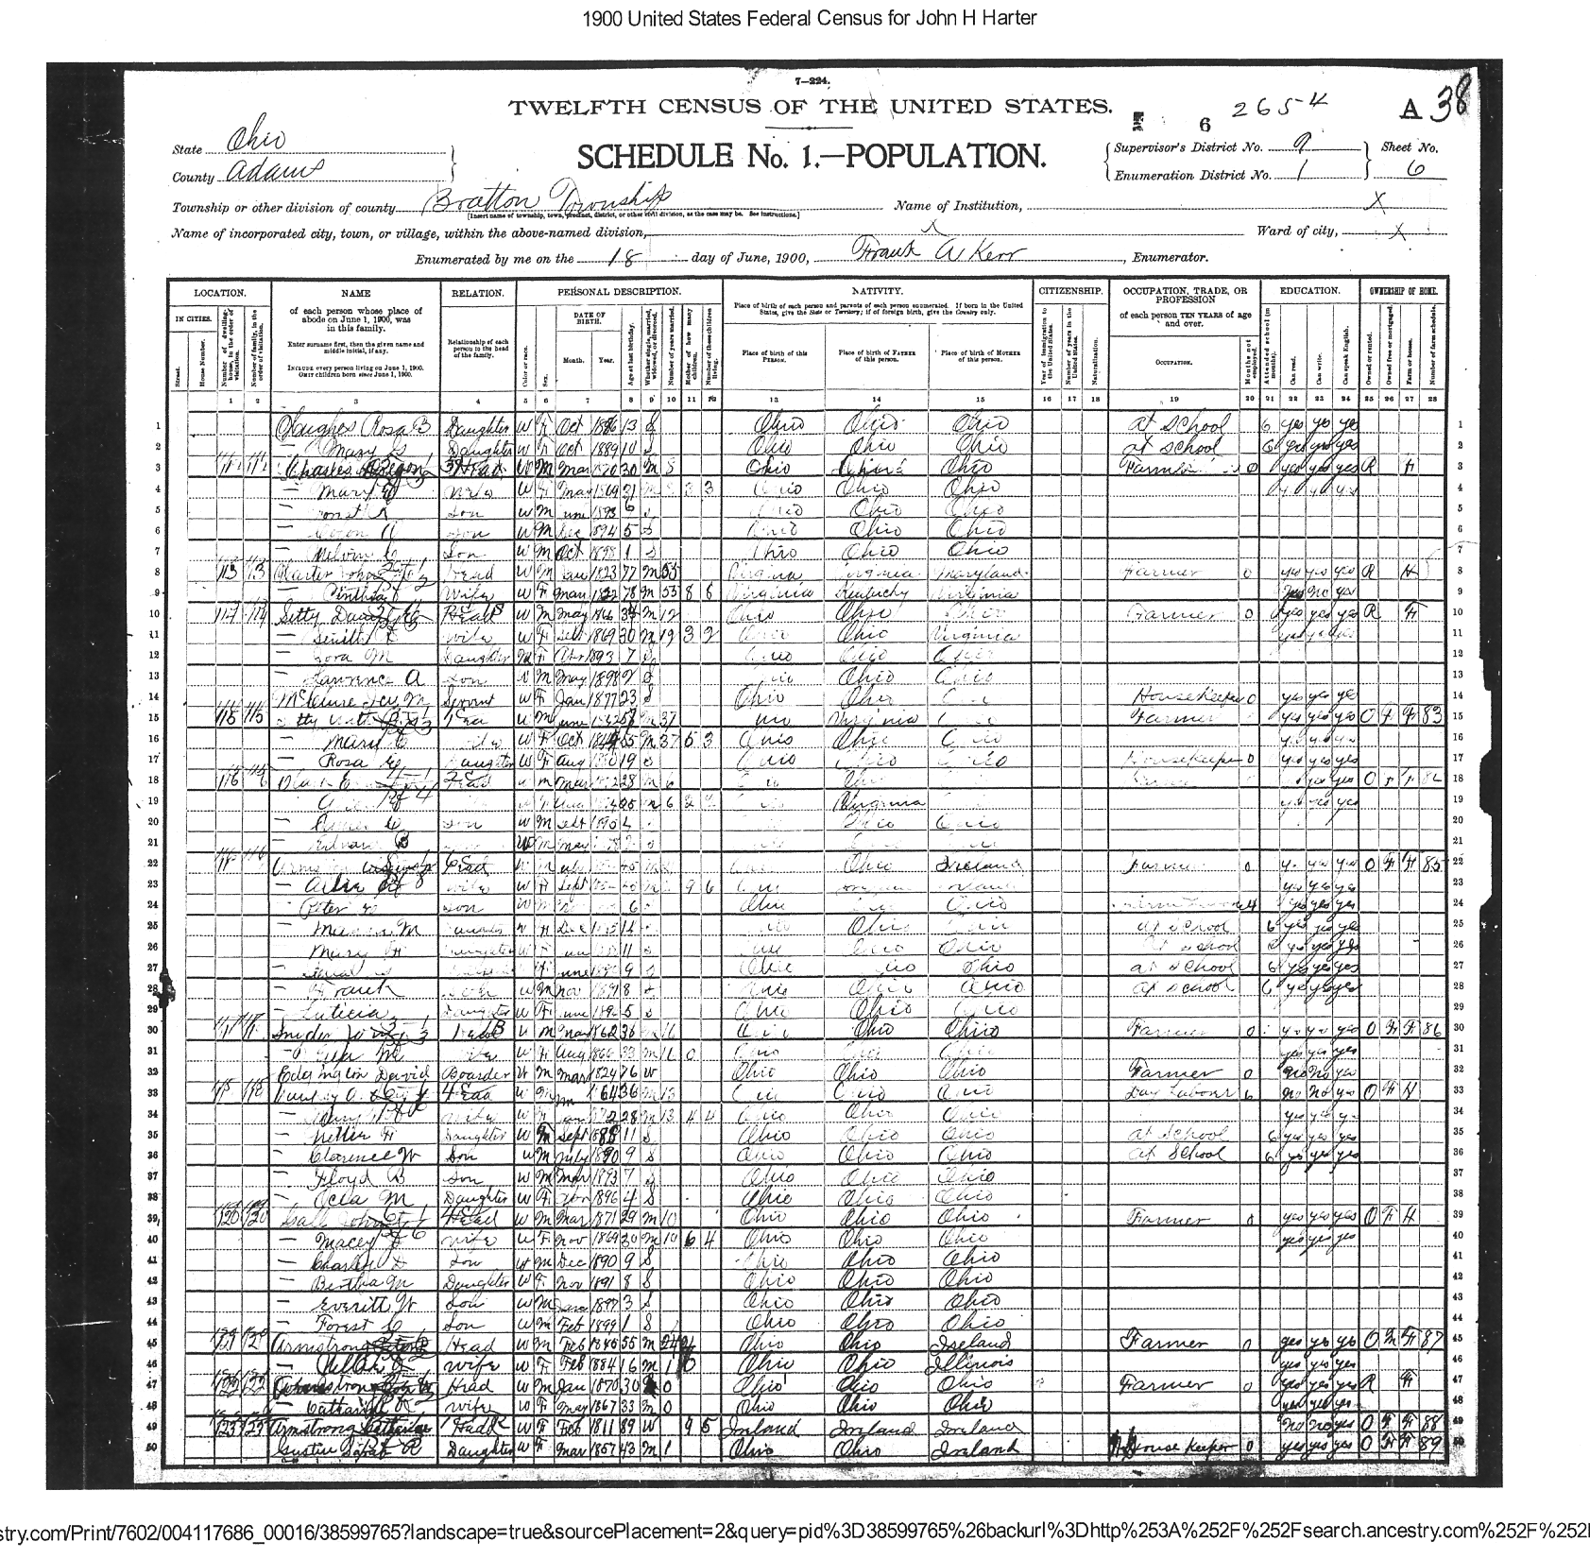
1900 Census
John Harter
Bratton Twp,
Adams, Ohio
Notes:
Record Url: http://search.ancestry.com/cgi-bin/sse.dll?
indiv=1&db=1880usfedcen&h=22842024
Source Citation: Year: 1880; Census Place: Bratton,
Adams, Ohio; Roll: 989; Family History Film: 1254989;
Page: 9A; Enumeration District: 001; Image: 0020
Source Information: Ancestry.com and The Church of
Jesus Christ of Latter-day Saints. 1880 United States
Federal Census [database on-line]. Provo, UT, USA:
Ancestry.com Operations Inc, 2010. 1880 U.S. Census
Index provided by The Church of Jesus Christ of Latter-day
Saints © Copyright 1999 Intellectual Reserve, Inc. All
rights reserved. All use is subject to the limited use license
and other terms and conditions applicable to this site.
Original data: Tenth Census of the United States, 1880.
(NARA microfilm publication T9, 1,454 rolls). Records of
the Bureau of the Census, Record Group 29. National
Archives, Washington, D.C.

Slide 48
Hottinger/Kutz Tree
Maxatawney, PA & Shenandoah Valley, VA
0. Nicholas Kutz b. 1690 – d. 1749 b. Switzerland & d. Maxatawney, Berks, PA
+ Anna Catharina Grimm b. 1695 – d. 1768 b. Berks PA d. Maxatawney, Berks, PA m.
1. Marie Catherine Kutz b. 1725 – d. 1827 b. Maxatawny d. Rockingham, VA? see Cootes Store, VA
+Johann Conrad Hottinger b. 1722- d. 1786 or 1804 b. 1729 arrived in Philadelphia, 1757- Maxatawney, Berks, PA
m. 1745
( I suspect that there is a generation missing here)
2. Magdeline Hottinger b. 1777 – d. 1853 b. &d. Pendleton WV
+ Michael Yankey b. 1773 – d. 1835 b. & d. Rockingham, VA
3. Asenith Yankie b. 1821-d.1902 b. Rockingham, VA,
+ John Harter b. 1822-d. 1905 b. VA
3. William Harter b. 1841- d. ? b. VA
3. Jemima Elizabeth Harter b. 1844- d. 1901 b. Hardy County WV; m. + Robert Ballentine b. 1803? – d. 1884 b.. Cumberland, PA m. 1863 Clark,OH
3. Delila C Harter b. 1845- d. ? b. VA
3. Sarah Ann Harter b. 1847- d. 1926 b. VA
+ Isaac Overholser b. 1845- d.1896 b. OH, d. strait Creek Cem.
3. Americas Simeon Harter b. 1851-1935 b. VA
+ Mary Jarnagin b. 1849-d.1918 b. Highland, OH
3. James H. Harter b. 1853- d. ? b. VA
3. Noah C. Harter b. 1857- d. ? b. VA
3. Elsworth E. Harter b. 1864- d. ? b. OH
2. Andrew b. 1775 b. Rockingham, VA,
2. Jacob b. 1775 b. Rockingham, VA,
2. Elizabeth b. 1776? b. Rockingham, VA,
+ Frederick Hottinger
Notes:
Parents of Marie Catherine Kutz
Nicholas Kutz
Birth 1690 in SwitzerlandDeath 1749 in Maxatawney, Berks, Pennsylvania,
Anna Catharina Grimm
Birth 1695 in Berks, Pennsylvania, USADeath 07 APR 1768 in Maxatawney, Berks, Pennsylvania,
Ancestry Family Tree: Mullen/Tomlin/Siegfried/Galvin
From Ballentine Family Tree
Michael Yankey
Birth 1775 in Pendleton, Virginia, United StatesDeath 1835 in Shenandoah Mtn, Pendleton, Virginia, United States
+ Magdaline Hottinger
Birth 1777 in Rockingham, Rockingham, Virginia, United StatesDeath 1853 in Rockingham, Rockingham, Virginia, United States
She is daughter of
Johnann Conrad Honinger
Birth 1750Death 19 Jun 1804 in Rockingham, Virginia, United States
+ Marie Catherine Kutz
Birth 1719 in Maxatawny, Berks, Pennsylvania, United StatesDeath 27 Feb 1827 in Maxatawney, Berks, Pennsylvania, United States
Honninger:
Johnann Conrad Honinger
Birth 1750Death 19 Jun 1804 in Rockingham, Virginia
From AlYankee1
Conrad Heninger
Birth 14 MAY 1722 in Hatten, Bas Rhin, GermanyDeath 15 AUG 1786 in Maxatawney, Berks, Pennsylvania,
Marie Catherine Kutz
Birth 1719 in Maxatawny, Berks, Pennsylvania, USADeath 27 FEB 1827 in Maxatawney, Berks, Pennsylvania, USA
Johann Conrad Henninger
Birth 20 Feb 1650 in Hunawihr, Haut Rhin, GermanyDeath 21 Jun 1712 in Hatten, Bas-Rhin, Alsace, France
Lewis Yankey writes Nicholas Kutz b. 1729 Stuttgart, Germany
Jacob Cootes
Birth 1762 in Berks, Pennsylvania, United StatesDeath aft 1835 in Cootes Store, Virginia
From Cootes Family Tree
Lemin Family Tree
Johannes Conrad HENNINGER
Birth 14 May 1722 in Hatten, Bas-Rhin, Germany Death 15 August 1786 in Washington County, Virginia, USA
Anna Marie Catharine KUTZ
Birth 1725 in Maxatawny, Berks, Pennsylvania, USADeath 27 Feb 1827 in Maxatawny, Berks, Pennsylvania, USA

Slide 49
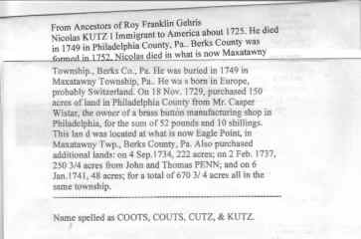
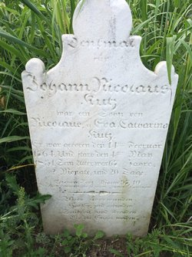
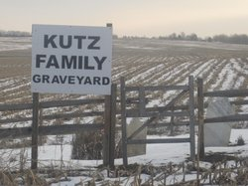
Nicholas Kutz (1690-1749)
Nicholas Kutz was born in Switzerland in 1690. He immigrated to America, in 1719, on the ship "Allemaengle". Records from Nov. 18, 1729 show that he purchased 150 acres in Philadelphia County (now Berks, Co.) from Mr. Casper Wistar for 52 pounds & 10 shillings. This land was located at what is now Eagle Point in Maxatawny Township. On Sept. 4, 1734 he purchased 222 acres, on Feb. 2, 1737, 250 3/4 acres from John & Thomas Penn. On Jan 6, 1741, he purchased 48 acres for a total of 670 3/4 acres in the same township. He also purchased a brass button making business in Berks Co. PA. He died in 1749, in what is now Maxatawny Township, Berks Co. Pennsylvania. His family was the first Kutz family on record in Pennsylvania.
Kutztown (Berks County), Berks County, Pennsylvania, USA
Notes:
http://www.findagrave.com/cgi-bin/fg.cgi?page=gr&GScid=2326533&GRid=79940995&
Kutz family records in Berks County Historical Society Library, Reading, Pa.

Slide 50
Zerkel/Yankee Tree p. 5
Shenandoah Valley Virginia
0. John Yankee b. 1750-d. 1783 b. Germany,
+ Catherine Zerkel b. 1743 – d. ? M. 1771, Rockingham, VA
1. Michael Yankee b. 1775 – d. 1835 b. &d. Pendleton WV
+ Magdeline Hottinger b. 1777 – d. 1853 b. & d. Rockingham, VA
2. Asenith Yankie b. 1821 - d.1902 b. Rockingham, VA,
+ John Harter b. 1822-d. 1905 b. VA
3. William Harter b. 1841- d. ? b. VA
3. Jemima Elizabeth Harter b. 1844- d. 1901 b. Hardy County WV; m. 1863 Clark,OH
3. Delila C Harter b. 1845- d. ? b. VA
3. Sarah Ann Harter b. 1848- d. 1901 b. VA
+ Isaac Overholser b. 1846- d.1896 b. OH
3. Americas Simeon Harter b. 1851-1934 b. VA
+ Mary Jarnagin b. 1849-d.1918 b. Highland, OH
3. James H. Harter b. 1853- d. ? b. VA
3. Noah C. Harter b. 1857- d. ? b. VA
3. Elsworth E. Harter b. 1864- d. ? b. OH
Notes:
Zerkel marries grandson
From Ballentine Family Tree
Michael Yankey
Birth 1775 in Pendleton, Virginia, United StatesDeath 1835 in Shenandoah Mtn, Pendleton, Virginia, United States
+ Magdaline Hottinger
Birth 1777 in Rockingham, Rockingham, Virginia, United StatesDeath 1853 in Rockingham, Rockingham, Virginia, United States
She is daughter of
Johnann Conrad Honinger
Birth 1750Death 19 Jun 1804 in Rockingham, Virginia, United States
+ Marie Catherine Kutz
Birth 1719 in Maxatawny, Berks, Pennsylvania, United StatesDeath 27 Feb 1827 in Maxatawney, Berks, Pennsylvania, United States
Michael Yankee son of John Yankee & Catherine Zerkel
Catherine Zerkel
Birth 1743 in Slabrock, Page, VirginiaDeath in Rockingham, Virginia
John Yankee
Birth 1750 in Marsburg, , , GermanyDeath 25 Dec 1783 in Shenandoah Mountain, Pendleton, West Virginia
Honninger:
Johnann Conrad Honinger
Birth 1750Death 19 Jun 1804 in Rockingham, Virginia
From AlYankee1
Conrad Heninger
Birth 14 MAY 1722 in Hatten, Bas Rhin, GermanyDeath 15 AUG 1786 in Maxatawney, Berks, Pennsylvania,
Marie Catherine Kutz
Birth 1719 in Maxatawny, Berks, Pennsylvania, USADeath 27 FEB 1827 in Maxatawney, Berks, Pennsylvania, USA
Johann Conrad Henninger
Birth 20 Feb 1650 in Hunawihr, Haut Rhin, GermanyDeath 21 Jun 1712 in Hatten, Bas-Rhin, Alsace, France
My Family Tree by Robin Blackmon Inman
Asenith marries Naselrod

Slide 51
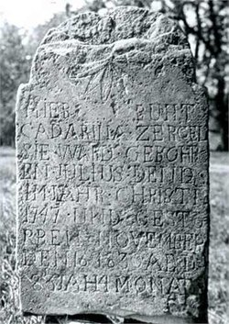
Catharine Zirkle
- not our Catherine Z
Birth: Jul. 12, 1747 Shenandoah County,Virginia,
Death: Nov. 16, 1830 Forestville Shenandoah County Virginia,
Catherine Sehler wife of Michael Zirkle
Family links:
Spouse: Michael Zirkle (1735 - 1811)
Children:
Catharine Zirkle Roush (1763 - 1845)*
Magdalena Zirkle Keplinger (1764 - 1860)*
John Zirkle (1766 - 1790)*
Elizabeth Zirkle Nease (1767 - 1859)*
Anna Mary Zerckel Nease (1770 - 1825)*
George Zerkel (1774 - 1848)*
Lewis Zerckel (1776 - 1856)*
Henry Zerkel (1778 - 1863)*
Abraham Zerkel (1780 - 1861)*
Jacob Zerkel (1782 - 1863)*
Jonathan Zirkle (1789 - 1855)*
*Calculated relationship
Burial:
Zirkle Cemetery
New Market
Shenandoah County
Virginia, USA
http://www.findagrave.com/cgi-bin/fg.cgi?page=gr&GSln=ZI&GSpartial=1&GSbyrel=all&GSst=48&GScntry=4&GSsr=1641&GRid=33373819
Notes:
http://image2.findagrave.com/photos250/photos/2015/65/33373819_1425737242.jpg
http://www.findagrave.com/cgi-bin/fg.cgi?page=gr&GSln=ZI&GSpartial=1&GSbyrel=all&GSst=48&GScntry=4&GSsr=1641&GRid=33373819&

Slide 52
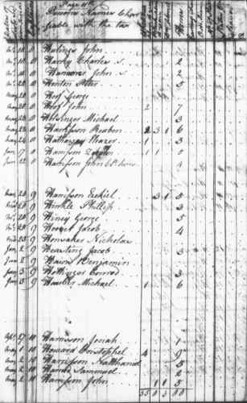
Conrad Hottinger’s Tax
1792
3 Horses
Johnann Conrad Honinger
b. 1741 in Rockingham, Virginia,
d. 19 Jun 1804 in Rockingham, Virginia
Notes:
Hottinger Family Tree
Johnann Conrad Honinger
Birth 1741 in Rockingham, Virginia, United StatesDeath 19 Jun 1804 in Rockingham, Virginia, USA

Slide 53
…Although documentation has not yet been secured, family research has identified an immigrant, Andrew Jaencke, arriving on the Moravian ship, Irene, on June 22, 1750. He was a member of the Henry Jorde Colony of Moravian followers, entering at the port of New York with the intended destination of Bethlehem, Pennsylvania. Andrew Jaencke may have been the immigrant that started the Yankey family in America but this is yet to be proven. In 1783, Michael Yankey and his brothers, Jacob and Andrew, were "bound out until age 14" by Shenandoah County Circuit Court to local German families, Nease, Bird and Zerkle living near the Shenandoah and Rockingham County line. Michael and Magdalene Hottinger Yankey are the great-great-great-grandparents of the author.

Slide 54
From Mike McClure - Wikitree
Biography
(From a letter to Fran Ganard from Gerald Wayne Yankie) October 2004. Some time ago we talked about the Andrew Jaencke that arrived in NY on the Moravian ship Irene, June 22, 1750. Many in our family suspect that this Andrew Jaencke is the beginning of the Yankey family in America but this has not been proven. There is no proven connection of Andrew Jaencke to the Michael Yankey (1st) from Rockingham Co. Virginia, more research in required. What we do know, Michael Yankey (1st), son of John Yankey, was born in Virginia c. 1775. Michael Yankey (1st) had two brothers, Jacob Yankey, about two years older, born c. 1773, and Andrew Yankey, the same age as Michael (twins??). It seems that John Yankey either died or for some other reason was unable to care for his young boys Michael, Andrew and Jacob. The records show that Michael and Andrew were both 8 years old, Jacob was 10 years old and on December 25, 1783, all three boys were "bound out" (assigned to foster families) per instructions of the Shenandoah County Circuit Court at the County Seat in Woodstock, Virginia, "until the age of 14". In 1791, Michael Yankey was "conformed" into the Pine Church (Lutheran Church) in Shenandoah County, Virginia. Michael Yankey married Magdalene Hottinger (Daughter of Conrad Hottinger and Mary Catherine Kutz Hottinger) on July 20, 1793 in Rockingham Co. Virginia. Children of Michael and Magdalene Hottinger Yankey (four sons and six daughters) Jacob Yankey------------Lived and raised family in Rockingham Co. VA Lydia Yankey-------------Lived and raised family in Rockingham Co. VA Michael Yankey, Jr.-----Started family in VA, moved to Franklin Township, Adams Co. Ohio William A. Yankey ------Moved to Yazoo Co., Mississippi, raised family. Catherine Yankey-------Lived in VA. Jonathan Yankey--------Moved to Adams Co. Ohio, Married Sarah Armstrong (1), Married Elizabeth Lawrence (2) Mary (Polly) Yankey----Lived in ÊVA. Phoebe Yankey----------Lived in VA. Malinda Yankey----------Lived in VA. Asenith Yankey----------Moved to Adams Co. Ohio married John Harter, both buried in Franklin Twnship, Adams Co. Ohio.
There are many Yankey/Yankie descendants from these ten children. Michael Yankey, Jr. lived a few miles from Jonathan Yankey in Adams Co. Ohio. However, I will focus on my specific line from Jonathan Yankey and Sarah Armstrong Yankey and will quote from the family bible records.
Jonathan Yankey (son of Michael and Malinda Yankey) was born April 24, 1806 in Rockingham Co. VA and died April 12, 1896 in Darlington MO, buried in Rouse Cemetery. Malinda may have been a familiar name for Magdalene Hottinger Yankey, not to be confused with Jonathan's younger sister, Malinda Yankey. Jonathan Yankey and Sarah Armstrong were married Thursday Feb. 23 1832 in Franklin Township, Adams Co. Ohio. Sarah Armstrong was born November 19, 1810 in Franklin Township, Adams Co. Ohio and died February 14, 1856 and is buried in the Armstrong Family Cemetery in what is now Bratton Township, Adams Co. Ohio. between Louden and Locust Grove, Ohio, off Horner Chapel Road, very near Serpents Mound. Michael Yankey ... ^{[1]}
Can you add any information on Michael Yankey? Please help grow his WikiTree profile. Everything you see here is a collaborative work-in-progress.
Sources
No sources. The events of Michael's life were either witnessed by Mike McClure or Mike plans to addsources here later.
Footnotes
↑ Entered by Mike McClure, Friday, November 22, 2013.
Notes:
(From a letter to Fran Ganard from Gerald Wayne Yankie)
October 2004.
Some time ago we talked about the Andrew Jaencke that arrived in NY on the Moravian ship Irene, June 22, 1750. Many in our family suspect that this Andrew Jaencke is the beginning of the Yankey family in America but this has not been proven. There is no proven connection of Andrew Jaencke to the Michael Yankey (1st) from Rockingham Co. Virginia, more research in required.
What we do know, Michael Yankey (1st), son of John Yankey, was born in Virginia c. 1775. Michael Yankey (1st) had two brothers, Jacob Yankey, about two years older, born c. 1773, and Andrew Yankey, the same age as Michael (twins??). It seems that John Yankey either died or for some other reason was unable to care for his young boys Michael, Andrew and Jacob. The records show that Michael and Andrew were both 8 years old, Jacob was 10 years old and on December 25, 1783, all three boys were "bound out" (assigned to foster families) per instructions of the Shenandoah County Circuit Court at the County Seat in Woodstock, Virginia, "until the age of 14".
In 1791, Michael Yankey was "conformed" into the Pine Church (Lutheran Church) in Shenandoah County, Virginia.
Michael Yankey married Magdalene Hottinger (Daughter of Conrad Hottinger and Mary Catherine Kutz Hottinger) on July 20, 1793 in Rockingham Co. Virginia.
Children of Michael Êand Magdalene Hottinger Yankey (four sons and six daughters)
Jacob Yankey------------Lived and raised family in Rockingham Co. VA
Lydia Yankey-------------Lived and raised family in Rockingham Co. VA
Michael Yankey, Jr.-----Started family in VA, moved to Franklin Township, Adams Co. Ohio
William A. Yankey ------Moved to Yazoo Co., Mississippi, raised family.
Catherine Yankey-------Lived in VA.
Jonathan Yankey--------Moved to Adams Co. Ohio, Married Sarah Armstrong (1), Married Elizabeth Lawrence (2)
Mary (Polly) Yankey----Lived in ÊVA.
Phoebe Yankey----------Lived in VA.
Malinda Yankey----------Lived in VA.
Asenith Yankey----------Moved to Adams Co. Ohio married John Harter, both buried in Franklin Twnship, Adams Co. Ohio.
There are many Yankey/Yankie descendants from these ten children. Michael Yankey, Jr. lived a few miles from Jonathan Yankey in Adams Co. Ohio. However, I will focus on my specific line from Jonathan Yankey and Sarah Armstrong Yankey and will quote from the family bible records.
Jonathan Yankey (son of Michael and Malinda Yankey) was born April 24, 1806 in Rockingham Co. VA and died April 12, 1896 in Darlington MO, buried in Rouse Cemetery. Malinda may have been a familiar name for Magdalene Hottinger Yankey, not to be confused with Jonathan's younger sister, Malinda Yankey. Jonathan Yankey and Sarah Armstrong were married Thursday Feb. 23 1832 in Franklin Township, Adams Co. Ohio. Sarah Armstrong was born November 19, 1810 in Franklin Township, Adams Co. Ohio and died February 14, 1856 and is buried in the Armstrong Family Cemetery in what is now Bratton Township, Adams Co. Ohio. between Louden and Locust Grove, Ohio, off Horner Chapel Road, very near Serpents Mound.
Children of Jonathan and Sarah Yankey: ( all children born in Franklin Township, Adams Co. Ohio, now Bratton Township)
1. William J. Yankey born January 6, 1834, died June 6, 1855, buried in the Armstrong Family Cemetery.
2. John M. Yankey born September 29, 1836, died May 12 or 13, 1962, member of the 63rd OVI, Company E at St. Louis, MO. Buried in the Jefferson Barracks National Cemetery, St. Louis, MO.
3. Mahala Jane Yankey born October 4, 1838, dated of death, place of death and burial location unknown.
4. Milton N. Yankey born June 14, 1841, died December 25, 1861, member of the 70th OVI, Union Army, buried in the ArmstrongÊ Family Cemetery.
5. Joseph Trimble Yankey born July 24, 1844, died June 12, 1926, buried in Pleasant Hill Cemetery, Sinking Springs, Highland Co. Ohio. Joseph Trimble Yankey was a member of the 141st Regiment, Company K, OVI, Union Army.
6. Sarah Angeline Yankie born May 26, 1848, died 1911 in Cincinnati, Ohio at age 63, ruptured gall bladder and peritonitis, burial place in ÊAdams Co. Ohio unknown.
7. James Minor Yankey born April 21, 1852, died Feb. 13, 1928 in Los Angeles, CA., cemetery unknown.
After the death of Sarah Armstrong Yankey, Jonathan Yankey married a second time. Jonathan Yankie and Elizabeth Lawrence were married Nov. 7, 1856. Jonathan's bible records two births to this marriage.
1. Margaret Z. Yankie born August 22, 1862, died October 5, 1862.
2. Nelson F. (Ferdinand?) Yankie born Feb. 29, 1864, died "Tues. 2:25am, March 10, 1931 in Carthage, MO."
Elizabeth Lawrence Yankie died July 22, 1898 in Darlington, MO. and buried next to her husband, Jonathan Yankie, in Rouse Cemetery, Darlington, MO.
The bible of Jonathan shows that he fathered nine children, seven with Sarah Armstrong Yankey and two with Elizabeth Lawrence Yankie.
William J. Yankey died at age 21, John M. Yankey died at age 26, Milton N. Yankey died at age 21, Margaret Z. Yankie died an infant, no off-spring from these four children are recorded or known. Five of the children married and have known families.
November, 2000. Your posting regarding Frederick Nesselrodt is very interesting to me. I am a member of this list and have enjoyed learning so much from John and the others. The reason that I find your posting so interesting is that I live in the log house where Frederick Nesselrodt II. lived with his wife Lydia. He and Lydia are buried on the farm. Just thought that would be an interesting note for you and perhaps even the others. Keith A. May, descendant of John George May, Bergton, Virginia==== AMREV-HESSIANS Mailing List ==== We don't have many rules or regulations on this mail list, but please check them out in the archives. In case of questions write to your host hessian@cgocable.net
Virginia, Rockingham County, Bergton.
Keith Allen May lives there in an old log house which was owned by Lydia Yankey and Frederick Nesslerodt II, they are buried on the property. Frederick Nesslerodt is a documented Hessian soldier. Below is some of my research about Hessians in the Yankey family.
Re: Nesselrodt / Captain Trumboe
I had the good fortune to meet Lewis Yankey several years ago, before his wife Mary died. The Yankey/Yankie family are lucky to have such a dedicated person interested in preserving family history and stories. I do know Pat Ritchie by email only and hope to continue dialog with her and others in your area. I want to visit Rockingham Co. again soon. I just received book on the life and family of Lorenzo Frederick Smith through eBay, from Lois May Rhodes. Now I would like to get Lewis' books too. We know that the original Yankey's spoke mainly German but unable to tie a connection to any specific region in Germany. That link seems to be missing. Along with the family stories about Hessians in the family, it makes some sense that the first Yankey in America could have been a Hessian deserter or prisoner. My line, which I can send more detail, comes from Michael Yankey and Magdaline Hottinger, their son, Jonathan Yankey b.1806, moved to Adams County Ohio and married Sarah Armstrong. Jonathan is my great-great grandfather. The spelling of the name was changed from Yankey to Yankie around 1856 in the family bible. I still can't get over the fact that you live in the house owned by Frederick Nesselrodt and Lydia Yankey. Did you say that they are buried on your property? Lydia Yankey is the sister of my Jonathan Yankey.
Lewis Yankey. Lewis just died about 2 months ago, but he had done extensive research on the Yankey Family in the Bergton, Virginia area. In fact, I believe that several local publications were done on the localYankey family, and numerous Yankeys still live in the Bergton Community. Pat Ritchie would have a lot of the information on this family since she often assisted Lewis with his projects. Ê ÊPat is a wealth of knowledge regarding the northwestern part of Rockingham County, a area with several known Hessians. (I will carbon this message to Pat, and she may be able to shed additional insight) Pat is an extremely busy person so it may take her a while to get back. I have heard that the original Yankey in the Bergton area was a Hessian but I am not sure if it was ever documented. One of Lewis's grandchildren told me that but I am not sure of the validity? Just as I am not sure if my ancestor was, George May, although it is often told that he was a Hessian.-Keith A. May, Bergton, Virginia
Home of Frederick Nesselrodt II and Lydia Yankey in Bergton, VA. The Yankey/Yankie Family researchers have tried for some time to uncover the Hessian connection in the Yankey line. The Frederick Nesselrodt mentioned by Linda C. Magee must have been the father of Frederick Nesselrodt II, husband of Lydia Yankey. Are you aware of other Hessians related to the Yankey family? Regards, Gerald W. Yankie, November, 2000

Slide 55
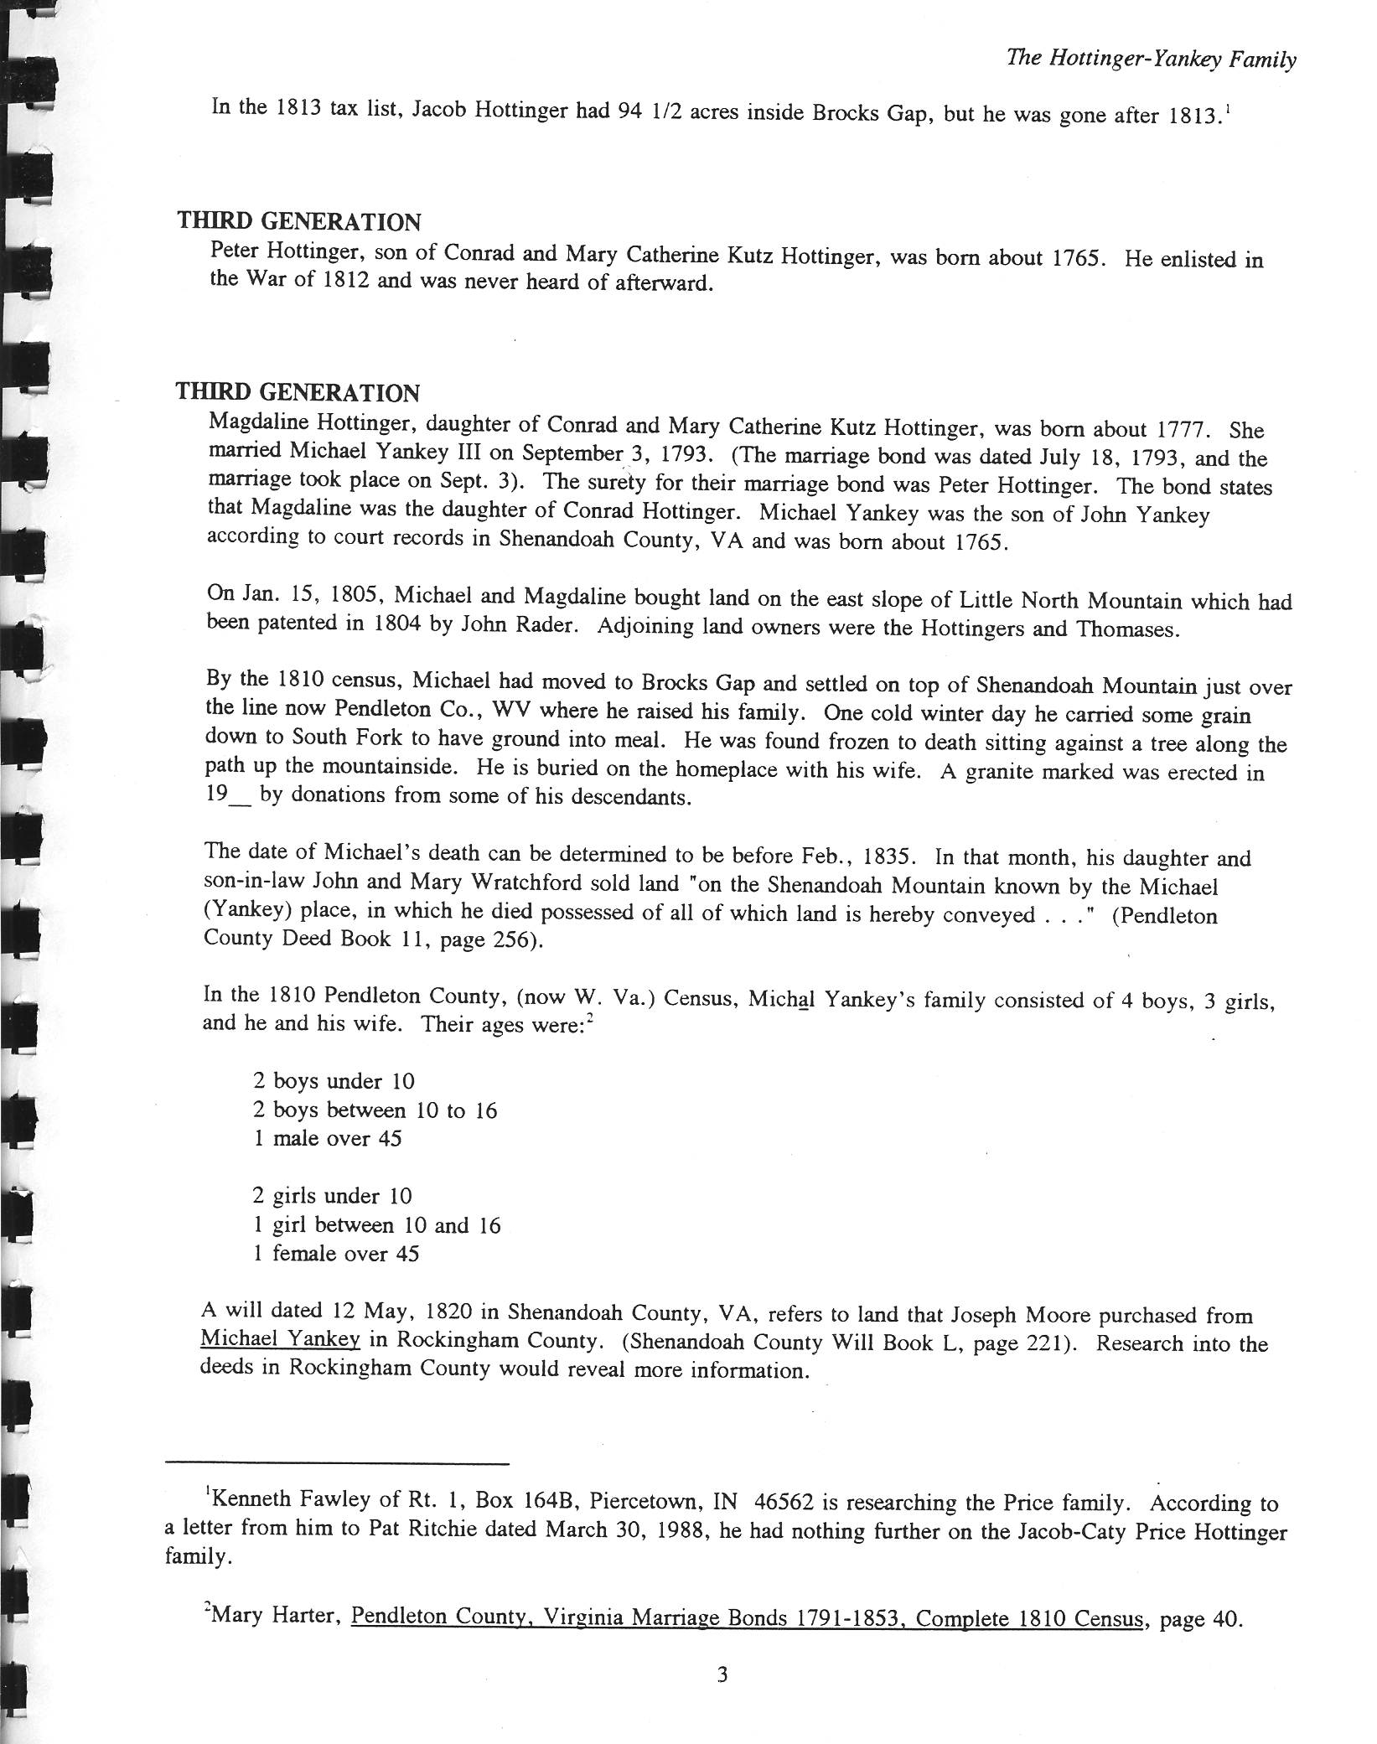
The Hottinger-Yankey Family p. 3

Slide 56

1790 US Census-
Michael Henninger
Bern, Berks County, PA

